Slide 1
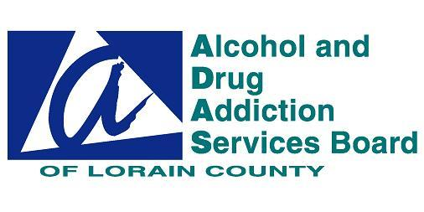
Data, Opioids &
Ohio’s Prescription
Drug Epidemic
Presented by
Elaine Georgas, Executive Director
Alcohol and Drug Addiction Services Board of Lorain County

Slide 2
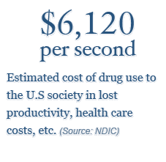

Slide 3
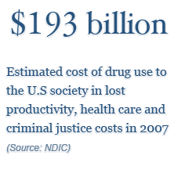

Slide 5
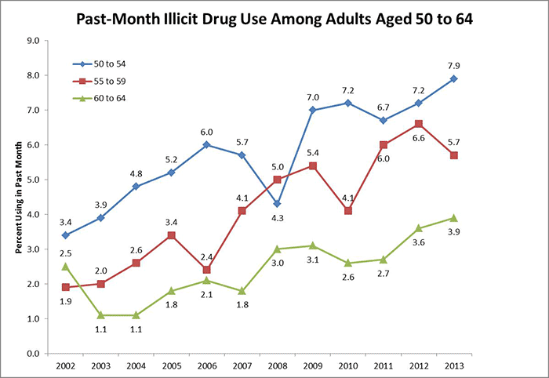
Drug use is increasing among people in their fifties and early sixties. This increase is, in part, due to the aging of the baby boomers, whose rates of illicit drug use have historically been higher than those of previous generations.

Slide 6
Key Findings: Data from the National Vital Statistic system (Mortality)
From 2000 to 2013, the age-adjusted rate for drug-poisoning deaths involving heroin nearly quadrupled from 0.7 deaths per 100,000 in 2000 to 2.7 deaths per 100,000 in 2013. Most of the increase occurred after 2010.
The number of drug-poisoning deaths involving heroin was nearly four times higher for men (6,525 deaths) than women (1,732 deaths) in 2013.
In 2000, non-Hispanic black persons aged 45-64 had the highest rate for drug-poisoning deaths involving heroin (2.0 per 100,000). In 2013, non-Hispanic white persons aged 18-44 had the highest rate (7.0 per 100,000).
From 2000 through 2013, the age-adjusted rate for drug-poisoning deaths involving heroin increased for all regions of the country, with the greatest increase seen in the Midwest.

Slide 7
Opioid and Heroin Death Trends

Slide 10
According to results from the 2013 National Survey on Drug Use and Health (NSDUH), almost 5 million Americans aged 12 or older used opioids during the past month – 4.5 million used opioid pain relievers non-medically and 300,000 used heroin.
In addition, opioid pain relievers were cited as the primary substance of abuse in 9.8% (176,907) of treatment admissions and heroin was cited in 16.3% (292,934).

Slide 11
Opioid Pain Relievers An estimated 1.5 million Americans aged 12 and older used opioid pain relievers non-medically for the first time in 2013, making it the second most initiated illicit drug behind marijuana.
The average age of first use for opioid pain relievers was 21.7 years in 2013 (Americans aged 12-49).3 The vast majority of Americans who misuse opioid pain relievers receive them from a friend or relative for free (53%) or from one doctor (21%).
Roughly 1.9 million Americans met criteria for dependence or abuse for opioid pain relievers in 2013, a slight decline from 2012. Admissions to treatment for opioid pain relievers increased by 500% from 2000-2012.

Slide 14
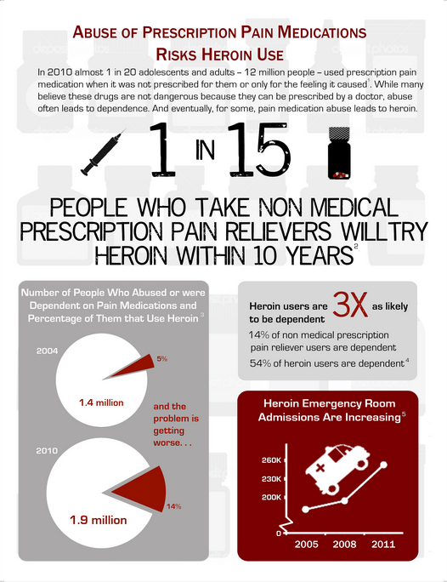

Slide 16
What is Prescription Drug Abuse?
  Prescription drug abuse is when someone takes a medication in an inappropriate way, such as:
    Without a prescription
    In a way other than as prescribed
  For the “high” elicited
  It includes taking a friend's or relative's prescription to treat pain or because you think it will help with studying.

Slide 17
What are the most common misperceptions about Prescription Drugs?
There's a reason why prescription drugs are intended to be taken under a doctor's direction: If used improperly, they can be dangerous. Despite what many teens and adults think, abusing prescription drugs is not safer than abusing illicit drugs. As the facts will tell you, prescription drugs can have dangerous short- and long-term health consequences when used incorrectly or by someone other than for whom they were intended.

Slide 18
According to state data, Ohio has seen 897 deaths in 2013 attributed to heroin overdoses including 31 in Lorain County.
(reported by Attorney General Mike DeWine, April 21, 2014 Community Drug forum)

Slide 19
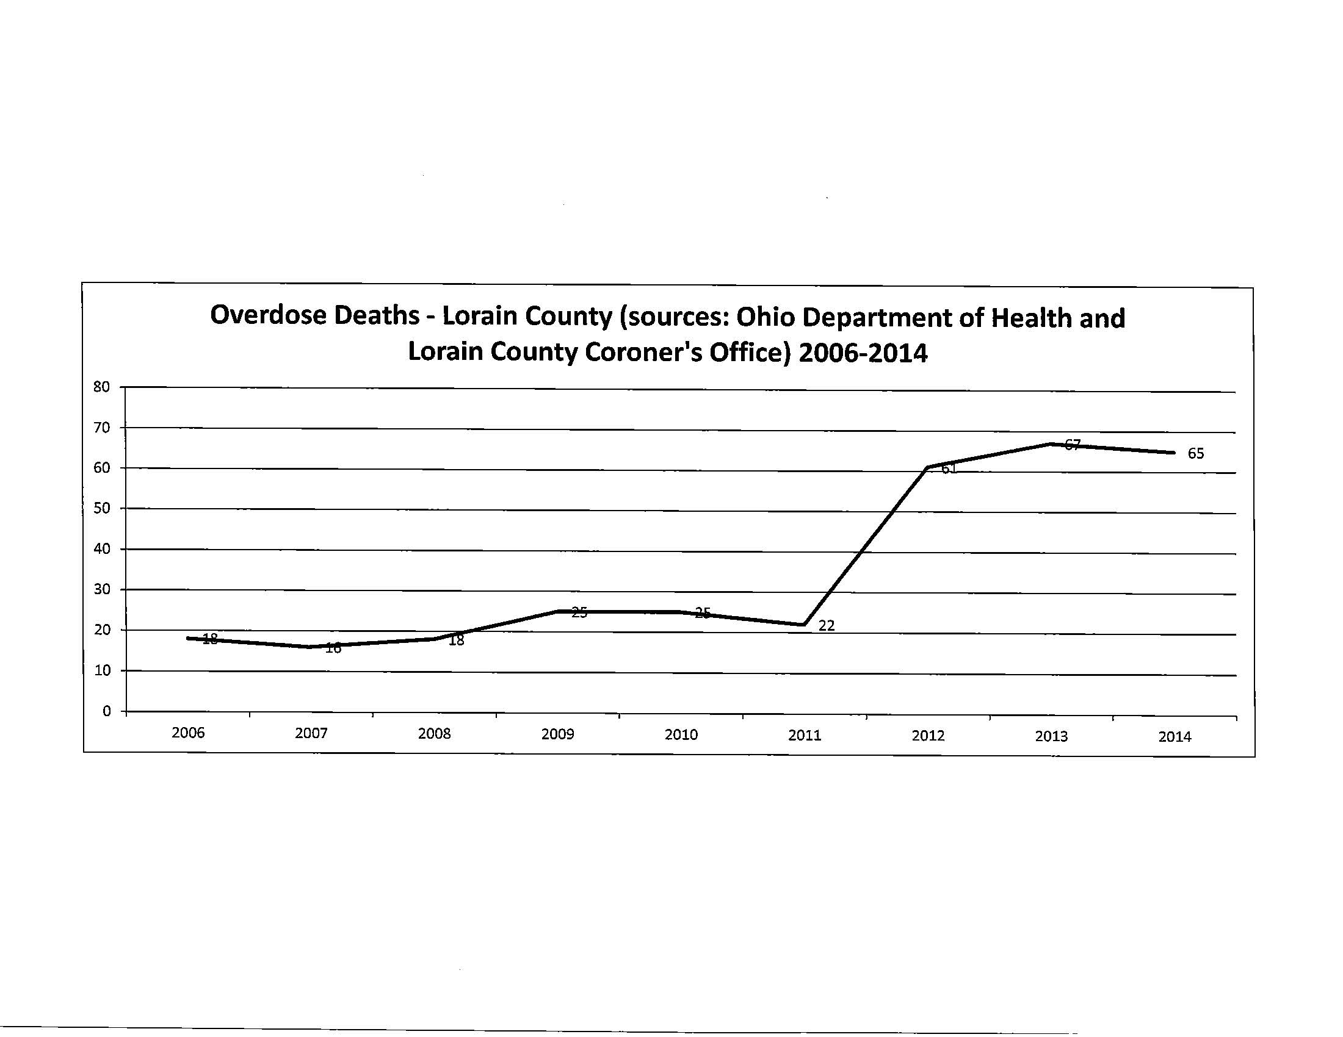
At least 66 Overdose Deaths in Lorain County due to opiates and/or heroin in 2013.
(As reported by the Lorain County Coroner, Dr. Stephen Evans)

Slide 20
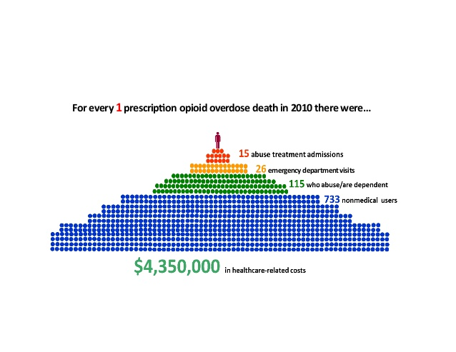

Slide 21
Based on Lorain County’s population of 67 overdose deaths in 2013, there are at least 49,111 Non-Medical Users of Opioids in Lorain county

Slide 22
What are the Most Commonly Abused Prescription and Over-The-counter drugs?
Opioids (such as the pain relievers OxyContin and Vicodin), central nervous system depressants (e.g., Xanax, Valium), and stimulants (e.g., Concerta, Adderall) are the most commonly abused prescription drugs.
Medications available without a prescription—known as over-the-counter drugs—can also be abused. DXM (dextromethorphan), the active cough suppressant found in many over-the-counter cough and cold medications, is one example. It is sometimes abused to get high, which requires taking large and potentially dangerous doses (more than what is on the package instructions).

Slide 25
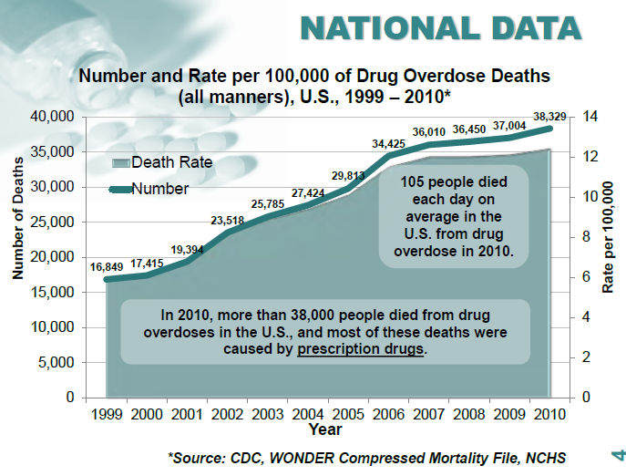

Slide 26
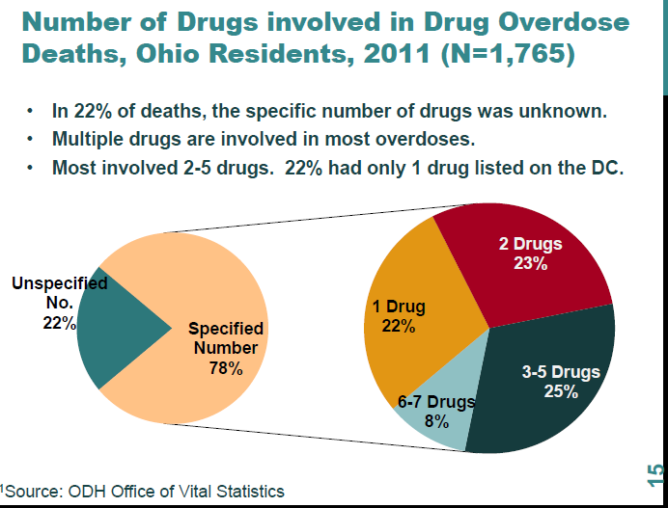
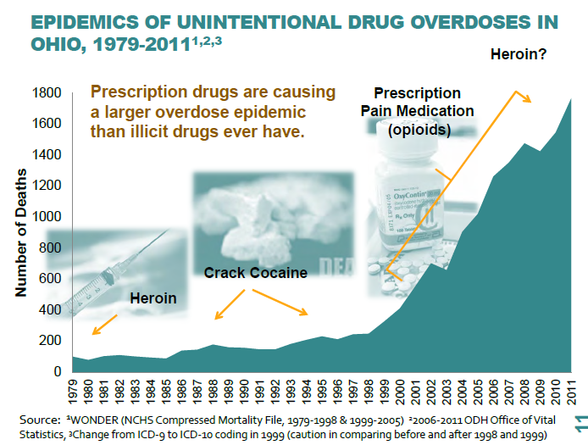

Slide 27
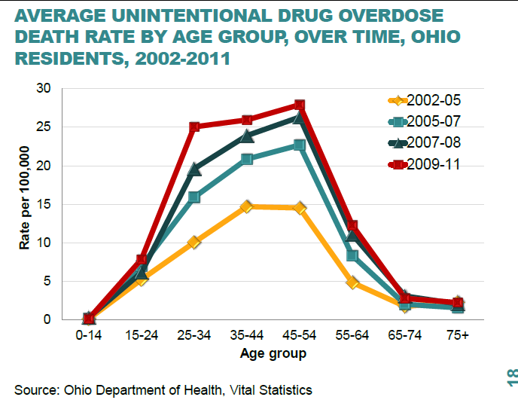

Slide 28
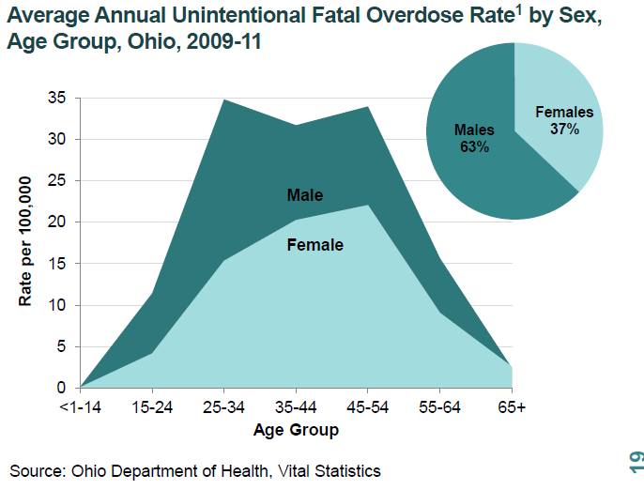

Slide 29
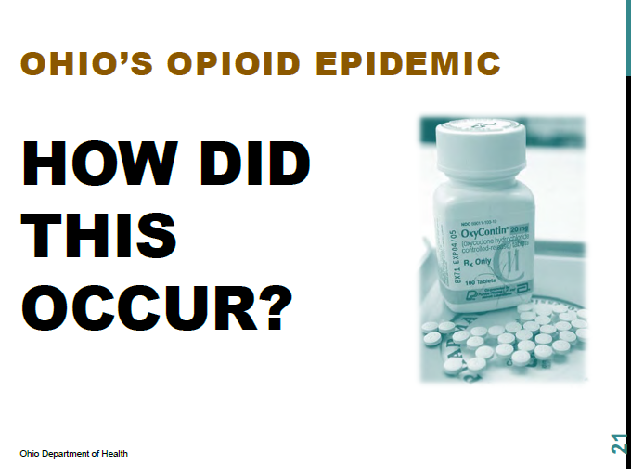

Slide 30
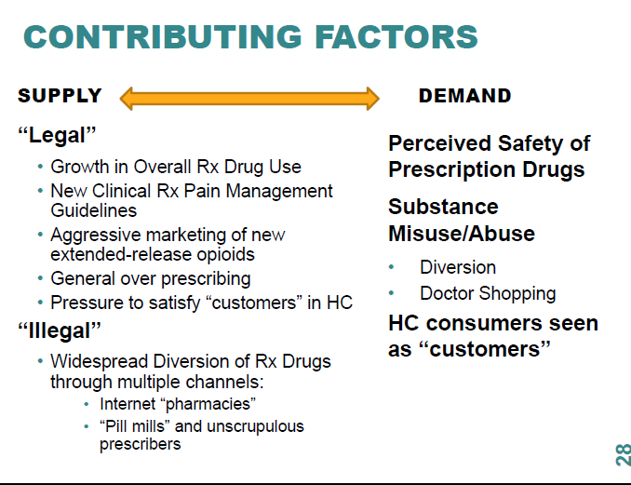

Slide 31
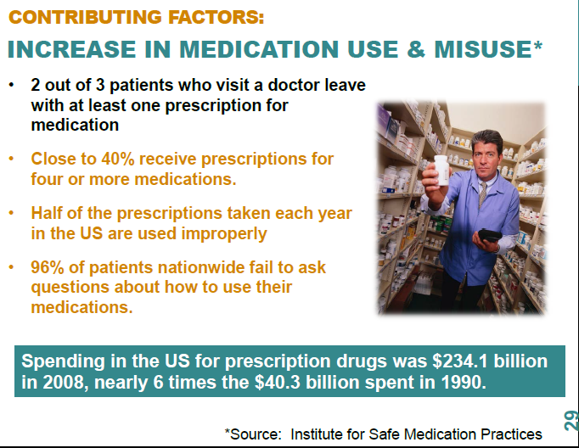

Slide 32
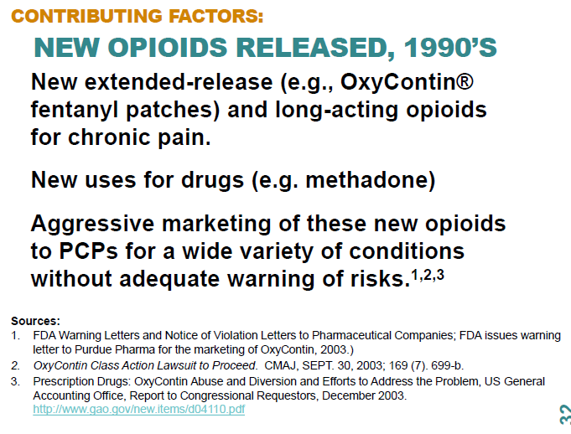

Slide 33
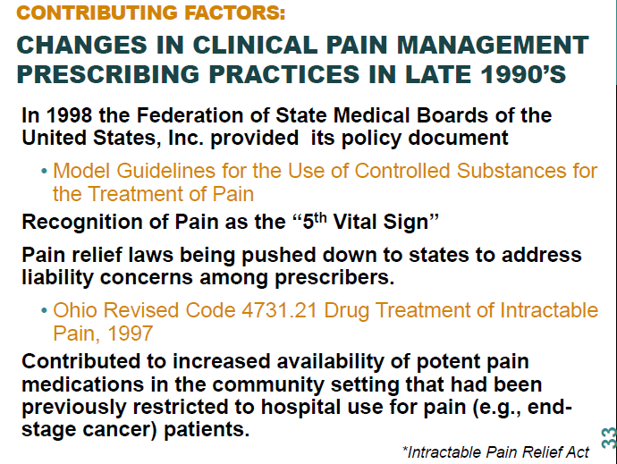

Slide 34
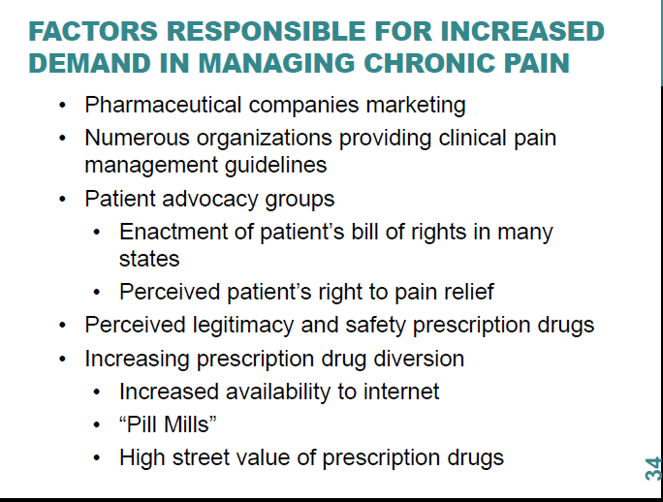

Slide 35
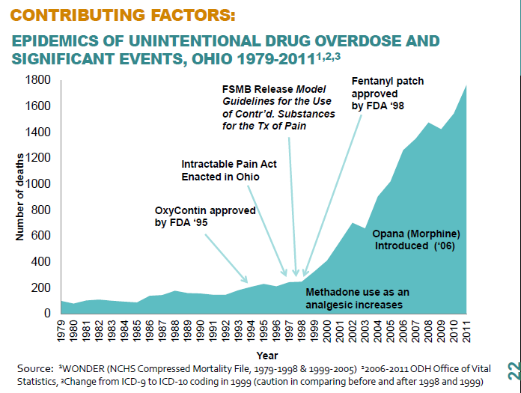

Slide 36
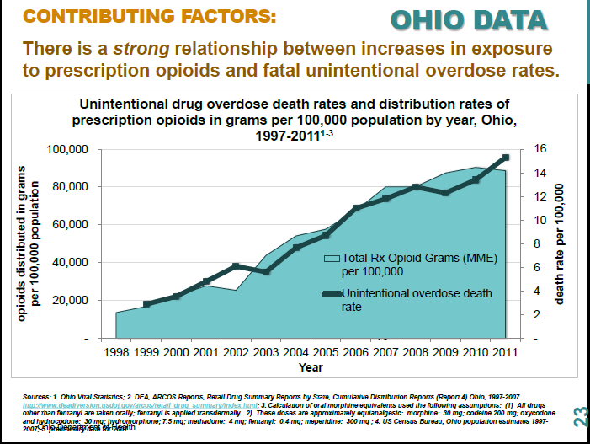

Slide 37
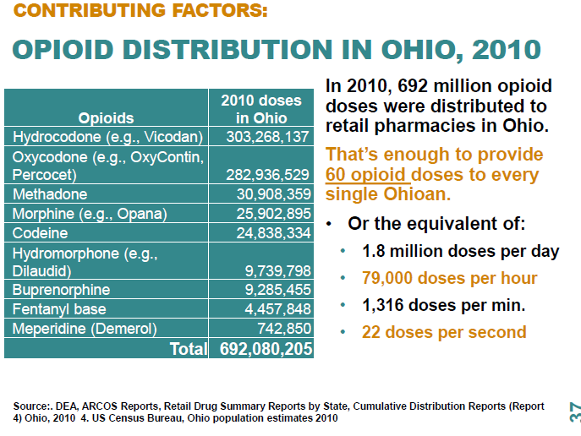

Slide 38
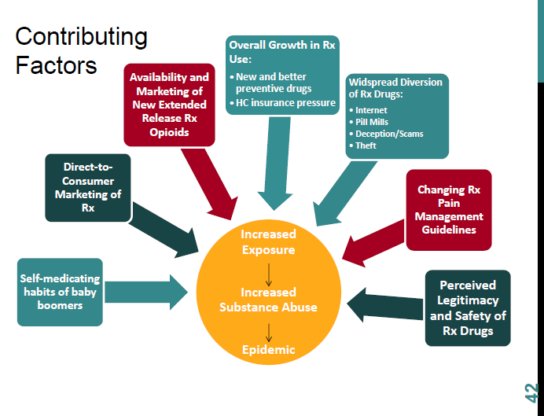

Slide 39
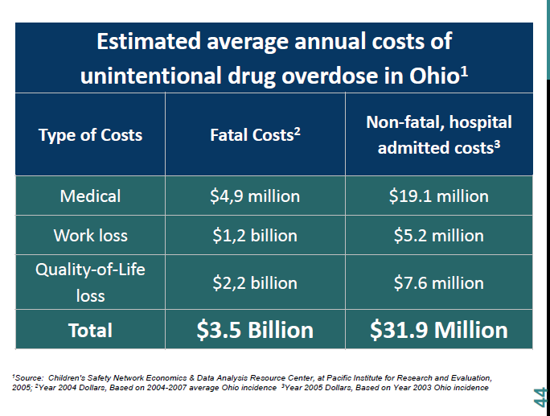

Slide 40
Community Health Improvement
Goal: By December 31, 2017, Lorain County will see a 25% reduction in overdose deaths from opiates/heroin.
(Offered from Project DAWN of Lorain County to the Lorain County Health Improvement Plan)

Slide 41
Strategies to Address Goal
Reducing the Availability of Opiates Including Heroin
Providing Support to addicts and family members including treatment and relapse prevention
Prevention and Education to Target Audiences: Addicts, Family Members, Recovery Community, Schools/Students, Pharmacies, Medical Personnel (including family physicians, dentists), Faith Based Communities, General Community
Advocate: Legislation, Regulation, Information

Slide 42

EMPLOYEES: BE EMPOWERED
START TALKING!
about safe & responsible medication practices
Notes:
SPEAKING POINTS
No doubt you’ve been hearing and reading things in the media about our nation’s prescription painkiller epidemic. You might even know someone who has developed a problem with those types of drugs. Most of us do.
But I’d like to challenge you to take a look at your relationship with ALL prescription medications -- not just the ones that cause addiction and even death.
How to use this presentation
These PowerPoint slides and accompanying speaking points are intended to be used by employers to facilitate a 15-20 minute awareness session for employees about safe and responsible prescription medication practices.
The slides can be projected on a wall or distributed as a handout.
For additional awareness tools that can be used to supplement this presentation (e.g., fact sheets, wallet cards, posters, table tents, postcards), visit www.GenerationRxWorkplace.com/downloads.html.
For more information on how you can “Start Talking!” to your employees about alcohol and other drug issues, register to receive bi-monthly BIZ tips by visiting www.StartTalking.ohio.gov/Business.aspx.

Slide 43
We take a lot of meds!
70% take at least one
50% take at least 2
20% take 5 or more
Notes:
We as a nation take a lot of prescription meds.
Almost 70% of Americans take at least one prescription medication and more than half take at least two.
20% of us … take 5 or more.
And the most commonly prescribed drugs are antibiotics, antidepressants, and painkillers, like Vicodin and OxyContin.

Slide 44
Many are Abused
Second only to marijuana
Higher than all other drugs of abuse COMBINED
Classified as an epidemic
Notes:
Many of us are healthy and responsible consumers of prescription medications and enjoy a better quality of life due to the positive effect those meds have on our overall health.
However, according to several national surveys, prescription medications are being abused at a rate second only to marijuana.
In fact, we are abusing prescription drugs at a rate higher than all other drugs of abuse COMBINED … including cocaine, heroin, and methamphetamine.
And because of this high rate of abuse, the Center for Disease Control and Prevention (CDC) has classified prescription drug abuse as an epidemic.

Slide 45
Take an active role!
Talk to your doctor
Talk to your pharmacist
Use as directed
Avoid sharing (on purpose or unintentionally)
Dispose of medications properly
Notes:
Employees are being asked to take a more active role in our health and our health care spending. With the introduction of such things as high deductible insurance plans; health spending and savings accounts; and a new emphasis on prevention and wellness, the days of walking into a doctor’s office and simply following orders -- without asking critical questions -- are over.
Not only does this consumer mentality make sense from a dollars and cents standpoint, but it’s also compatible with the goal of taking ownership for our overall health and well-being.
Adopting these 5 points will arm you in becoming a safe & critical consumer of prescription medications:
Talk to your doctor
Talk to your pharmacist
Use as directed
Avoid sharing (on purpose or unintentionally), and
Dispose of medications properly

Slide 46

1. TALK TO YOUR DOCTOR
Right & responsibility
BEFORE prescribed a drug
Prepare questions
  Questions about symptoms
  Questions about the drug
  Questions about taking the drug
Notes:
Talk to Your Doctor
You have a right and a responsibility to talk with your doctor and ask questions about your health care -- especially as it relates to prescription medications.
In fact, to be a safe and critical consumer, the time to start asking questions is before your doctor puts pen to the prescription pad.
Enlisting your doctor’s expertise at the point when you have questions and concerns about your health and discussing alternative ways to deal with the condition can help prevent substance abuse.
Time is limited during your doctor’s appointment and asking good questions takes some forethought. So it’s a good idea to prepare your questions ahead of time and literally carry your list into the office.
Consider questions in these 3 categories:
Questions about your symptoms
Questions about the drug that’s being recommended, and
Questions about taking the drug

Slide 47
Questions about Your Symptoms
Where do you think my symptoms are coming from?
Is there anything I can do to prevent this condition in the future?
What are some things – besides taking meds – that I could do to manage the symptoms?
Notes:
Ask your doctor questions about your SYMPTOMS.

Slide 48
Questions about the Drug
Can you please spell the name of the drug?
Is this the brand or generic version of the drug? Is a generic available that might cost less?
Do you have any samples of this drug to get me started?
Are there discount cards available for this drug?
What is this medication supposed to do?
What are the most important things you think I should know about this drug?
Does it have addiction potential?
Notes:
Ask your doctor questions about the DRUG that’s being recommended.

Slide 49
Questions about Taking the Drug
How might this drug interact with other things I am taking (including over-the-counter medications, supplements, herbal products or food)?
What are the possible side effects?
When do you anticipate I will experience the intended effects of the medication?
When should I take the medication?
How will I know when it’s time to stop taking the medication?
How will my progress with this drug be monitored?
How might this drug negatively impact my job?
Notes:
Ask your doctor questions about TAKING THE DRUG.

Slide 50
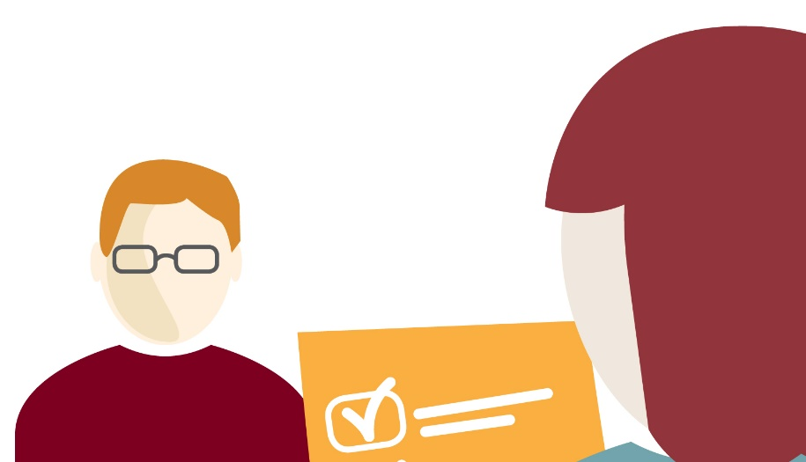
2. TALK TO YOUR PHARMACIST
Personal relationship
Most qualified to answer questions
Can help monitor
One pharmacy
Prepare questions for
  before the drug is prescribed
  after the drug is prescribed
Notes:
2. Talk To Your Pharmacist
Another important person on your healthcare “team” -- a person you need to talk with -- is your pharmacist.
Research suggests that if we have a personal connection with our pharmacist, we’ll be more likely to take our medications safely and appropriately. This means we’ll get the best outcomes from our medications, too.
Pharmacists are highly trained professionals and, in fact, are THE most qualified people to answer questions about medications -- including over-the-counter drugs and supplements, and their interactions with each other.
And because many of us have multiple doctors who each write prescriptions, your pharmacist can help monitor everything you are taking.
Using only one pharmacy can help you be a more safe and critical consumer of your prescription medications.

Slide 51
Ask Before the Rx is Filled
Do you have a record of my allergies?
What about a current list of other medications I am taking (including over-the-counter products)?
How much will I be charged for this medication?
Is there a generic form of this drug?
Does the pharmaceutical company offer any discount cards for this medication?
Does this medication have addiction potential?
Notes:
Ask your pharmacist questions BEFORE the Rx is filled.

Slide 52
Ask After the Rx is Filled
Do you have any concerns about this drug based on what I’m already taking?
What are the most important things you think I should know about this medication?
What’s the best time of day to take this medication?
Do I need to get up in the middle of the night to take it?
Should I take it with food or drink?
What things should I avoid while taking this medication - like exposure to the sun, alcohol, certain activities or certain foods?
What should I do if I miss a dose or take too much?
What’s the best way to store and dispose of this medication?
Is it safe to take this medication if I am or become pregnant?
Notes:
Ask your pharmacist questions AFTER the Rx is filled.

Slide 53
3. USE AS DIRECTED
Read the label
Read accompanying information
Ask before increasing or decreasing dose
Respect warnings
Alert doctor to any changes
Keep in original containers
Talk to doctor if you can’t afford the meds
Notes:
3. Use as Directed
According to a 2013 study conducted by the National Community Pharmacists Association, 75% of us who take an ongoing prescription do not take it as directed.
Be sure to:
Read the label on the bottle.
Read the information that accompanies the medications to learn even more about the drug.
Ask your doctor before increasing or decreasing your dose or stopping early.
Respect the warnings – especially as they relate to driving and other safety sensitive tasks, and consuming with alcohol or other drugs.
Alert your doctor if anything changes with your health that might warrant an adjustment to your medications – like if you are or wish to become pregnant.
Keep your medications in their original containers. (With caution, a pill box many be used to help keep track of when to take your medications.)
Talk to your doctor or your pharmacist if you can’t afford the medication.

Slide 54
4. AVOID SHARING
Class E-federal offense
Health and safety risks
  labeling
  allergies
  other medical conditions
  dosing
Notes:
4. Avoid Sharing
Sharing any type of prescription medication with another person is a class E-federal offense -- punishable by prison time and substantial fines. It’s a big deal, yet many of us are not aware of that fact when offering one of our meds to a friend or family member.
In addition to the legal consequences of sharing our medications, there are significant health and safety risks as well:
The user does not have any of the labeling or accompanying information about the medication to learn risks and precautions about taking the meds.
The user could be allergic to the medication, or could be taking something else that could cause a negative reaction.
The user might have a medical condition that would be masked or worsened by the use of a shared drug.
Dosing is an issue, as a doctor considers gender, age, weight, symptoms, and other patient information when deciding how much the patient should take.

Slide 55
Don’t share by accident!
Keep meds in secure location
Consider a place other than a bathroom
Keep out of sight and reach of children
Store in original containers
Keep close inventory of meds
Notes:
Sharing By Accident:
Over 50% of people who abuse drugs get them from a friend or family member for free.
One way to avoid medication getting into someone else’s hands is to store our meds carefully and appropriately:
Keep them in a secure location, preferably in a lock box.
Consider a place other than the bathroom. Not only is it an obvious place for abusers to look, medications can be damaged by humidity and changing temperatures in the bathroom.
Keep them out of sight and out of reach from children.
Store them in their original containers.
Keep a close inventory of your medications – especially painkillers and other drugs that are commonly abused.

Slide 56
5. DISPOSE OF MEDICATIONS APPROPRIATELY
Return unused, unneeded or expired Rx meds
Mix meds with unpalatable substance
Place mixture in sealed bag
Throw bag in household trash
Scratch-out information on Rx bottle and throw in trash
Notes:
5. Dispose of Medications Appropriately
When you are ready to pitch, the FDA has published disposal guidelines to prevent the harm associated with using an outdated or unneeded medication, or from someone else abusing the medication. These guidelines were also developed to minimize the environmental risks of introducing the medications into our waste water system by flushing:
Return unused, unneeded or expired prescription drugs to the pharmacy or a designated take-back location.
Mix medicines with an unpalatable substance such as kitty litter or used coffee grounds.
Place the mixture in a container such as a sealed plastic bag.
Throw the container in your household trash.
To dispose of your empty prescription bottles or containers, scratch out all information on the empty prescription bottle or container and throw it in your household trash, too.
You should only flush medications down the toilet if the patient information specifically says it is safe.

Slide 57
Know someone with a problem?
Help is available
Contact a professional
Check out resources available
For more information about helping resources, visit www.GenerationRxWorkplace.com
Notes:
If you know someone who might have a problem, it’s tough. But help is out there for the abuser or addict and for those of you who care about one.
In an ideal world, a person who has a problem with drugs would simply acknowledge and take care of it, without it ever impacting their family or job. But because of the nature of abuse and addiction, and the stigma and denial attached to the issue, that rarely happens.
So step #1 if you think you have or could be developing a problem, or care about someone who is struggling, is to contact a professional who can help. It’s too hard to “go it alone.”
Check out what resources might be available through your employer or in your community.
And for more information about helping resources, visit www.GenerationRxWorkplace.com.

Slide 58

The abuse of prescription medications is 100% preventable!
Notes:
Remember … the abuse of prescription medications is 100% preventable if we learn to be safe and critical consumers of these powerful substances.

Slide 59
Drug Prevention – The ROI for Business
The misuse and abuse of drugs and alcohol rob workplaces of their most valuable assets: present, clear-thinking, productive working adults. The operational loss ranges from $81-$193 billion. Ohio wants its businesses to have the tools to protect their bottom lines and deal with this insidious thief head on. Their best weapon is their own employees. Informed adults are more productive and creative employees, responsible parents and critical consumers.
In 1997, Ohio implemented a workers’ compensation premium discount program designed to help employers more effectively prevent on-the-job injuries and illness by integrating drug-free efforts into their overall workplace safety program. For 13 years, Ohio’s Drug-Free Safety Program had the deepest of such discounts in the nation! That program is still available, but we aim to do more by creating a Start Talking! Business Impact Zone.

Slide 60
The following statistics highlight the financial incentive for your business to become involved. Substance abusers:
are 1/3 less productive than non-abusers
are 10 times more likely to miss work than non-abusers
use 300-400% more medical benefits
are responsible for 50-80% of workplace shrinkage and theft
have 3.6 times more accidents on the job, and 5 times more off
file 51% of all workers’ compensation claims
Employers have financial incentives to get involved in motivating and arming their workforces to join the battle against substance abuse.

Slide 61

Start Talking! BIZ Tips is a free, bi-weekly email to keep employers apprised of the evolving situations impacting workplaces and provide information about new resources Ohio’s leadership is making available for employers to protect their workforces and their bottom lines. To sign-up to stay informed with BIZ Tips: http://starttalking.ohio.gov/Business.aspx

Slide 62
Start Talking! Business Impact Zone (BIZ) is a business community service center, developed and powered by Working Partners ®, to arm Ohio employers with easy access to information and practical tools to combat substance abuse that robs workplaces of productivity and safety.
Of the $55.7 billion in costs related to opiate abuse in 2009, the majority were tied to the workplace, not law enforcement and incarceration as often thought. Nearly 46 percent of the $55.7 billion ($25.6 billion) was attributable to losses in productivity. Cost to health insurers was an additional $25 billion attributable to the misuse of prescription drugs.

Slide 63
For prescription drug abuse alone, it is clear that American businesses are picking up the expensive check, and employers are often left with few resources to meet these challenges. Workplace interests can be well served by educating employees about the dangers of misusing or abusing prescription medications.
Start Talking! BIZ is arming employers with resources to build critical, responsible employees. Check out these free online resources including, a brief "Employer Video" to inform employers, a short PowerPoint presentation for use in an employee wellness or safety gathering (What to Say to Employees – a Toolkit) and clink-n-print materials to mount an awareness campaign (Download FREE Stuff).

Slide 64
Thank you
Are there any Questions?
Visit: www.lorainadas.org
Elaine Georgas, Executive Director
Alcohol and Drug Addiction Services Board of Lorain County
Georgas@lorainadas.org

