Slide 1



Corporate Wellness 2015
Presented by: Xcell Medical Group

Slide 2

What is Wellness?
Wellness:
“An intentional choice of a lifestyle characterized by personal responsibility, moderation, and maximum personal enhancement of physical, mental, emotional and spiritual health.”

Slide 3
What is Workplace Wellness
Workplace Wellness is “an organized, employer – sponsored program that is designed to support employees (and sometimes, their families) as they adopt and sustain behaviors that reduce health risks, improve quality of life, enhance personal effectiveness, and benefit the organization’s bottom line.”
Harvard Business Review

Slide 4
Why Implement Corporate Wellness?
Health Care Costs: Costs projected to jump 10% in 2015 (Price Waterhouse Coopers, June 2015)
Most Illnesses Can Be Avoided: Preventable illnesses make up approximately 70% of the entire burden of illness and associated costs in the United States (WELCOA, Six Reasons for Worksite Wellness)
Expanding Work Week: Typical American now works 47 hours a week, 164 more hours than only 20 years ago. (Julien Schor, Harvard Economics professor)
Increased Stress Levels: 78% of Americans describe their jobs as stressful and the vast majority indicate stress levels have worsened over past ten years. (WELCOA, Six Reasons for Worksite Wellness)

Slide 5

The Rising Costs of Healthcare

Slide 6
Studies Show “Proof” of Programs
High Adoption Rates: More than 81% of America’s business with 50 or more employees have some form of health promotion program (WELCOA)
Lower Health Care Costs: Wellness programs reduce health care costs for companies by about 26% and cut sick leave by an average of 28% (American Journal of Health Promotion, 2010)
Effective Recruitment/Retention: 22 of Fortune magazine’s “100 Best Companies to Work For” – businesses that enjoy national recognition for desirable benefit packages, plan to add a total of 87,750 jobs this year. (Fortune magazine Top 100 Companies to Work For, February 23, 2010)

Slide 7
What Wellness Programs do:
Reduce employee healthcare costs
Increase employee productivity (prevents presenteeism)
Reduce absenteeism
Reduce disability and workers’ compensation costs
Promote healthier, more satisfied workforce
Improve corporate profitability

Slide 8
How do your Employees Stack up?
Statistically, for every 100 employees in your company:
5 have diagnosed diabetes
10 have undiagnosed diabetes
12 are heavy drinkers
15 are bothered by excess stress
23 have total cholesterol (>240)
27 have no regular exercise
29 have elevated blood pressure
33 use tobacco products
46 have high overall coronary risk
60 are outside recommended weight range
Source: Center for Disease Control

Slide 9


Profile of an Unhealthy Employee
48 Year Old Male
Works in Suburban USA
Tobacco and Alcohol Use
Unhealthy Diet
Physically Inactive
High Stress Job and Family Responsibilities
Family History of Stroke and Emphysema
Height 6’1” and Weight 280 Pounds

Slide 10

Obesity
>30% of Americans
>$13 Billion Annually in Medical Fees
and Lost Productivity
$8,720/Employee/Year
Higher Risk Than:
– High Blood Pressure
– High Cholesterol
– Heart Disease
– Diabetes
– Sleep Apnea

Slide 11

Inactivity
>$24 Billion/Year
Increased Activity Could Save $70 Billion/year
Activity is More Effective in Reducing Cardiovascular Risk than
Weight Loss

Slide 12

Smoking
1 in 5 Deaths / Year
>1 pack/day Smokers Have 75% Higher Rate of Lost Production Time Than Nonsmokers
$27 Billion or $3,856 Per Smoker per Year

Slide 13

Stress and Depression
– Stress and Depression Increase Health Care Costs more than Obesity, Smoking, or High Blood Pressure Combined.
– Accounts For 20% of Absenteeism and Turnover
– Costs $300 Billion/Yr

Slide 14

Drug and Alcohol Abuse
Absenteeism is 2-3x Higher Drug and Alcohol Users
3x as Many Sickness Benefits Filed
5x as Many Workers' Compensation Claims

Slide 15
Chronic Disease
45% of Population Has at Least One Chronic Disease
- CHD, Diabetes, Asthma, etc.
70-80% of Healthcare Costs
$5000 Worth of Spending Per Person on
Treatment of Chronic Disease

Slide 16
What factors influence a decision to implement a workplace wellness program?

Slide 17
Health Statistics That Impact The Bottom Line
Helping employees stay Healthy benefits everyone:
80% of Americans suffer with at least one chronic illness and 60% suffer with more than one. This costs the average employee 9 sick days missed annually and up to 90 days of decreased production. 90 days of decreased production is approximately 38% of the employees work for a year!
Most Americans begin to treat disease only after obvious symptoms develop which in most disease processes occur in the last 25% of the disease progression.
Doing screenings to find the markers or indicators of undetected disease process makes it easier and significantly less expensive to effectively treat the disease.
Diseases detected in the earliest stages are more likely to completely resolve and not result in a chronic illness.
Most Americans do not seek regular health screenings. The most effective programs for getting personnel screened are the ones provided on-site by employers.

Slide 18
Prevention vs. Chronic Disease - Reverse the “Flow”
“The Natural Flow of Health Risks…is Toward High Risk in the Absence of Programs Targeted at Maintaining the Population at Low Risk” – Dee Edington, PhD
General Wellness
Presence of Risk Factors for Disease
Established Disease
Disease – with Complications
$
$$
$$$
$$$$
Costs follow risk – the greater the number of risk factors, the higher the cost
A culture of health that promotes healthy behaviors may prevent or slow progression of disease and keep employees as healthy and low cost as possible – to the left side of the risk continuum

Slide 19
5% of Employees Can Account for 75% of Cost
Percentage of Healthcare Costs Attributable to
Employees in Different Health Categories*
Employees in Different Health Categories*
Employees in Different Health Categories*
Most health care strategies focus on the 5% in the “sickest” category
While this may yield short-term savings, to provide quality, cost-effective care, the employer needs to manage the entire population
Vast majority of high cost patients revert to low cost after incurring major medical expenses
35% with established
conditions
50% of the population is well or has risk factors
15%
of cost
10%
of cost
5% with complications
75%
of cost

Slide 20
Worksite health promotion programs can yield a $5 to $6 return on investment for every dollar spent over a 2 to 5 year period
46% of employees participating in on-site smoking cessation program quit; 48% smoked less – L-3 Communications
Classes and fitness training offered to prevent back injuries resulted in increased employee morale, reduced worker’s comp claims, medical costs and sick days related to back injuries producing a net cost-benefit ratio of 1 to 1.79 – County in California
Participants in their “Stay Alive & Well” program significantly lowered cholesterol levels, blood pressure and weight and experienced 21% lower lifestyle-related claim costs than non-participants. Resulting savings: $127.89 per participant with a benefit to cost ratio of 1.68 to 1 over two years. – Reynolds Electrical & Engineering Company, Las Vegas
22% fewer admissions to a hospital, 29% shorter hospital stays, and 42% lower expenses per admission – Superior Coffee and Foods, Illinois
Employees whose lifestyles included two to four health risks such as smoking, little exercise, overweight—were 75% higher than those of low-risk employees. High-risk employees who improved their health habits through the company’s health promotion program and became low risk cut their average medical claims in half, lowering their medical insurance costs by an average of $618 per year. – Steelcase

Slide 21
Your Business and Employees experience the benefits
Implement your Wellness Program
Pick your Wellness Program
Health programs increase productivity, reduce accidents and absenteeism and are good for the bottom line.

Slide 22
6 MODIFIABLE behaviors which drive 80% of the Chronic Illness Costs*
Modifiable Behaviors
Smoking
Physical inactivity
Poor diet
Poor standard of care compliance
Insufficient sleep
Lack of health screening
*Source: The World Economic forum : The New Discipline of Workforce Wellness. Enhancing Corporate Performance by Tackling Chronic Disease” 2010.

Slide 23
Conditions Directly related to Modifiable Behaviors
Diabetes
Coronary artery disease
Hypertension
Dyslipidemia
Obesity
Asthma
Arthritis
Sinusitis
Heart failure
COPD
Chronic kidney disease
Depression
Back pain

Slide 24
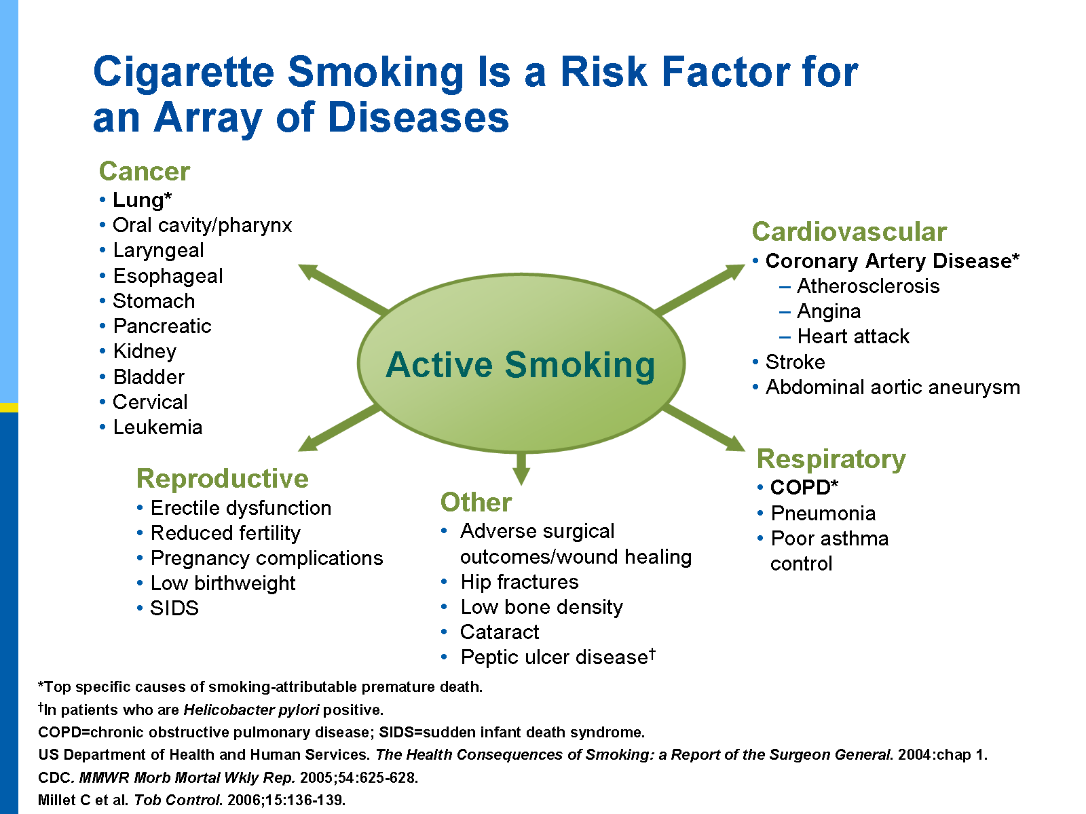

Slide 25


Pick a Wellness Program that provides services to meet company objectives
Health Education
Weight-loss
Fitness Challenges
Literature
Screenings
Health Risk Assessments
Onsite Seminars

Slide 26
Initiating Corporate Wellness
Wellness Challenges – Create healthy change across your company!
Improve the overall health of your workforce in a cost-effective way with fun and exciting team challenges. In addition to fostering a sense of teamwork and building morale, challenges drive employees to adopt or continue healthy habit. Well-organized challenges use incentives to engage the widest possible segment of your workforce while improving communication and changing behaviors.
Onsite Health Fairs – Screenings and education delivered with a healthy dose of fun!
Health fair screenings are designed to give you and your employees a snapshot of their current health, but they can be entertaining and educational, too. Brought to your worksite so employees don’t have to go far, the screening can be for bone density, body composition, vision, blood pressure, blood glucose, cholesterol, and more. Add in bonuses like nutrition education, chair massage, stress reduction, ergonomics, and other valuable extras, and your employees will look forward to these events as a can’t-miss social event.
Onsite Seminars – Add in-depth education to your wellness offerings!
XCW’s high-energy seminars motivate, teach, and encourage your employees with fitness, nutrition and stress management news, tips, and techniques. From one-hour programs to engaging multi-session courses, these seminars help employees bridge the gap from health screening data to actionable steps to take for better health.

Slide 27
Seven Crucial Facts You Must Know about Health Fairs
Health screenings should not be optional. A comprehensive health screening sets a baseline for both employees and for your company’s wellness program. In order to make changes that have lasting meaning, employees need to know numbers like blood pressure, body mass index, blood glucose, waist measurement, and full lipid panel (cholesterol).
Promotion for events must be effective. Your health fair doesn’t accomplish anything if no one shows up. Since participation is the key to success, call on your screening vendor to help with designing promotional materials that not only publicize the health fair but also make it inviting and important.
Education is key. Your health fair should have professional educators on hand from your screening vendor to provide individual coaching for your employees. While screening results indicate problem areas, only effective education can give employees effective tools to create changes in behavior.
Keep it fun. A “fair” has to have elements of entertainment, or word will spread about your dull affair and no one will show up next year. Healthy cooking demonstrations, free mini-yoga sessions, chair massages, and other fun events will get people in the door year after year.

Slide 28
Seven Crucial Facts You Must Know about Health Fairs
Aggregate reporting Can Help. While individual results are confidential, your screening vendor should provide you, upon request, with aggregate reports on the comprehensive results of the screenings. The vendor should also be able to advise you about the course of your program based on the findings and help you keep up with ROI.
Use an experienced vendor. Using a screening partner with clinical experience gives you the convenience of top-quality, onsite screenings that are private and cost effective.
Show your employees that they matter to you. Finally— and most importantly —showing your workforce how important they are to you elicits better performance from them. An onsite health fair with screenings conveys the message that their well-being matters to you.

Slide 29
Seven Steps to Wellness Success
Keep It Simple.
Privacy. No time to participate. Unawareness of the program. No interest. If you are encountering these barriers to full employee engagement in your wellness program, you can take steps to address them by giving employees the simplest options. Always make the default option the healthy, “opt-in” choice by communicating program goals and taking concrete steps, including: making the workplace free of candy or soda; putting healthy snack and beverage options in vending machines; serving healthy snacks at meetings; putting up positive health messages in public and common areas; offering wellness and fitness programs onsite; motivating employees to stretch and move around during the workday; establishing a walking, biking, or running path or route around the building or grounds; placing showers and lockers in the workplace; and installing racks for those who want to bike to work. The easier the program, the more employees will join in your efforts to create a healthy environment.

Slide 30
Seven Steps to Wellness Success
2. Practice It.
The success of your wellness program will begin at the very top of the organization. The more company leaders participate in the program, the more employees will too. In addition to senior leadership, you should establish committees and appoint Wellness Winners, or front-line leaders who will spread the word about the program and its goals face to face. Be sure to choose these “on the ground” leaders from a wide variety of personnel—choose among genders, racial and ethnic identities, salaried or hourly employees, union and non-union workers, and so on. These Winners do not have to be the fittest employees; in fact, they are often more effective if they have their own personal goals to achieve. Most of all, Wellness Winners are those who listen well, engage other employees, and foster enthusiasm for the program throughout the company.
We have found that Wellness Winners programs work best when they create a grassroots mood among employees, who feel included and take ownership of the program. Taking this route allows employees to support not only the wellness program, but also the overall goals of the company. A study from a major wellness company found that employees are two-and-a-half times happier at work and three times more likely to act positively about their health when the company promotes a strong culture of wellness. Happy, healthy employees become productive employees, and the example for this culture begins at the top.

Slide 31
Seven Steps to Wellness Success
3. Understand Your Workforce.
A wellness strategy that works is one that knows its employees and understands how to reach them. We encourage your organization to use focus groups and surveys to discover what barriers your wellness program may face, to solicit feedback from potential participants, and to create a program that draws its strength from listening to and learning from the workforce. In addition to considering demographic information, you must take into account literacy and language barriers; restrictions to information access, both at home and at work; and job restrictions that may keep employees from participating freely. Be sure to reach out to families, as well; scheduling activities and establishing goals that include spouses and children increase the chance of program success. Also, be willing to personalize the program as needed to meet individual needs or overcome specific barriers.

Slide 32
Seven Steps to Wellness Success
4. Identify It and Publicize It.
Develop four steps that encourage a higher rate of participation in the program: 1) give the wellness program an identity that is easy to understand, remember, and relate to; 2) locate a space, whether physical or virtual that serves as a “home base”; 3) provide simple, practical materials designed not only to educate employees but to keep them up to date with changes in the program; and 4) make all messaging about the program as personal as possible.
Creating an identity for the program—a brand, a logo, a clever name—allows employees to recognize and easily understand the program and its basic goal of creating a healthier workspace. “Home base” can be a workroom with brochures, if you are located in one space, or it can be a website (or both). This space should offer all information about the program, including its goals, health risk data, FAQs, incentives for accomplishments, changes to the program, and so forth. Communication of the program provides a great opportunity to employ social media; other forms of communication include meetings, coaching sessions with Wellness Winners, and time for one-on-one motivation and connections.

Slide 33
Seven Steps to Wellness Success
The website or physical area should be a comfortable space for employees to share their successes, frustrations, and suggestions on how to make the program better. Finally, you should share news, recognize Winners and personal accomplishments, and changes to the program.
Your employees are going to participate, and participate more fully, if they believe that the wellness program holds personal relevance to them. Shape your communications to the education level, interests, literacy, generation, and gender of your workforce. Ask participants to aim for achievements that mean something rather than are easy to attain. Involve families, bring employees together in physical and virtual spaces, build communities around health goals, and encourage networking in order to create the healthiest workplace possible.

Slide 34
Seven Steps to Wellness Success
5. Personalize It.
If you communicate your wellness program to employees on a personal level, it will have a greater chance of success. You should offer plenty of ideas, education and screening, and other resources in order for the workforce to create personal goals. Urging workers to establish goals that are achievable allows them to be successful early on in the program and experience a feeling of success, not to mention earn rewards.
Achieving goals at the start of the program drives motivation and helps employees feel competent about their own wellness, but it’s important that they set more difficult goals, too, in order to continue improving. The company has the responsibility of supporting those goals and should provide a wide variety of resources and tools: a health and wellness portal, screenings, incentives and rewards, challenges, and coaches and counselors. Employees should also be able to see their own progress, which can motivate them to continue in the program and develop the culture of wellness you are seeking in your organization.

Slide 35
Seven Steps to Wellness Success
6. Renew It.
Launching a corporate wellness program is naturally an exciting time—everyone comes together as a team, there are kickoff events and challenges, and information is widely available. However, organizations tend to let this enthusiasm lag as time goes on. A lack of follow through, a tired program, uninspired leadership, and little or no motivation on the part of employees can all lend to a drop in interest and participation rate. It is crucial to renew the program on a regular basis in order to keep your workforce excited about the program. Adding new elements, asking opinions of key participants, addressing fresh topics—these are all ways to keep employees energized. Reach out through social media and through your web portal. And be sure to make it fun; although your corporate wellness is a serious issue, your workforce will be more willing to hang in there if the company takes an overall lighthearted approach. Some ways to renew your wellness content, engage existing participants, and draw in new participants include giveaways and incentives, team challenges, and walking or stretching meetings.

Slide 36
Seven Steps to Wellness Success
7. Make It Worth It.
Consider offering incentives and rewards as a way of making your corporate wellness program successful. Incentives typically have one of three goals: 1) to influence the outcome of the program; 2) to join the program; or 3) a combination of both. Know your incentive goal before offering it and consider that some incentives work better than others for each type of goal. For example, financial incentives are typically more effective for encouraging employees to participate in the beginning or to accomplish a specific task, but this incentive usually does not influence a lasting change in behavior. On the other hand, the promise of concepts like a sense of community, honor, respect, or fun can create a connection on an emotional level and inspire individuals to persist in achieving their goals. We suggest using incentives that encourage your workforce to engage in healthy behaviors like opting in to a walking or stretching program, getting a physical, participating in a screening program, or following coaching guidelines. Start small by motivating employees to join in single events; over time, pursue a strategy of securing employee buy-in for the entire program.

Slide 37
Actions that your wellness committee may find useful in your workplace
Find places like paystubs, newsletters, and bulletin board (virtual or physical) to convey healthy tips, create it as an ongoing campaign
Devote a space in the break room or cafeteria to wellness information
Give a benefits fair
Create a virtual or physical library with resources like websites, tools, DVDs, and books
Hold exercise and yoga classes onsite
Provide an onsite or off site weight management training program
Sponsor corporate participation in community and charity walks/runs and match all employee contributions (Hermes Corporate Challenge?)
Encourage exercise time by allowing for flex scheduling
Offer incentives for participation in fitness programs
Negotiate with a local gym to provide discount memberships for employees and their families near their homes
Provide reimbursement for tobacco replacement or cessation products
Offer regular screenings for posture and ergonomics
Provide the opportunity for onsite screening of blood sugar, body composition, and cholesterol

Slide 38

Work Related Injuries and Corp. Wellness
How does Corporate Wellness factor into work related injuries?
Healthy workers are less likely to sustain work related injuries
It is easier to determine if an at work injury is legitimate
Work injuries tend to be less serious with a healthy workforce
Recovery time for an injury is quicker with healthier individuals

Slide 39
Decreasing Work Comp Costs
Use FCE testing for job applicants to pre-screen the job candidates
Institute a Corporate Wellness Program to increase the health of your workforce
Make sure that the injured employee is properly evaluated and diagnosed
Follow the at work restrictions recommended by the Physician

Slide 40
The Return on Investment (ROI) is clear. ROI for implementing health improvement programs is an average of $5-6.00 savings for every dollar spent on wellness program.
Workplace Wellness ROI

Slide 41
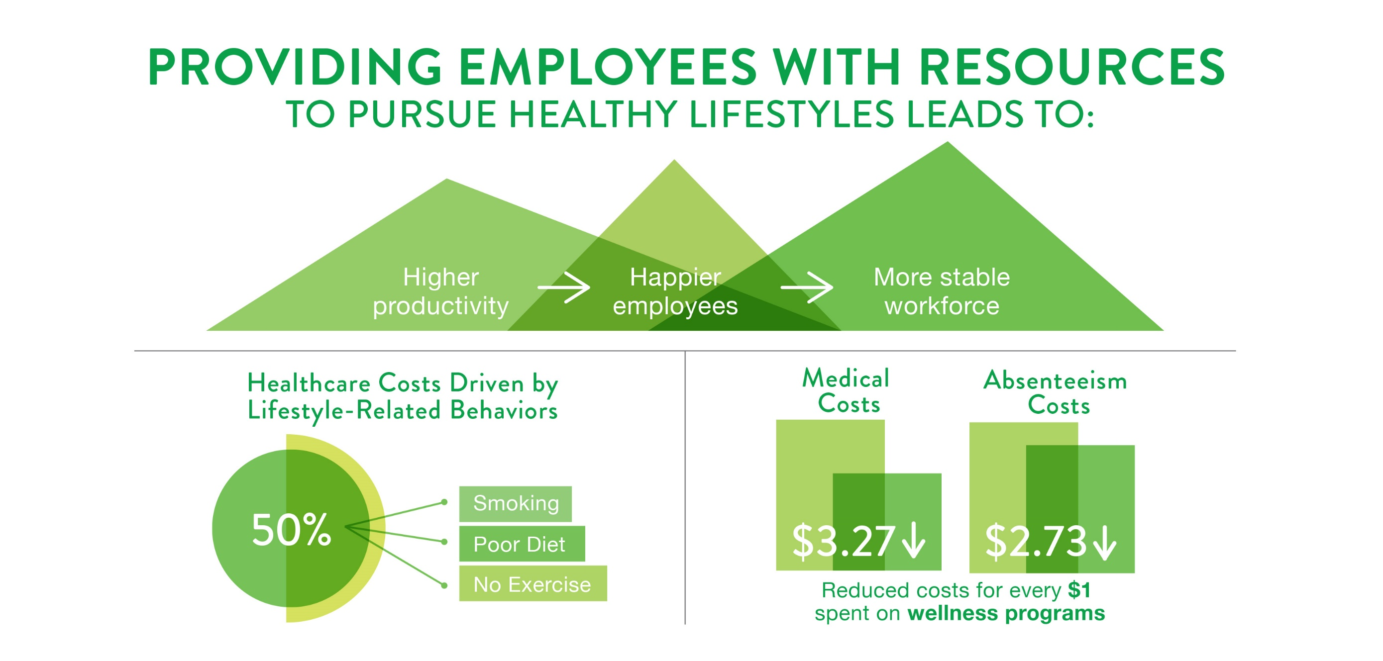

Slide 42
Wellness Programs
Benefit the Employer and the Employee
Thank you for having me as your speaker today!
Questions?

