Slide 1
Lorain County Transit
Lorain County Transit Needs Assessment

Slide 2
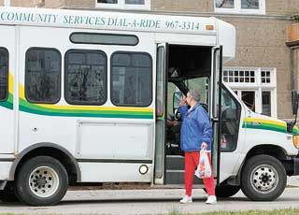
Agenda
Why are we here?
Why is transit needed?
What are Lorain County’s transit needs?
Where do go from here?

Slide 3
Why are we here?

Slide 4
To Give People Choices on How to Travel
Put priority on people, not cars.
Improve regional competitiveness.

Slide 5
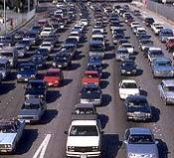
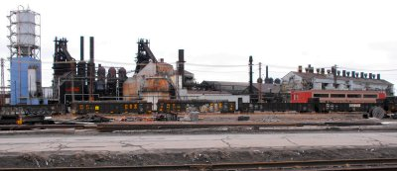
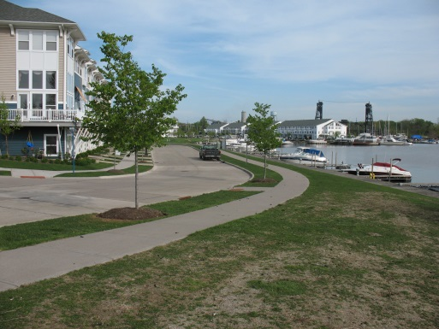
We Face Challenges
Existing land use and urban form doesn’t support transit
Limited transportation choices
Increasing congestion
Aging “baby boomer” population and emerging “millennials”
Increased competition for limited resources
Fiscal constraints and funding challenges

Slide 6
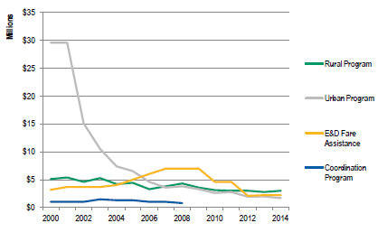
State Funding for Public Transit (2000 – 2014)

Slide 7
Why is transit needed?

Slide 8
Improve the Quality of Life
Direct Benefits
Mobility improvements
Travel time savings
Cost savings
Transportation system efficiency
Accident reduction
Energy savings
Environmental quality improves
Indirect Benefits
Increased economic activity
Increased competitiveness
Productivity improves
Land-use patterns change
Property values increase
Residual impacts
Residual community amenity

Slide 9
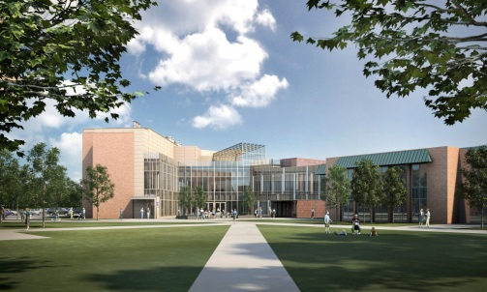
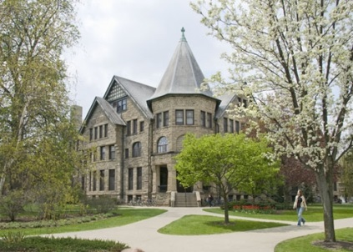
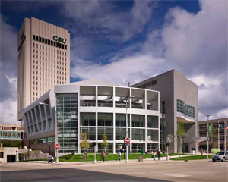
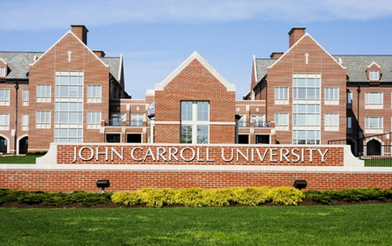
Public Transit – Connecting People to Opportunities
Provides mobility & freedom for people from every walk of life
Connects workers with jobs
Over 60% of trips are work related
“Public transit or public assistance”
Businesses located near transit see more employee reliability
Can reduce the need to build parking in high land cost areas
Connects students with schools and colleges
High schools
Lorain Community College, Oberlin College, Baldwin-Wallace College, Cleveland State University, Case-Western Reserve University, John Carroll University, Ursuline College, Notre Dame College

Slide 10
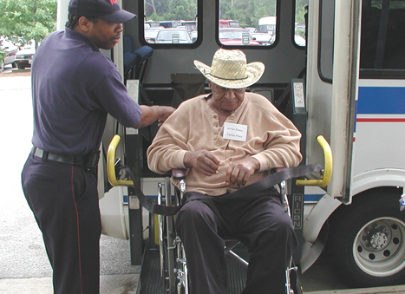
Seniors Citizens and Disabled Using Public Transit
Seniors are a growing segment of population.
20% of population by 2025
20% of those over 65 don’t drive
Disabled rapidly becoming more mainstreamed.
Seniors & disabled represent 48% of all transit rides in rural areas of Ohio.

Slide 11
Public Transit – Mobility Benefits
Relieves congestion
Public transit reduced congestion by 27% nationally.
People living near transit drive 4,400 fewer miles annually.
RTA eliminates 50,000 cars from the highways in Cleveland
Reduces pollution
Reduced CO2 emissions by 37 million tons
Reduces dependence on imported oil
Saves 4.2 billion gallons of gas annually
Cars per Household | Transit Oriented Developments | US Average
Cars per household (HH) | 0.9 | 1.6
Percent no cars per HH | 18.5% | 10.7%
Percent 2 cars per HH | 40% | 60%
Percent < 2 cars per HH | 63% | 45%

Slide 12
Public Transit – Mobility Benefits

Slide 13
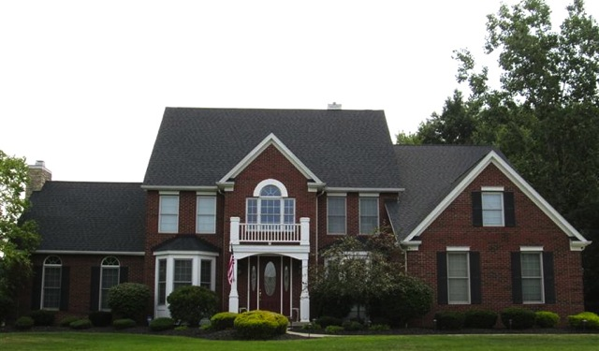
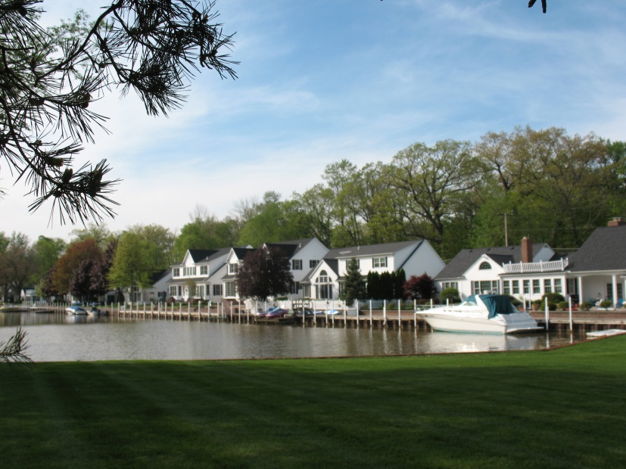
Other Reasons to Support Public Transit
Saves people money
Transit saves the typical rider over $9,000 annually (AAA).
Location efficient mortgage available for areas with high quality transit.
Allows riders to be productive during their commutes.
Saves cities and counties money
Less roadway infrastructure costs by reducing cars on the road.
Cities can spend less on paving and road building with more transit.

Slide 14
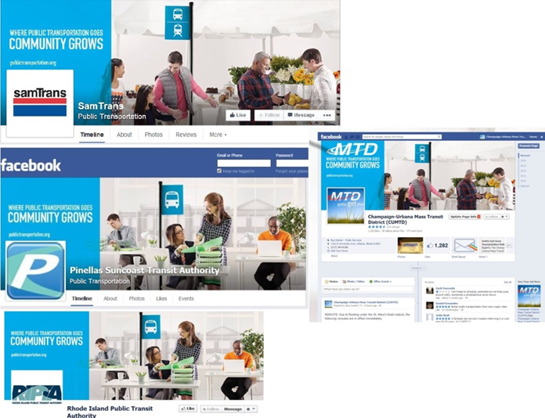
Public Transit Drives Community Growth and Revitalization

Slide 15
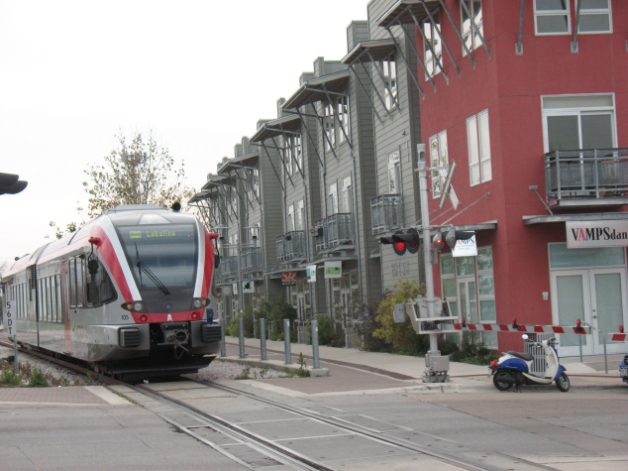
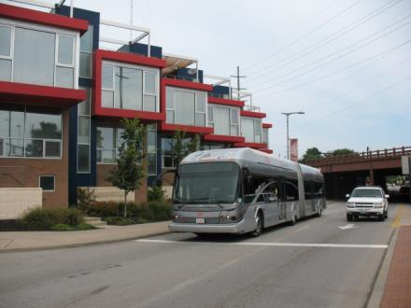
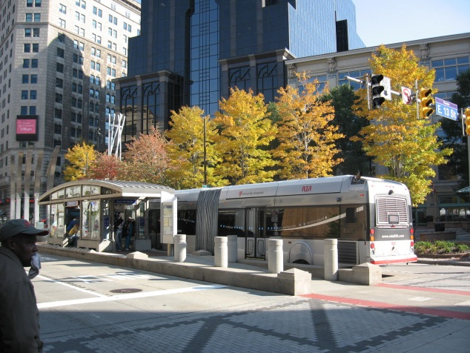
Public Transit Economic Development Multipliers
Public transit spurs economic growth and development
$1 billion of federal investment in public transit creates 50,000 jobs.
$10 million in capital investment yields $30 million in business sales.
$10 million in transit operations yields $32 million in business sales.
Home values increase 42 percent near high quality public transit.

Slide 16
Lorain County Needs

Slide 17
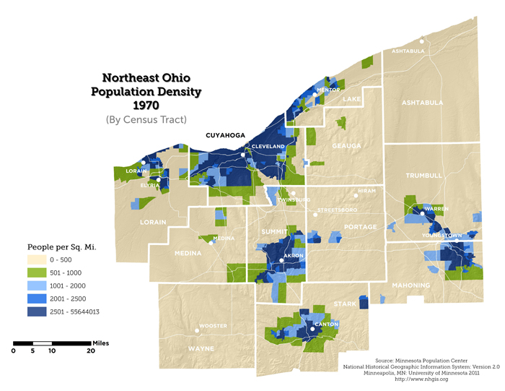
Northeast Ohio Population Density

Slide 18
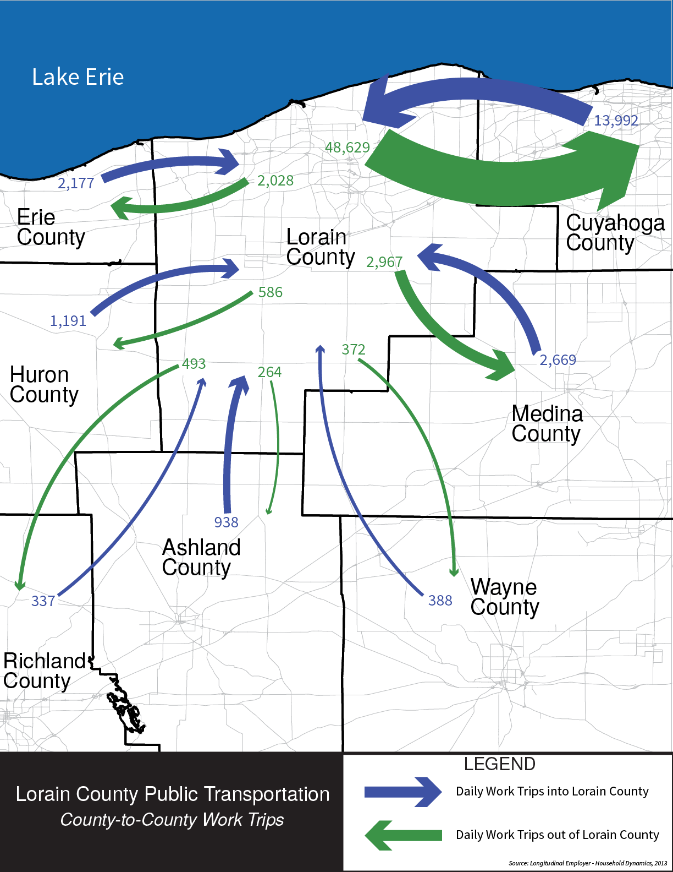
Lorain County Commuter Patterns to Adjacent Counties
Intercounty Commuter Trips
48,629 daily trips to Cuyahoga
13,992 daily trips from Cuyahoga
2,967 daily trips to Medina
2,669 daily trips from Medina

Slide 19
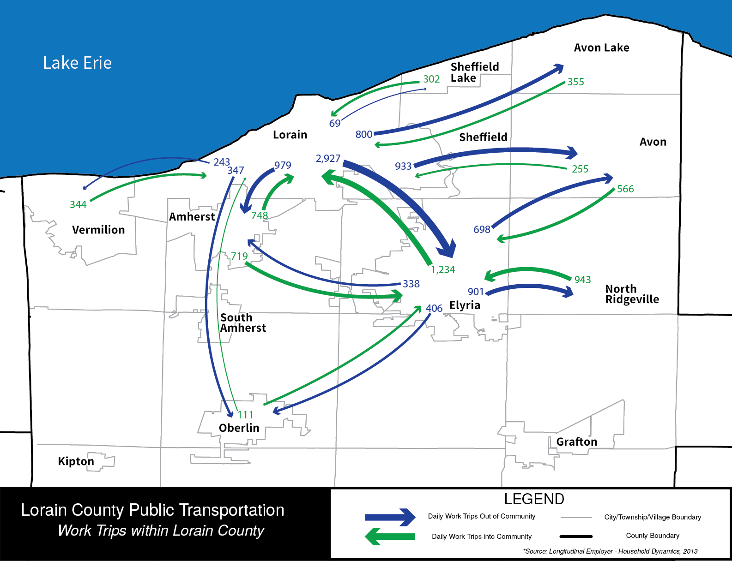
Lorain County Intra-county Work Trips

Slide 20
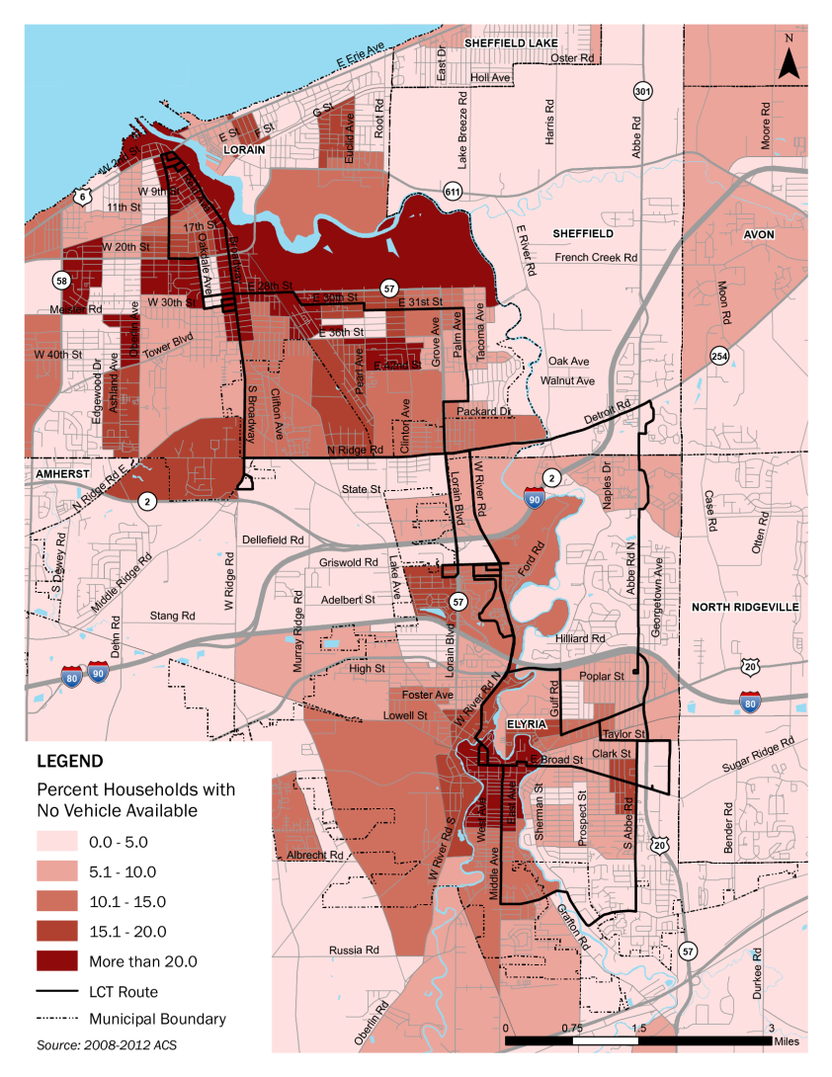
Lorain County Zero Car Households
Area | Total Households | Zero Car Households | % no car available
Lorain County | 115,670 | 7,712 | 6.6%
City of Lorain | 25,318 | 2,422 | 10.4%

Slide 21
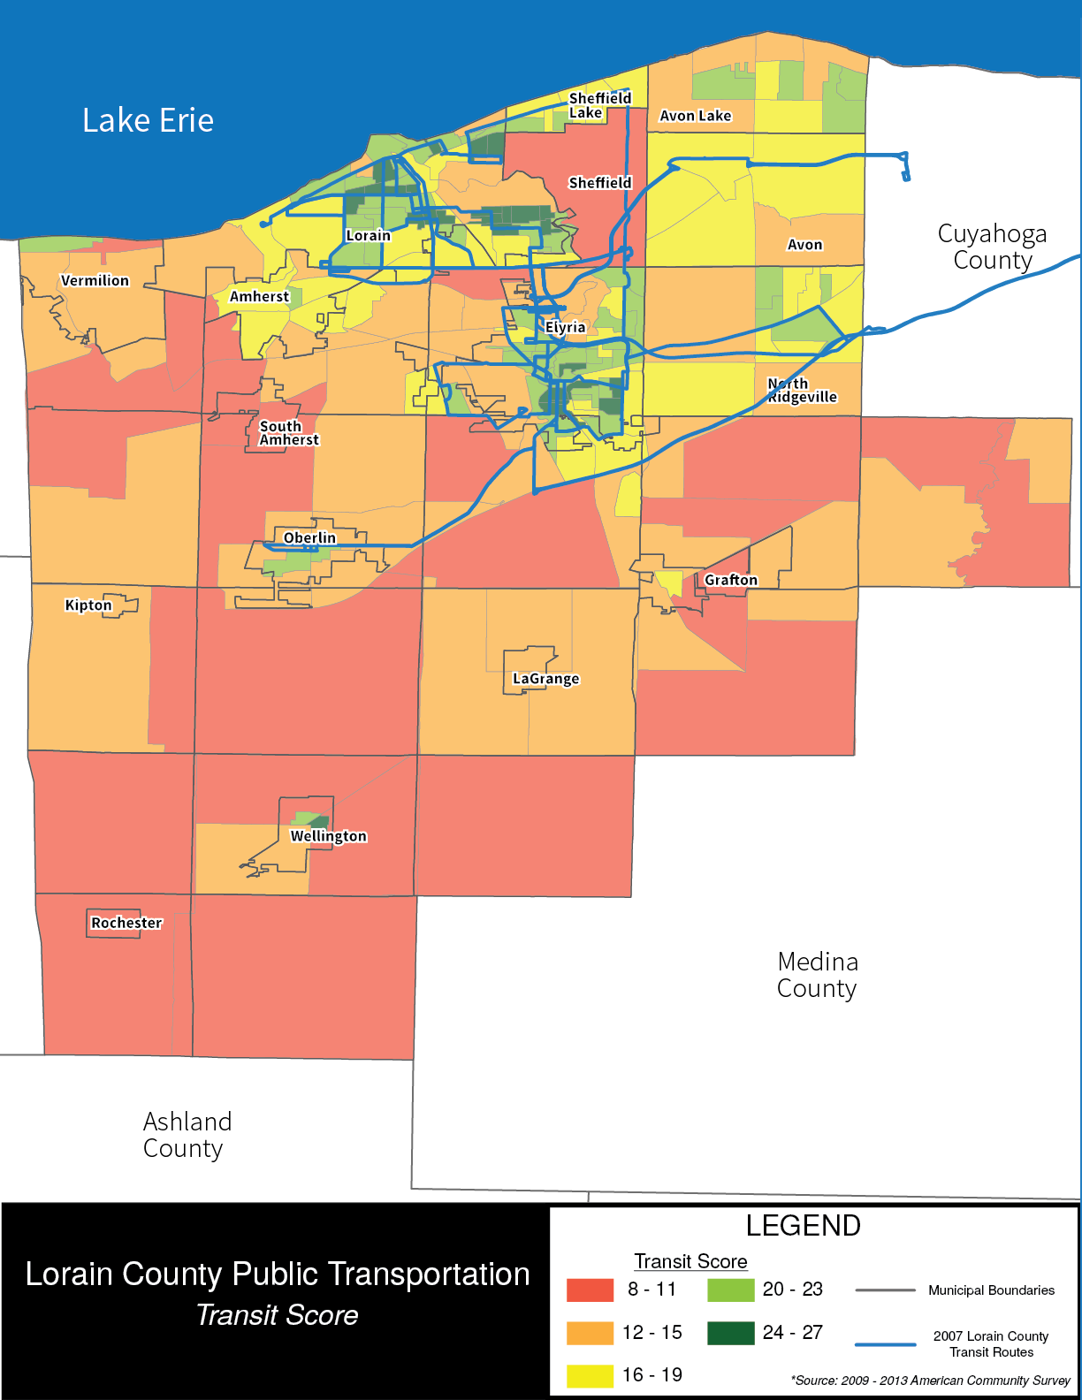
Transit Score 2007 Route Map
Population density
Youth (>18) Population
Senior (65+) Population
Proportion of Zero Car Households
Median Household Income
Proportion of households living below the poverty line

Slide 22
Transit Score 2015 Route Map
Population density
Youth (>18) Population
Senior (65+) Population
Proportion of Zero Car Households
Median Household Income
Proportion of households living below the poverty line

Slide 23
Lorain County Transit Routes 2015

Slide 24
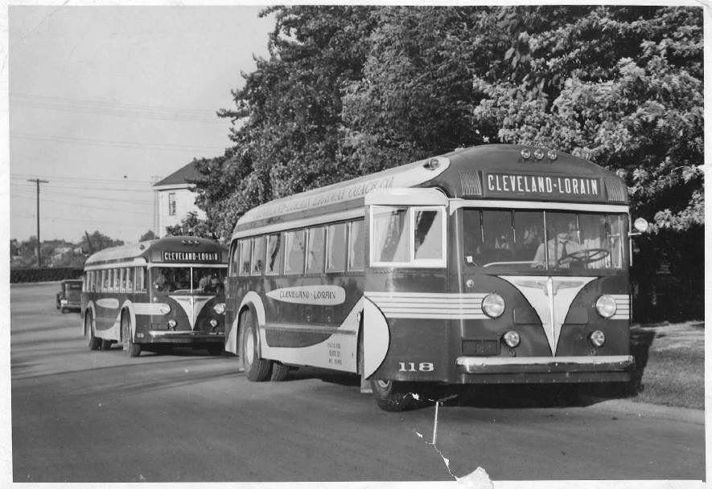
Lorain County Transit Funding and Revenue
Funding Sources | 2009 | 2010 | 2011 | 2012 | 2013 | 2014 | 2015 | Change
Farebox revenue | $468,329 | $157,368 | n/a | $185,251 | $134,577 | $113,556 | $107,691 | - 71.3%
Local general fund | 957,751 | 175,974 | n/a | 193,351 | 362,185 | $368,392 | $142,220 | - 62.2%
State funding sources | 337,018 | 283,977 | n/a | 231,311 | 131,362 | $109,500 | $99,595 | - 61.0%
Federal (social agency) | 2,264,022 | 967,574 | n/a | 955,445 | 1,012,689 | $607,427 | $665,855 | - 55.2%
Other grants | 83,456 | 1,329 | n/a | 0 | 0 | $0 | $0 | - 100%
Total | $4,110,576 | $1,586,222 | n/a | $1,565,358 | $1,640,813 | $1,085,319 | $1,015,361 | - 61.1%
Source: National Transit Database FY 2010 through 2013; Lorain County Transit, 2014-2015.

Slide 25
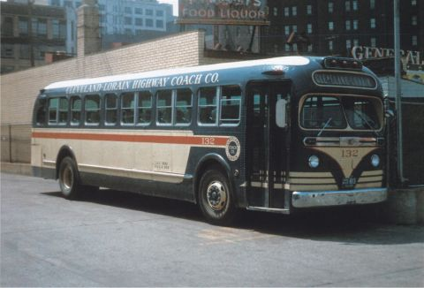
Lorain County Transit Service Trends
 | 2009 | 2010 | 2011 | 2012 | 2013 | 2014 | 2015 | Change
Annual Passengers | 602,298 | 107,360 | n/a | 75,405 | 70,152 | 56,574 | 49,965 | -91.7%
Revenue Hours | 65,508 | 17,911 | n/a | 12,956 | 14,268 | 12,422 | 12,603 | -80.7%
Revenue Miles | 1,159,218 | 164,557 | n/a | 182,250 | 230,440 | 151,540 | 160,755 | -86.1%
Peak Vehicles | 28 | 5 | n/a | 7 | 5 | 5 | 5 | - 82.1%
Source: National Transit Database FY 2009 through 2013; LCT 2014-2015

Slide 26
Transit in Lorain County
Lorain County is under-served
Lorain County has high transit propensity populations
Lower Income Students Disabled
Elderly Minorities No Car
Key destinations are not being served
Transit is under-funded
Lost federal funding due to lack of local match
Lost ridership and farebox revenue because of low service levels
Little or no state funding support

Slide 27
Where do we go from here?

Slide 28
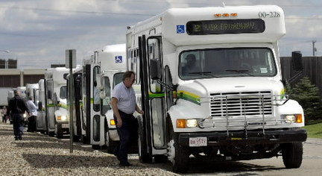
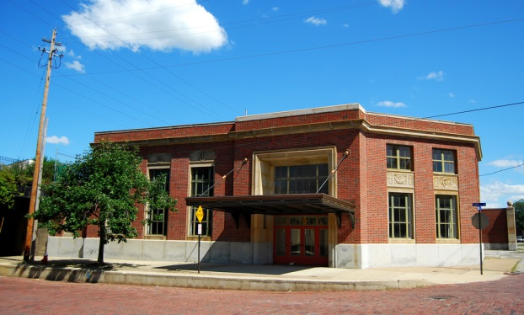
What’s Next?
Examine current conditions overview
Peer agency comparison
Lorain County Transit needs assessment
Present findings to community
Determine level of support for transit investment
Design a transit program that fits community desires and aspirations
Present suggested transit program to community

Slide 29
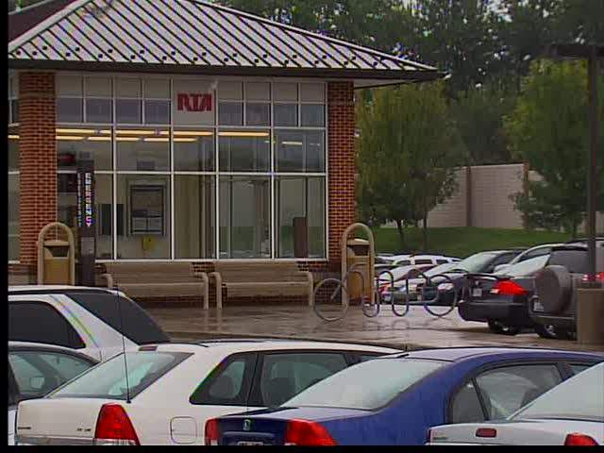
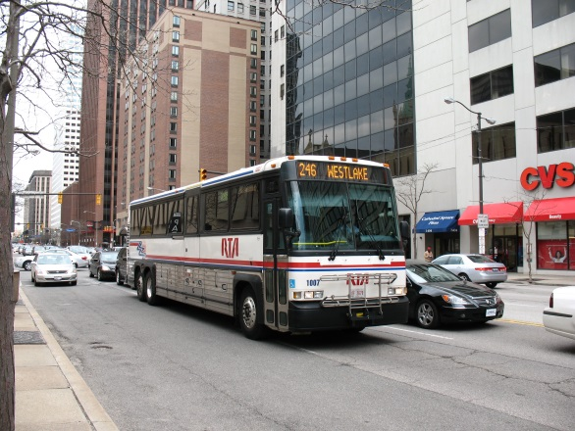
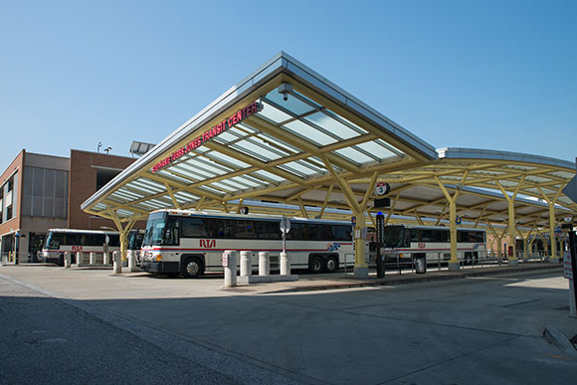
Community Outreach
Key Themes
Grow the Lorain County Transit system
Expand business / government partnerships
Network design connecting communities
More coordination with transit agencies outside Lorain County

Slide 30
Thank You
Ken Sislak
kenneth.sislak@aecom.com

