Slide 1
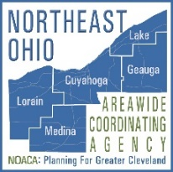
Lorain County
Chamber of Commerce
Grace Gallucci
Executive Director
April 26, 2017

Slide 2
What is NOACA … and what does it do?
NOACA is the federally designated metropolitan planning organization (MPO) for northeast Ohio
Conducts multi-modal transportation & environmental planning for a five-county region
Determines how federal transportation dollars are spent
Conducts transportation-related air quality planning and public education activities
Functions as the “areawide” water quality planning agency for the region

Slide 3
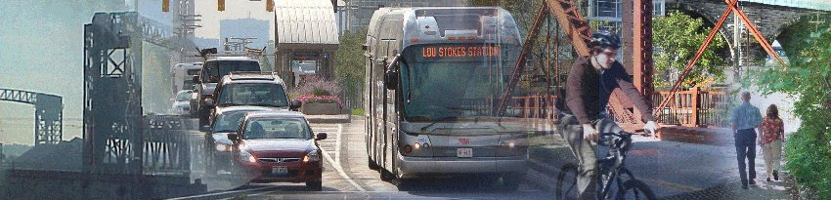
NOACA Vision Statement
NOACA will STRENGTHEN regional cohesion, PRESERVE existing infrastructure, and BUILD a sustainable multimodal transportation system to SUPPORT economic development and ENHANCE quality of life in Northeast Ohio.

Slide 4
Strategic Direction
Vision lends itself naturally to five goals:
STRENGTHEN
regional cohesion
PRESERVE
existing infrastructure
BUILD
a sustainable multimodal transportation system
SUPPORT
economic development
ENHANCE
quality of life in Northeast Ohio
Photo Source: Lorain Port Authority

Slide 5
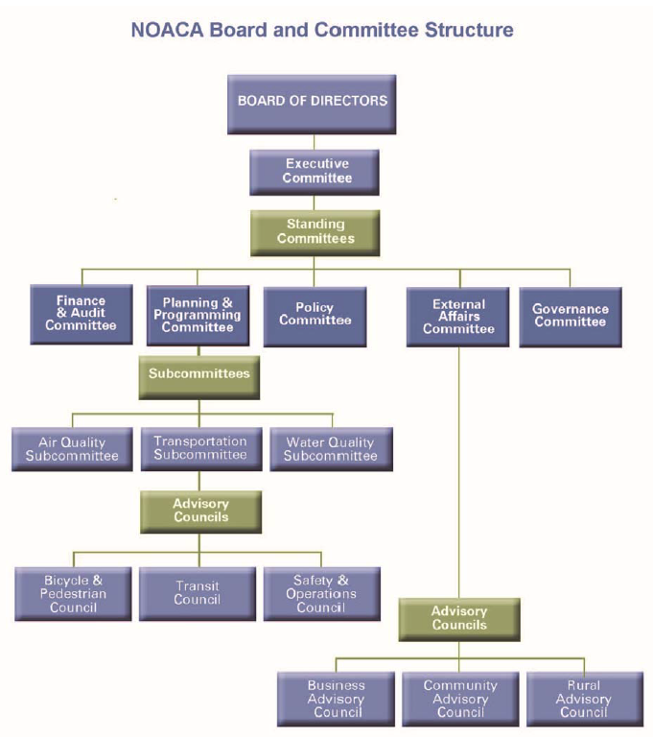
How is NOACA Organized?
Board of Directors (45 elected/appointed officials)
Committees
Subcommittees
Advisory Councils

Slide 6
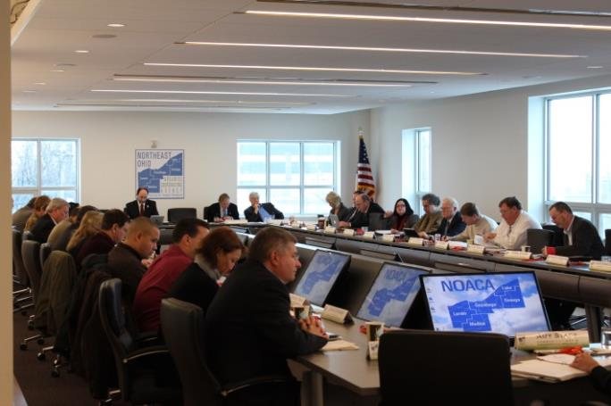
Lorain County Board Members
Holly Brinda, Mayor, City of Elyria
Kenneth P. Carney, Sr., P.E., P.S., Lorain County Engineer
Richard Heidecker, Trustee, Columbia Township; NOACA Assistant Secretary
John D. Hunter, Mayor, Sheffield Village
Ted Kalo, County Commissioner; NOACA Immediate Past President
Matt Lundy, County Commissioner
Chase M. Ritenauer, Mayor, City of Lorain
Notes:
Also recognize Alternates –
Lorain County
(1) County Commissioner (County Engineer) – Kenneth P. Carney, Sr., P.E., P.S.
Alternate: Robert Klaiber Jr., PE, PS, Deputy Engineer
(2) County Commissioner – Ted Kalo
Alternate: Betty Blair, former County Commissioner
(3) County Commissioner – Matt Lundy
Alternate: John D. Hunter, Mayor, Sheffield Village
(4) City of Lorain – Chase M. Ritenauer, Mayor
Alternate: Daniel Rodriguez, P.E., Deputy Director of Engineering
(5) City of Elyria – Holly Brinda, Mayor
Alternate: Timothy Ujvari, P.E., P.S., City Engineer
(6) Municipal Representative – G. David Gillock, Mayor, City of North Ridgeville
Alternate: John D. Hunter, Mayor, Sheffield Village
(7) Township Representative – Richard Heidecker, Trustee, Columbia Township
Alternate: Mark Cunningham, Trustee, Columbia Township

Slide 7
Core Functions
3C planning process
Comprehensive, cooperative & continuing process for transportation
Air quality (Transportation-related)
Major planning efforts
Long-range transportation plan (LRTP)
Transportation Improvement Program (TIP)
Overall Work Program (OWP)
Project programming & funds management
Maintenance of regional water quality management plan

Slide 8
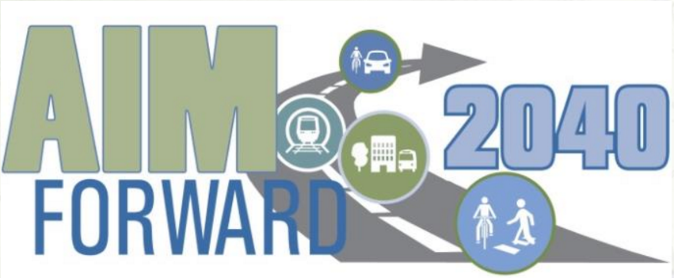
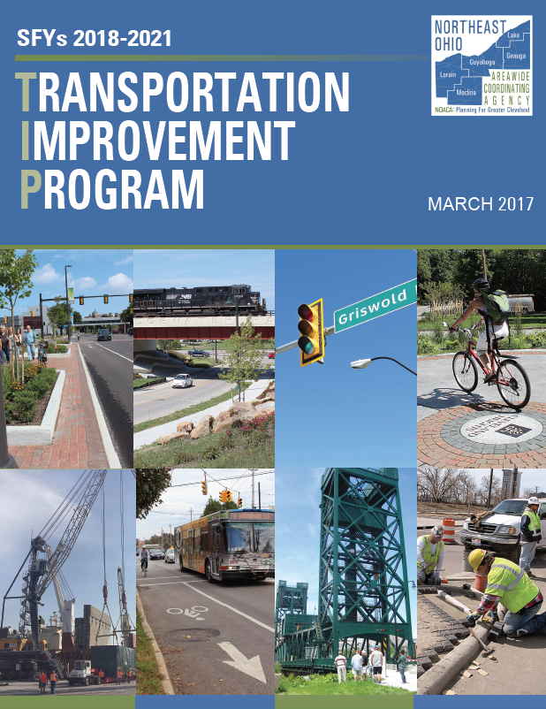
Transportation Plan and Transportation Improvement Program
Long-range Transportation Plan: The framework for transportation planning and programs over 20 years
DRAFT: AIMForward 2040 (2017)
Transportation Improvement Program:
Four-year capital improvement program that implements the vision of the long-range plan
DRAFT: SFY 2018-2021 TIP (2017)

Slide 9
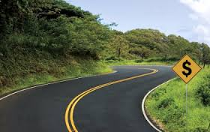
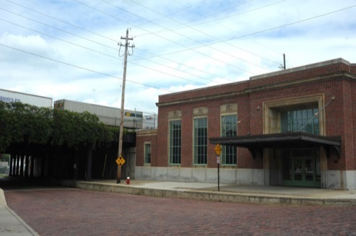
NOACA Programs
Surface Transportation Program ($31 M annually): Funds for general road & bridge rehabilitation and safety projects, transit capital and operational projects, and planning.
Transportation Alternatives Program ($3.1 M annually): Funds for pedestrian and bicycle facilities, safe routes for non-drivers, community improvement activities, preservation of historic transportation facilities, and environmental mitigation.

Slide 10
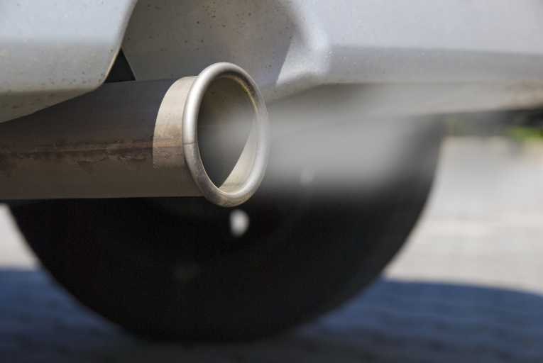
NOACA Programs
Statewide Congestion Mitigation and Air Quality Program ($15 M historic allocation): Funds for projects that reduce congestion and improve air quality for areas that do not meet NAAQS.
Outreach and Education
NOACA Rideshare
Congestion Reduction / Traffic Operations
NOACA STOP Program
Transit Vehicles, facilities, and service improvements
Bicycle Facilities
Alternative and Cleaner Burning Fuels

Slide 11
NOACA Programs
Transportation For Livable Communities Initiative (TLCI)
Planning Studies ($500 K annually): Helps local communities do local planning through grants and other assistance
Implementation Grants ($1.5 annually): Low-cost capital projects that implement TLCI or local planning study recommendations
Technical Assistance: NOACA staff led community transportation planning projects

Slide 12
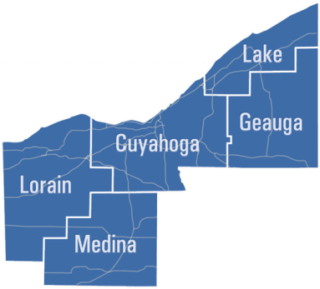
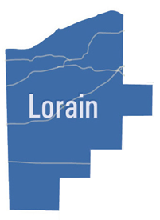
DRAFT 2018-2021 TIP All Funds
Summary ($M)
 | 2018 | 2019 | 2020 | 2021 | Total
Region | $678 | $360 | $306 | $248 | $1,592
 | 2018 | 2019 | 2020 | 2021 | Total
Lorain | $93 | $42 | $33 | $27 | $195

Slide 13
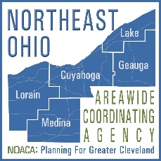
DRAFT 2018-2021 NOACA Funds
Summary ($M)
 | 2018 | 2019 | 2020 | 2021 | Total
Lorain | $11.9 | $5.6 | $2.8 | $2.2 | $22.5
Notes:
Builds on the $7.8 M committed for project delivered in 2015

Slide 14
NOACA Existing & Draft TIP Projects
Roadway Projects
Project | Location | SFY | $ (m)
EXISTING TIP PROJECTS:
Center Ridge Road (US20) Widening | North Ridgeville | 2018 | $5.5
Center Street (SR301) | Lagrange | 2018 | $2.1
Baumhart Road Rehabilitation | Lorain | 2019 | $2.3
Cooper Foster Road Improvements | Lorain / Amherst | 2019 | $2.0
DRAFT TIP RECOMMENDED PROJECTS:
East River Road Rehabilitation | Sheffield | 2018 | $1.0
North Ridge Road | Lorain, Elyria/Sheffield Twps | 2019 | $1.1
Chestnut Ridge Road | Elyria | 2019 | $0.7
Oberlin-Elyria Road | Carlisle Township | 2020 | $1.3
TOTAL |  |  | $16.0

Slide 15
NOACA Existing & Draft TIP Projects
Transportation Alternatives Projects
Project | Location | SFY | $ (m)
EXISTING TIP PROJECTS:
Beaver Creek Trail Phase IB | Lorain County Parks | 2017 | $0.7
Black River Trail Phases III | Lorain County Parks | 2017 | $1.2
Black River Trial Phases IV C | Lorain County | 2018 | $1.2
DRAFT TIP RECOMMENDED PROJECTS:
Oberlin Trailhead (Gasholder House) | Oberlin | 2018 | $0.3
Broadway Avenue Enhancements | Lorain | 2020 | $1.5
TOTAL |  |  | $4.9

Slide 16
Lorain County Current Projects
Studies:
Lorain County Transit Redevelopment Plan
Lorain County Lakefront Connectivity Plan
Implementation:
Downtown Revitalization and Connectivity, Elyria
Town Center Crosswalk Enhancements, North Ridgeville

Slide 17
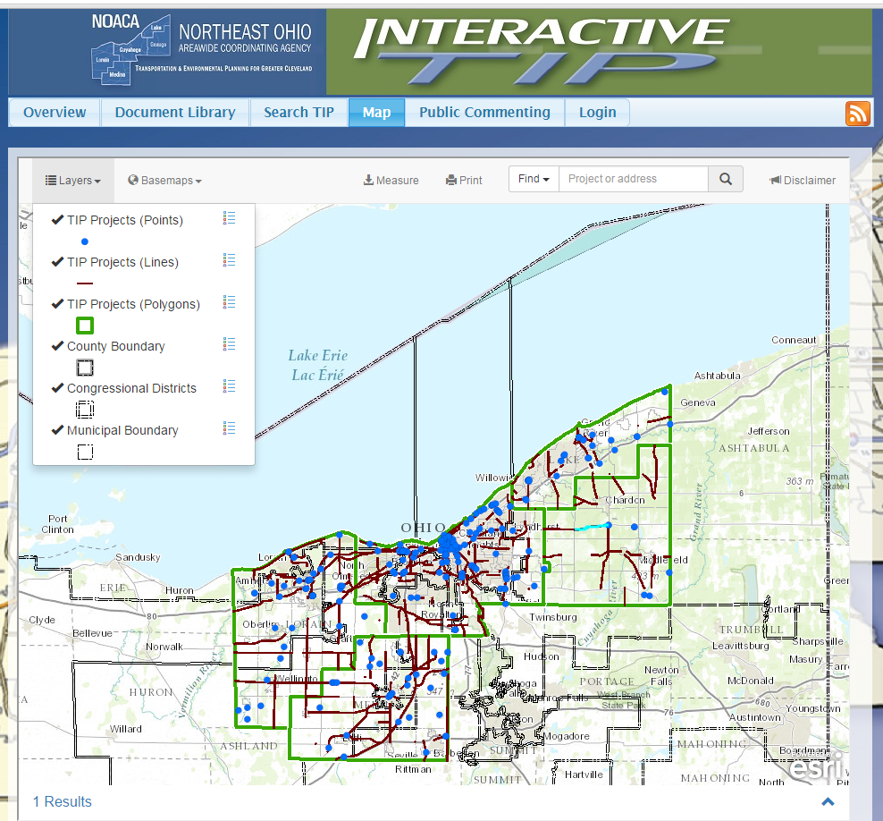
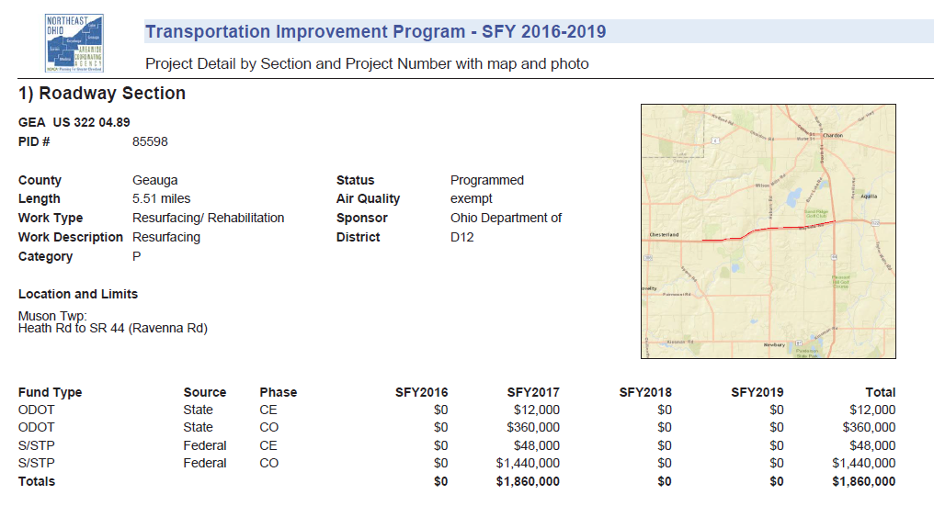
NOACA Interactive TIP Tool
NOACA Services Available to Lorain County and Northeast Ohio
Available Information
Project Name
Location
Sponsor Agency
Project Work Type and Description
Funding
Geographic
Congressional District
County
Municipal
Detailed Project Report

Slide 18
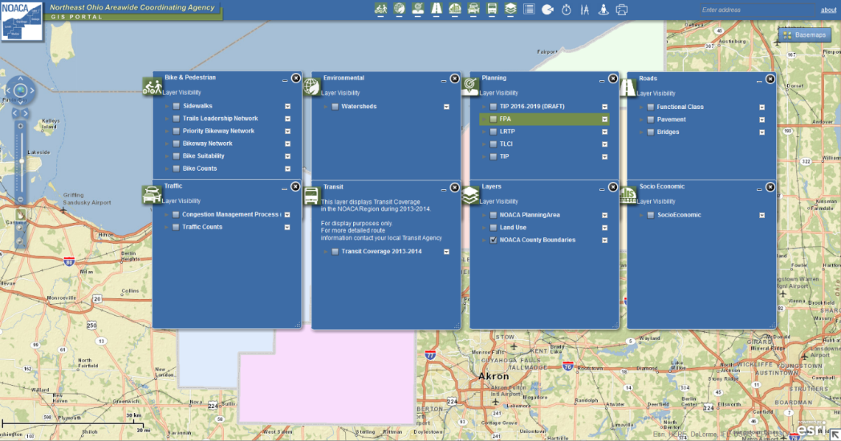
NOACA Services Available to Lorain County and Northeast Ohio
NOACA GIS Portal:
Socio-economic data
Pavements
Bridges
Traffic and bike volumes
Roadway functional classification
Watersheds
Bike Network
… and much more

Slide 19
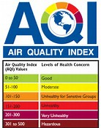
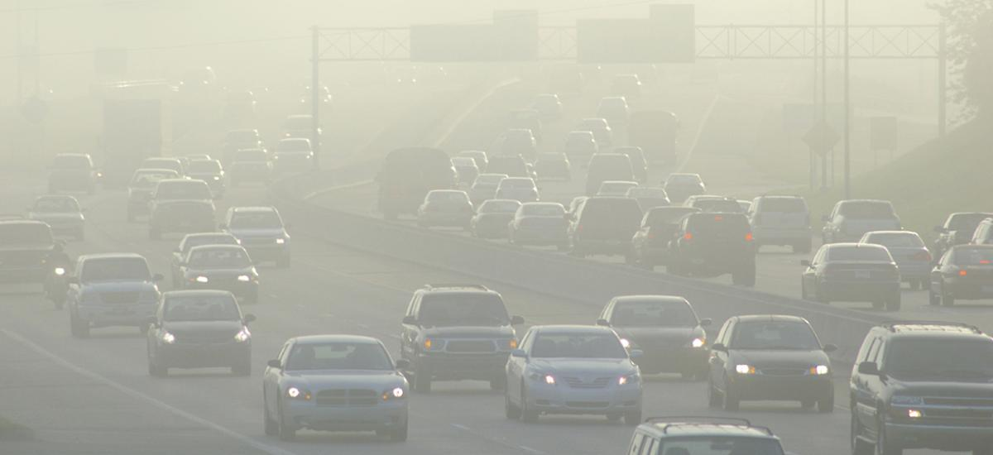
NOACA Services Available to Lorain County and Northeast Ohio
Ozone Action and NOACA Air Quality Programs: Works to educate the public and state lawmakers about air quality issues and practical ways to help clean the air

Slide 20
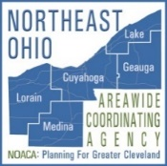
Gohio Commute A Smarter Way
NOACA Services Available to Lorain County and Northeast Ohio
NEW statewide website (mobile friendly)
Created by NOACA and other Ohio MPOs
Combines trip planning and ride matching into one convenient tool
Employers can create “subsites” - networks to encourage smart commuting and reduce parking demand – NOACA will help you get started!
Find it here: Gohiocommute.com/NOACA
Bike Cleveland Photo
Notes:
Region benefits from fewer drive-alone trips, more alternative commutes, less traffic, cleaner air, and improved public health

Slide 21
NOACA 2017 Annual Meeting Theme: “The Logistics of Regional Transportation”
Friday, September 8, 2017 from 11 a.m. to 2 p.m.
Global Center for Health Innovation
Keynote speaker: Jim Simpson, Chairman, Victory Worldwide Transportation
Register at noaca.org/annualmeeting
Sponsorships and tables available
Bike Cleveland Photo
Notes:
Jim Simpson: Chairman, Victory Worldwide Transportation, Inc.; former Commissioner of NJ DOT, head of Federal Transit Administration & NY Metropolitan Transportation Authority

Slide 22
Thank You
Visit NOACA at www.noaca.org for information on programs, services and contacts

