Slide 1
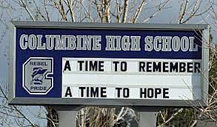

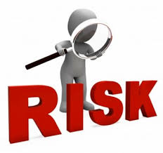

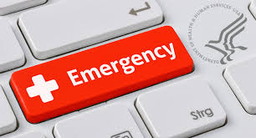

Crisis Communications
Lorain County Safety Council CEO Breakfast

Slide 2

What You Might Face
Active shooters
Contract scandals
Criminal accusations
Data loss
Discrimination complaints
Embezzlement
Environmental violations
Explosions
Fraud
Fiscal mismanagement
Hacker attacks
Inappropriate social media posts
Lawsuits
Legal malpractice
Partner disputes
Product failures
Reputational threats
Sexual misconduct
Structural failures
Terrorist incidents
Thefts
Union grievances

Slide 3
Crisis vs. Issue
Crisis
Unexpected and unpredictable
Victims
Require response in moment
“Explosive, unplanned visibility”
Issue
Known or planned
Normal executive activity
More control of outcome

Slide 4
“When written in Chinese, the word crisis is composed of two characters: one represents danger and the other represents opportunity.”
---- John F. Kennedy

Slide 5
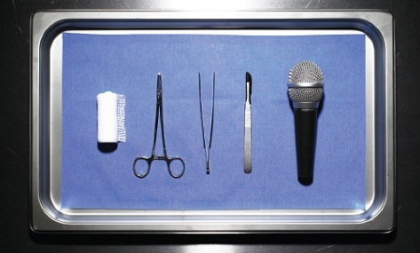
Crisis Communications
When the media turns their cameras on you
Who we are
What we do

Slide 6
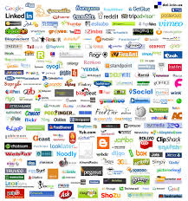




Legal controversies today are tried in the
Court of Public Opinion – as often as in
the Court of Law.
@crisiscomm

Slide 7

The Damage Control Playbook
Rule #1: Tell the truth
Rule #2: Tell it first
Rule #3: Tell it all
Rule #4: Tell it fast
Rule #5: Tell it to the people who matter most

Slide 8
What you mean, what it says
Let’s eat, Grandma.
Let’s eat Grandma

Slide 9

The Three Vs
Villain
Victim
Vindicator

Slide 10
No Comment = Guilty

Slide 11

Framing Issues
What happens when you ARE the Villain?

Slide 12
How to say, ‘I’m sorry’
Candor
Remorse
Commitment to change
Sincerity
Reflection of organization’s values

Slide 13
Sorry works
Research on hospitals: Litigation reduced after apologies
NY Times: At VA in Kentucky, malpractice suits decreased after full-disclosure and apology policy
Leading healthcare law firm: “…transparency in the healthcare system has become a fixed concept and appears to be here to stay.”

Slide 14
Sorryworks.net
Not admission of liability; effort to empathize with wronged party.
Effective apologies address the recipients’ feelings. They don’t prove a point.
Vow to find out what went wrong
Promise to fix it
Promise customer service assistance
Do NOT prematurely admit fault or assign blame
Do NOT use weasel words: “Well, I’m sorry people were offended.” “Well, I’m sorry people feel that way.”

Slide 15
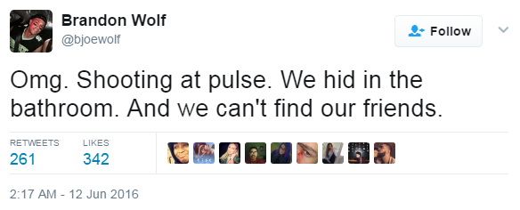
Why Social Media Matters
Because that’s where the news is.

Slide 16
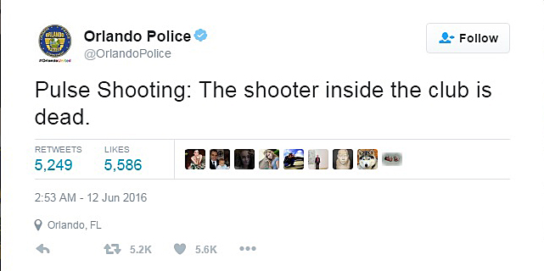
Why Social Media Matters In A Crisis
Because that’s where the newsmakers are.

Slide 17



310 million monthly active users
500 million tweets per day – 6,000 per second.
6-in-10 Twitter users get news there. (Pew – 2016)
54 percent of Twitter news consumers went there looking for it (highest of popular social media; FB only 38 percent)
Journalists make up 24.6 percent of verified accounts.
60% of consumers expect brands to respond to a Twitter query within the hour.

Slide 18
Largest social network
1.13 billion daily active users worldwide, including 67 percent of U.S. adults
Two-thirds of users get news on the site (Pew – 2016)
How we tell friends about stuff: 81 percent of all content shared in U.S. is shared on Facebook.
Great for distributing & receiving info during a crisis - if your following is established.

Slide 19
Before the Crisis: Be Social
Know where your audience lives
Secure your accounts
Establish terms of use
Establish social media guidelines
Build a following, promote interaction
Post a variety of content regularly

Slide 20
Evaluating the Social Media Threat
Where did the threat originate?
Who’s the source?
Is it catching fire online?
Are conventional media involved?

Slide 21
Winning on Social Media: Approach
Transparent
Responsive
Speed - Beware “confirmation bias”
Words + Action
Professional – and human

Slide 22
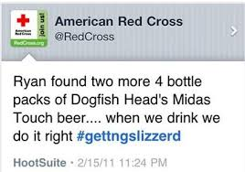
A Crisis In The Making

Slide 23
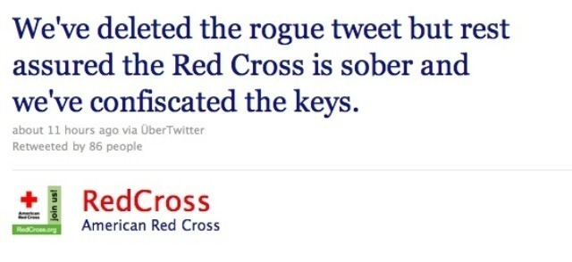
A Crisis Averted

Slide 24
Winning on Social Media: Action Steps
Monitor and be prepared to respond
Don’t let mistakes live on
Don’t arm wrestle with trolls
Pause before hitting “delete”
Go offline to get back on track
Know who’s running the site
Know your online audience

Slide 25
Winning on Social Media: Action Steps
Don’t forget your traditional audiences
Inform your traditional key internal and external audiences of the issue so they are not surprised by media coverage or their own social media feeds.

Slide 26
Response Decision Tool
SCENARIOS
Should you respond proactively? | Should you respond reactively? |  | Should you redirect the conversation? | Should you respond personally?
DECISION-MAKING CRITERIA
You want to reinforce the company’s purpose and values | You want to communicate “just the facts” | You want to redirect the conversation to the entity most responsible for information on a breaking issue (e.g. first responders, police) |  | You want to respond personally, supporting company messages
You want to correct misinformation or disinformation | You want to correct misinformation or disinformation | While specific posts do not call out or tag your company name, they require factual clarification about one of your products |  | Personal social media connections, friends and or community partners expect the family to respond on an issue
You want to respond in tandem with a partner, supplier, vendor, etc. | You want to make sure controversial posts “do no harm” to the company brand | You want to redirect the conversation to an issue that is positive, unifying and beyond reproach, but an issue that everyone agrees on (e.g. success, fulfillment, wellness) |  | You want to respond personally, though the company has elected not to respond
You want to advance a cause (e.g. a cause consistent with your company’s values) |  |  |  | You are tagged in social media posts and want to respond.

Slide 27
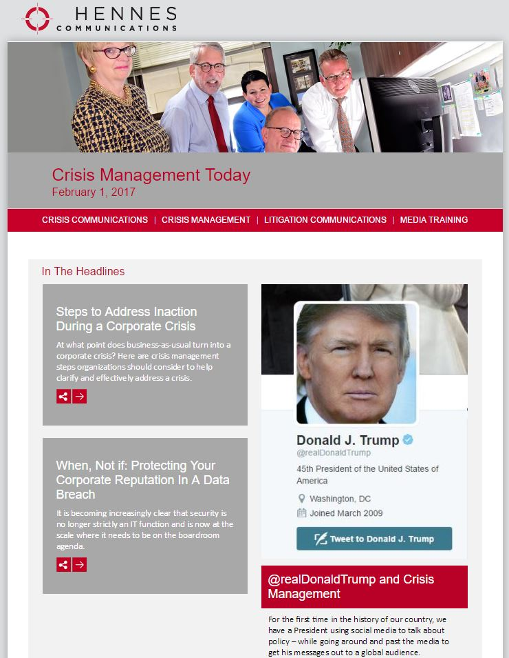
Crisis Management Today
The Hennes Communications Newsletter
Twice a month, best practices for crisis communicators.
For a free subscription, send your email address to
hennes@crisiscommunications.com

Slide 28
Hennes Communications
Crisis Communications
&
Reputation Management
Presented by Thom Fladung
Crisis Communications
Litigation Communications Support
Reputation Management
Hennes Communications Crisis & Reputation Today Newsletter
Twice a month, best practices for attorneys, bar executives & other crisis communicators.
For a gratis subscription, send your email address to hennes@crisiscommunications.com
Follow us on Twitter @crisiscomm and on
Facebook at CrisisComm
@crisiscomm

