Slide 1
Mercy Health
Occupational Health Center
Sherry Harvan RN, BSN * Consortium Coordinator – DOT/BWC * Drug and Alcohol Educator
Train Your Employees to Watch for Substance Abuse
Lorain County Safety Council
05-22-2019

Slide 2
We love where we live
There are good reasons we live here, work here and make a life here
However,
Every community has a darker side

Slide 3
Is the Substance abuse Problem all that bad?
Of the global supply of illicit drugs, the U.S. consumes 60% (OHS, 2019)
The State of Ohio still ranks 2nd in the nation for drug related deaths (CDC, 2019).
Lorain county sees more than double the national average of heroin and prescription opioid abuse (Altarum, 2017).
77% of all illicit drug users are employed (OHS, 2019)
Occupational Health studies estimate substance abuse annually costs U.S. companies over 81 billion related to: accidents, absenteeism, poor performance, mistakes, theft, equipment and property damage (OHS, 2019).
Substance abuse includes not only illicit drugs but also alcohol
Does the local substance abuse problem affect me?

Slide 4
What can we do about it ?

Slide 5
Watching for substance abuse
In order to initiate a reasonable suspicion DRUG or ALCOHOL test: (triggered by witnessing unsafe behavior)
Observations must be articulatable / documentable
Appearance
Behavior/Mood
Speech
Odor
Evidence of substance
Performance problems
Attendance problems

Slide 6
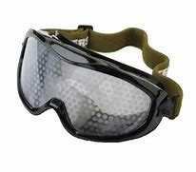
Visual Distortions of alcohol & cannabis

Slide 7
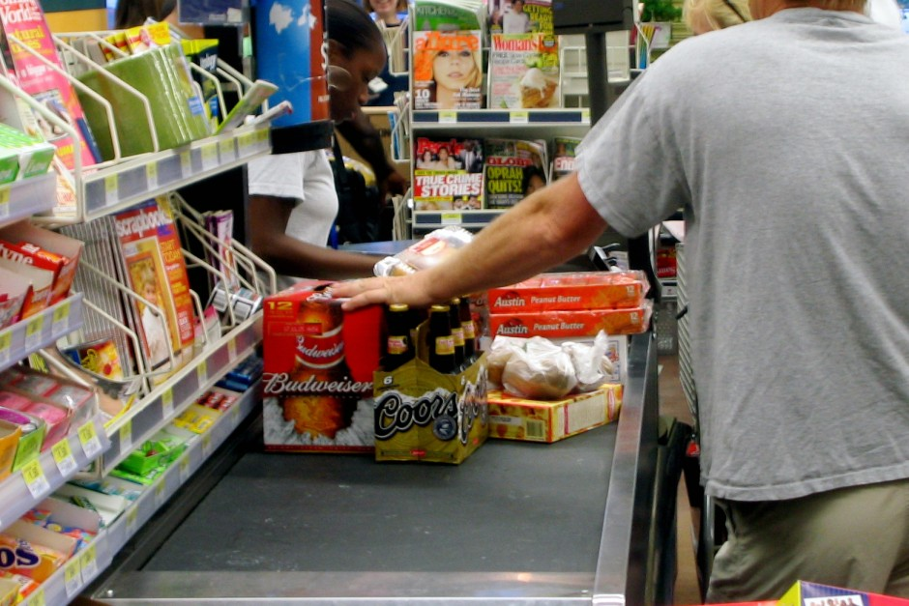
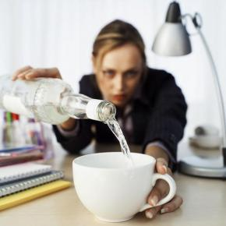
Alcohol
Legal, Accessible, Affordable, No social stigma,
Easiest to abuse
American Culture’s #1
drug of abuse but not most addictive
U.S. Department of Transportation, Federal Motor Carrier Safety Administration (FMCSA). (2018). Drug and alcohol program. Retrieved from https://www.fmcsa.dot.gov/regulations

Slide 8
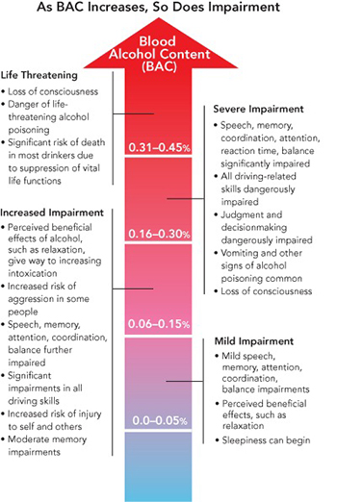
Alcohol
Withdrawal:
Hangover:
Fatigue, Thirst, Nausea
Vomiting, Headache,
Light & Sound Sensitivity
Dizziness
DTs (delirium tremens):
Tremors and
Muscle Cramps
Hallucinations
Seizures

Slide 9
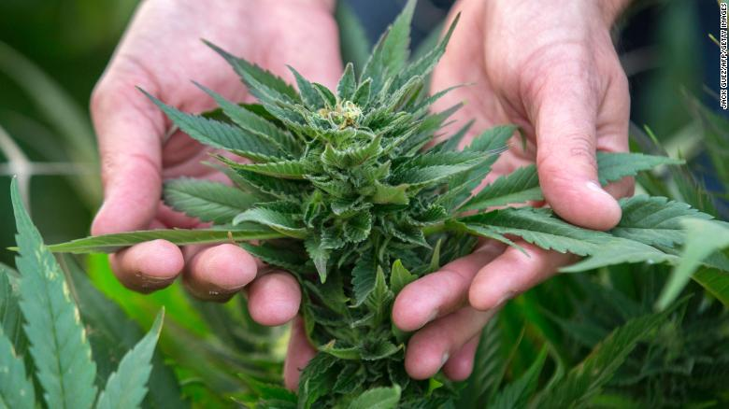
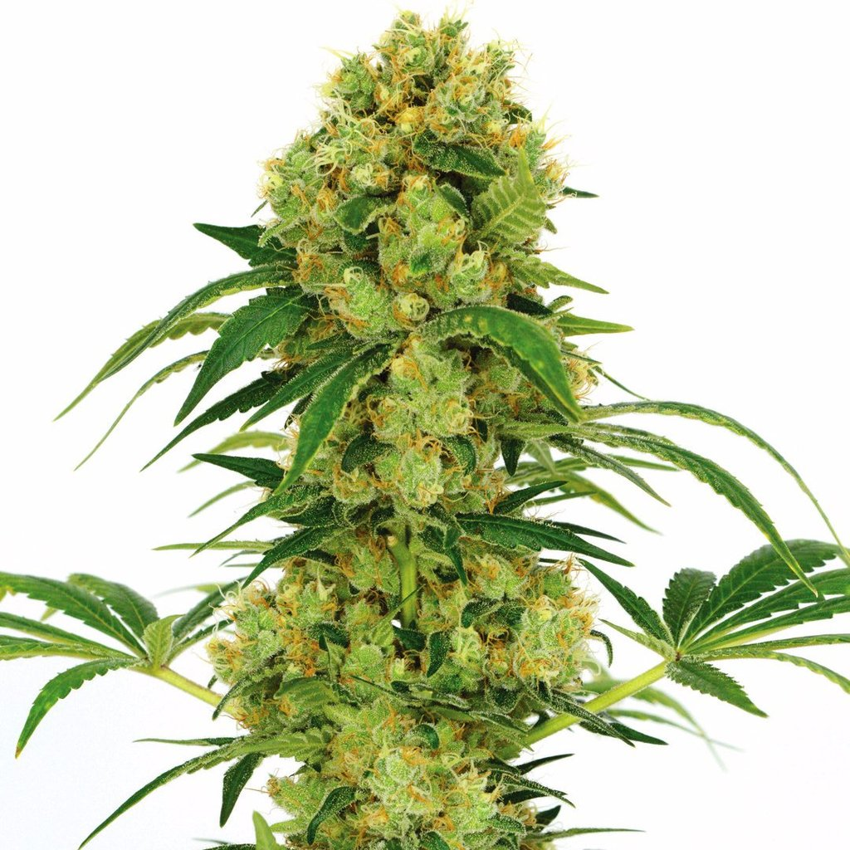
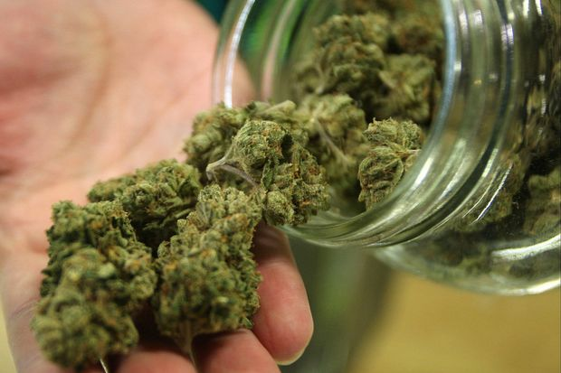
Cannabinoids
-Cannabis plant
-Dried Buds

Slide 10
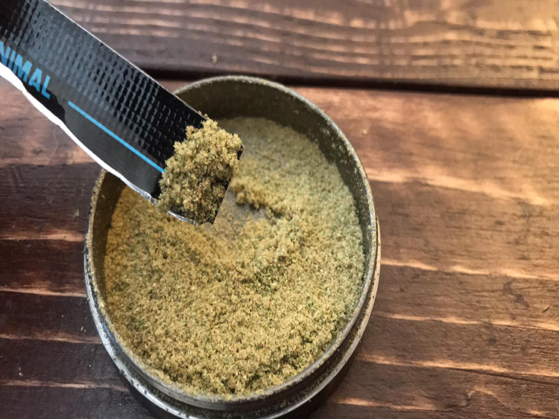
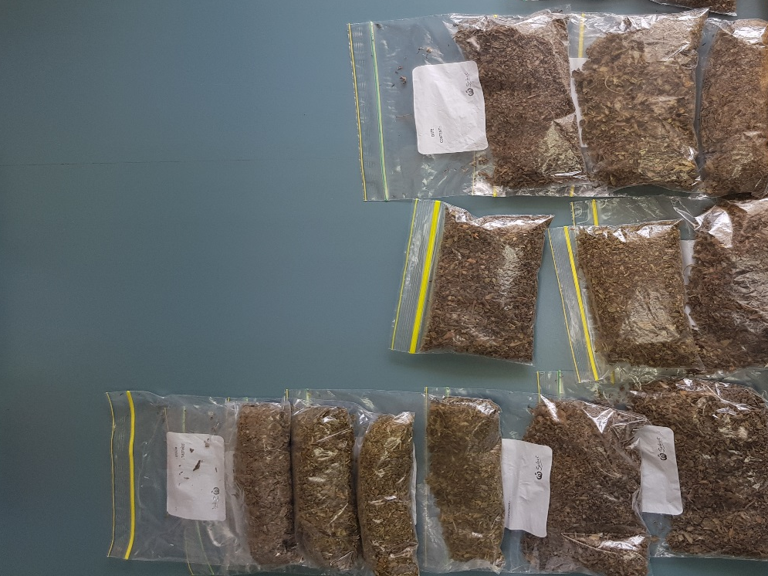
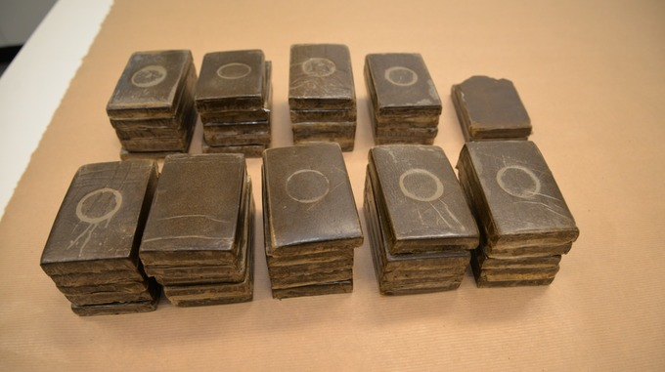
Cannabis packaged to ship & sell

Slide 11
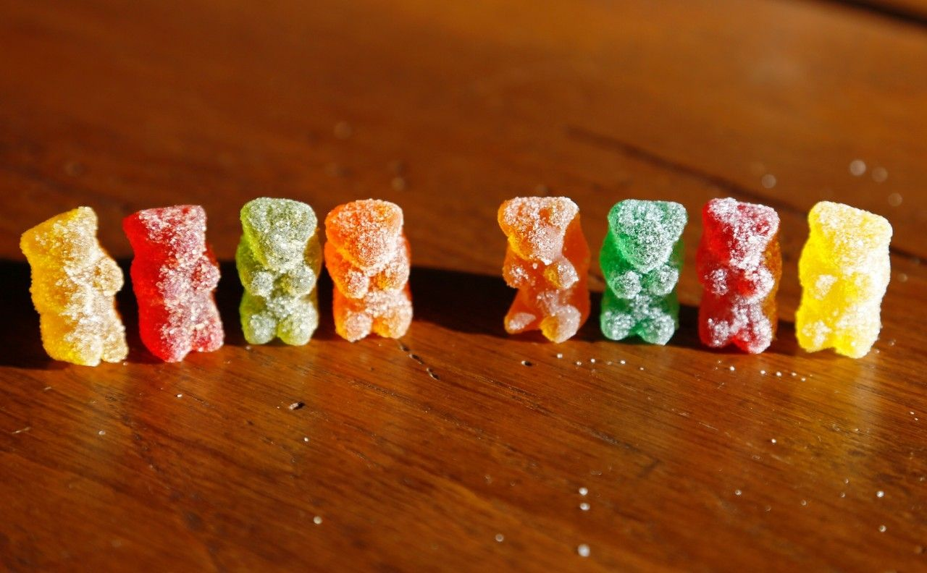
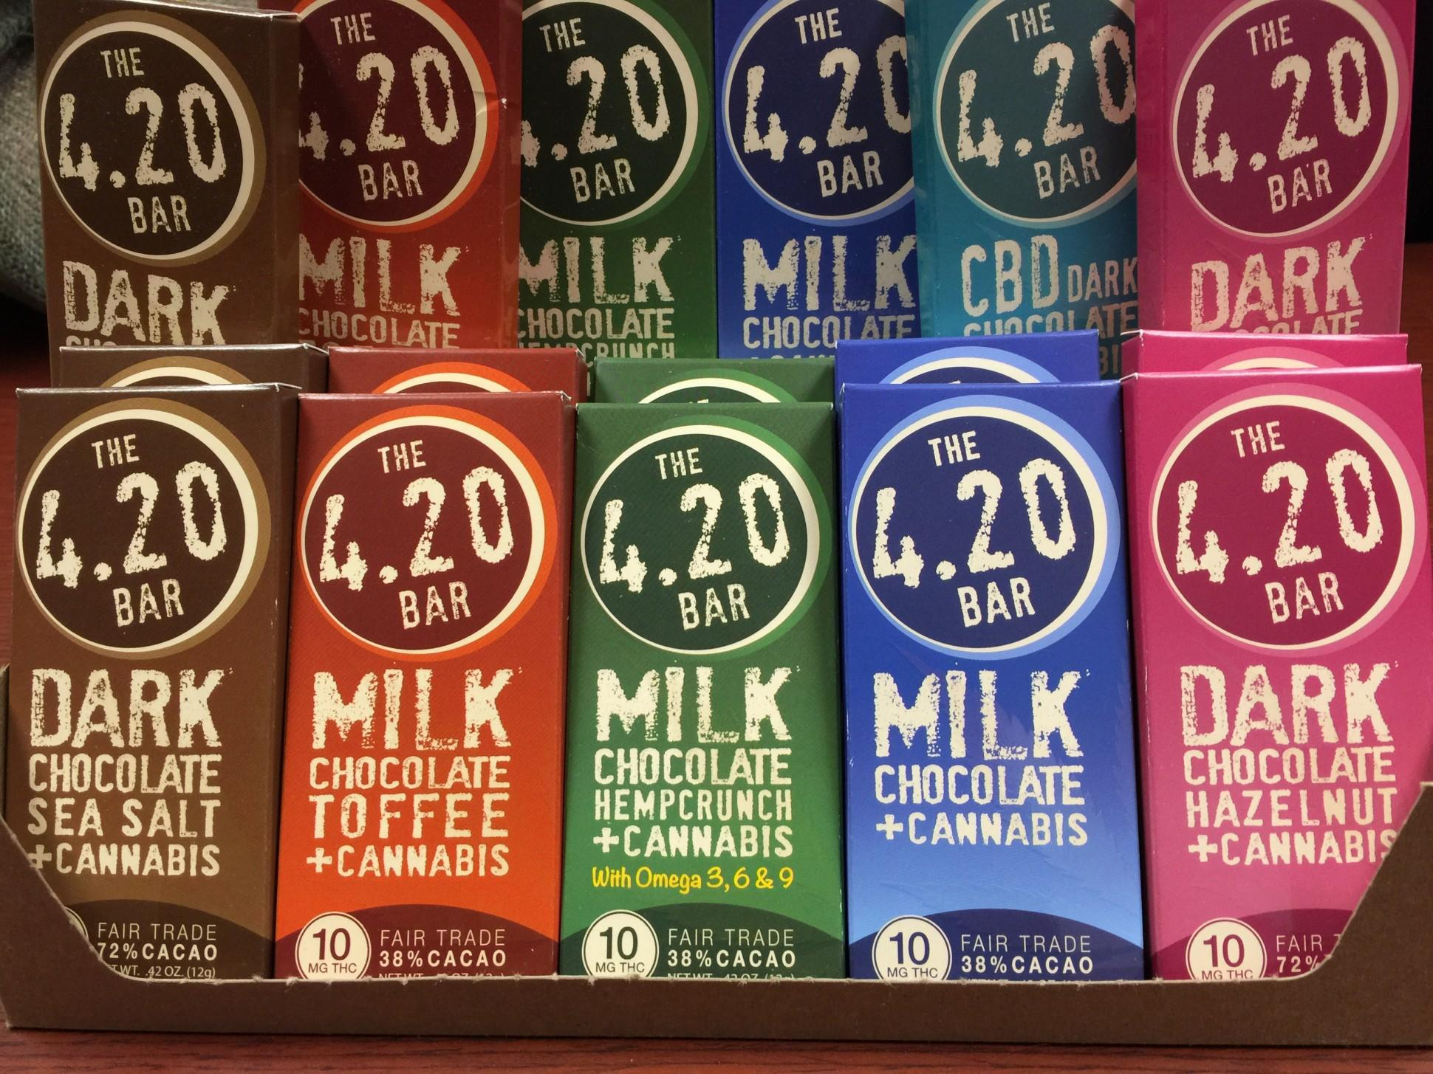
Marijuana Edibles Not easily distinguished from non-cannabis
Feb. 2019- Cleveland, OH – Woman arrested for child endangering because her 9yr old son shared THC gummy bears with 13 friends at his elementary school. J. Steer. (2/5/2019). Fox8 News

Slide 12
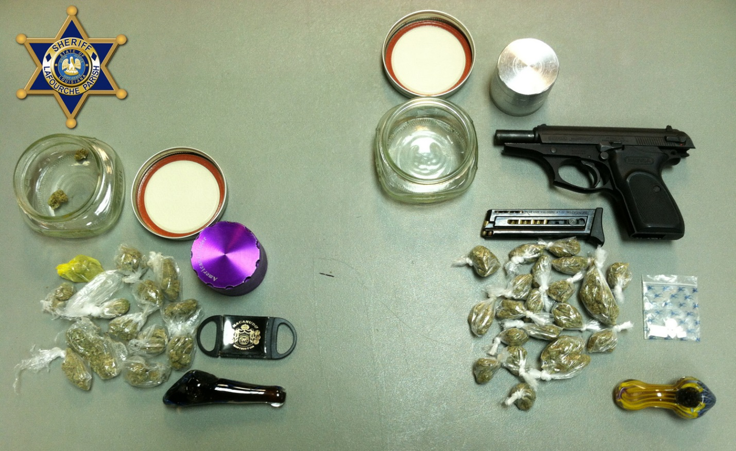
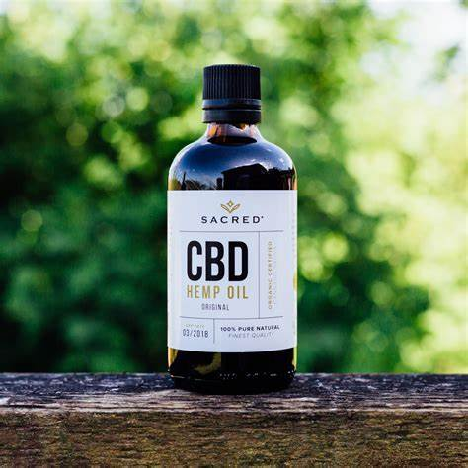
Paraphernalia & Product from a police seizure
-Pot for Individual use
*Now illegal to buy, sell, deliver or possess CBD OILS
Unless registered for medical marijuana use
Houser, S. (2018). CBD oil, sold in stores throughout Ohio, is illegal and can carry a felony charge, WOIO Channel 19 Retrieved from https:www.cleveland19.com/2018/10/10cbd-oil-sold-stores
State of Ohio Board of Pharmacy. (2019). Ohio medical marijuana control program CBD oil faq. Retrieved from https://medicalmarijuana.ohio.gov/Documents/formsmethods

Slide 13
Cannabis
High Withdrawal
-Red eye -stomach problems
-“who cares” -anxiety
-Sleepy - insomnia
-Temporary -memory loss
inability to learn - wide mood swings new things
-Distinct Odor
Estimated 2.7 million Americans dependent
General public barely admits addiction.
Vestal, C. (2018). Marijuana addiction is real but many users don’t realize that. Health & Science. The Washington Post Retrieved from: https://beta.washingtonpost.com/national/health-science/marijuana-addiction

Slide 14
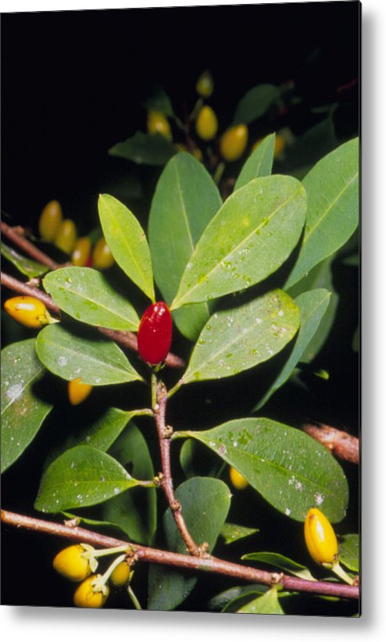
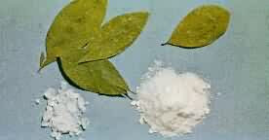
Cocaine
-Coca plant
-Dried coca leaves
-Coca powder/ cocaine

Slide 15
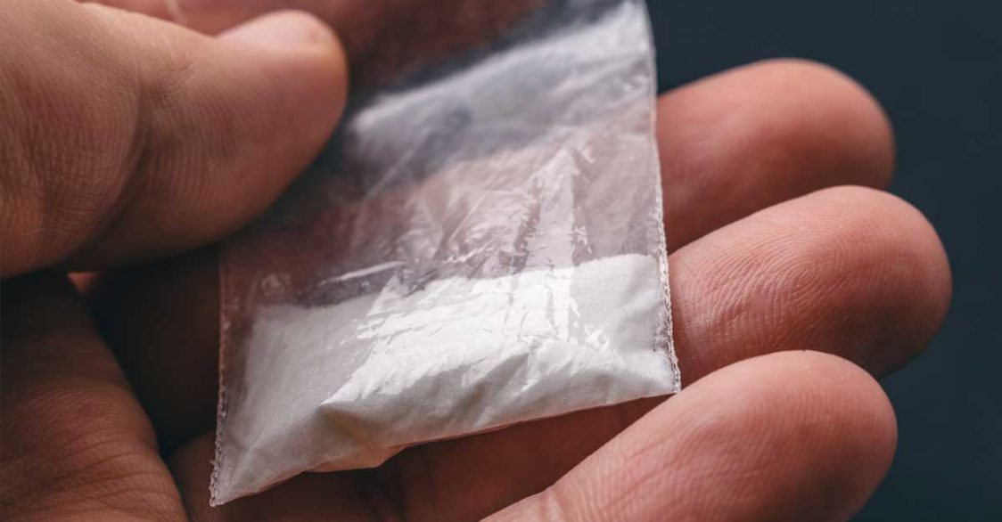
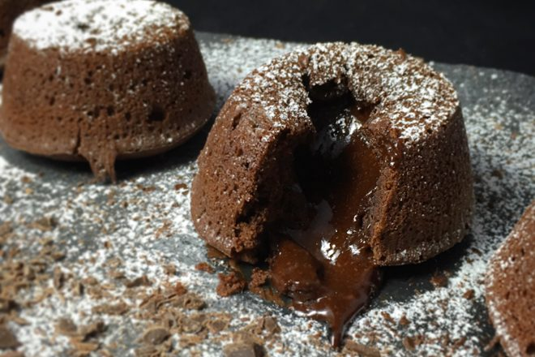
Familiar forms of cocaine

Slide 16
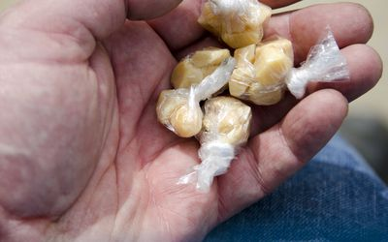
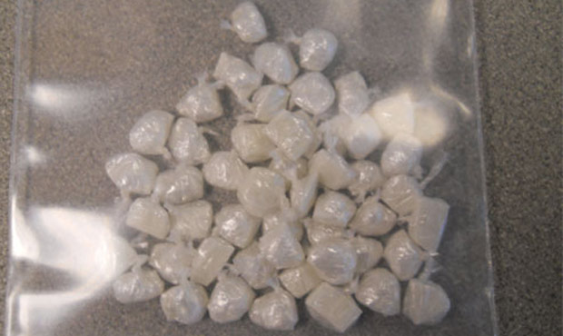
Crack Rocks
Concentrated cocaine
The most addictive drug on the American Black market
U.S. Department of Transportation, Federal Motor Carrier Safety Administration (FMCSA). (2018). Drug and alcohol program.
Retrieved from https://www.fmcsa.dot.gov/regulations

Slide 17
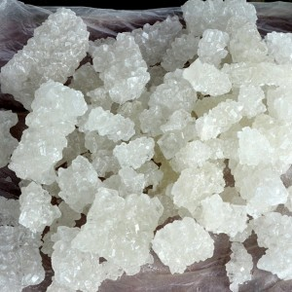
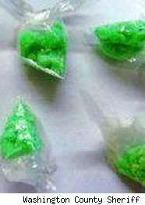
More pure form of crack
-Dyes added for product
Distinction:
- Branding / Mixing

Slide 18
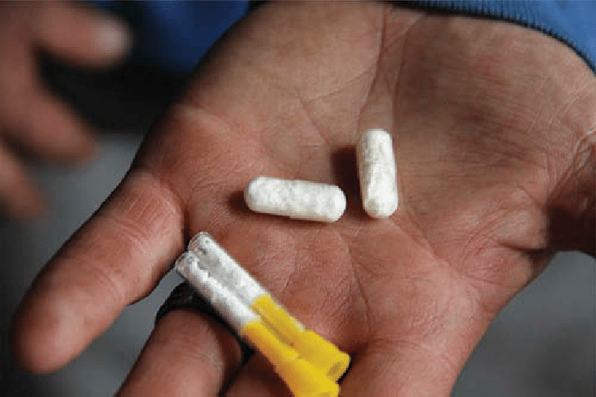
Cocaine- other packaging ideas for distribution

Slide 19
Cocaine
High Withdrawal
Excitable Fatigue
Dilated pupils, flushed face normal pupils
Faster breathing normal breathing
Insomnia “sleep all day”
Feelings of grandeur anxiety, paranoia
Very “talky” withdrawn
Dry mouth, sweaty

Slide 20
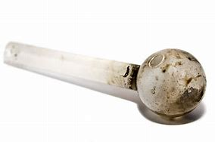
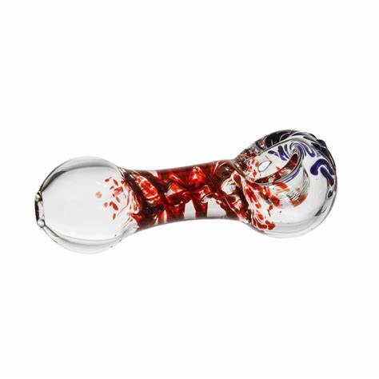
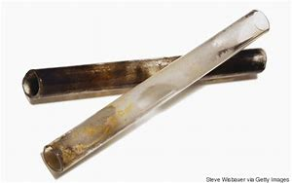
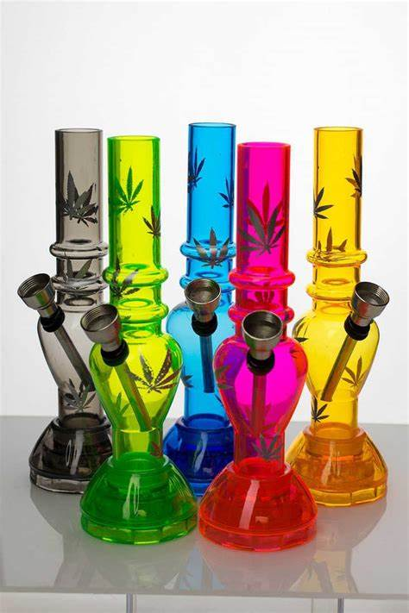
pipes
Pipes: Sold in cannabis novelty shops labeled for smoking tobacco. Mostly used to smoke cannabis, cocaine, heroin and methamphetamine.
Routes: Any mucosal
Surface or Orifice
If snorting – bloody nose
If smoking – chronic cough
If injecting – hides injection sites

Slide 21
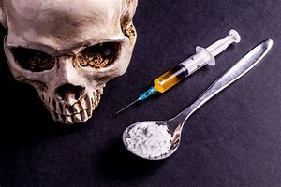
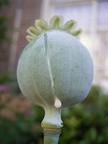
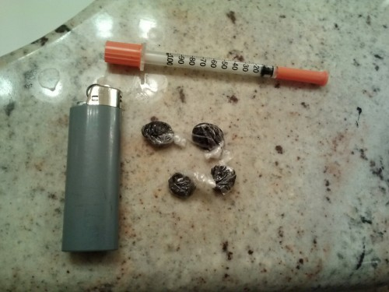
opioids
Heroin- made from
The resin of the poppy
Plant
Typically packaged
In plastic and administered
With an insulin needle
Referred to a “rig”

Slide 22
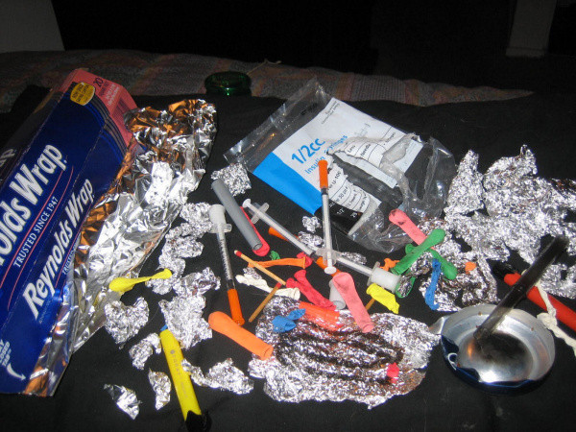
Paraphernalia you might see with heroine, crack, or meth use
-Lots of aluminum
foil in the garbage
-Scorched foil
-Ripped balloons
or plastic wrappers
-Pipes, Syringes
possibly
-Cotton balls

Slide 23
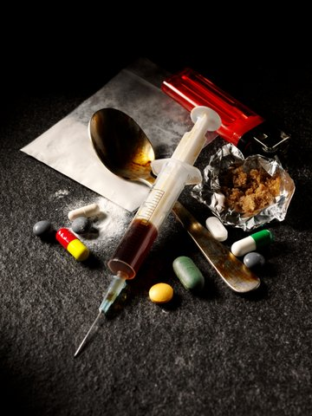
Opioids:
Depressants:
slow the body down,
impaired coordination
sleepy, tired, nodding off cold,
-may wear layers on a hot day
Out of breath
Pale skin, dusky lips
Pin point pupils
Nausea/vomiting

Slide 25
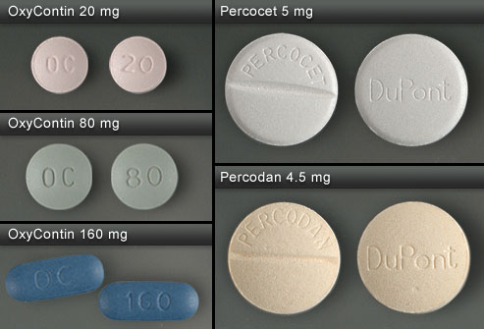
Examples of opioid pills

Slide 26
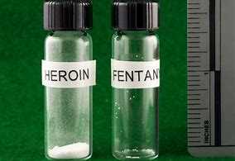
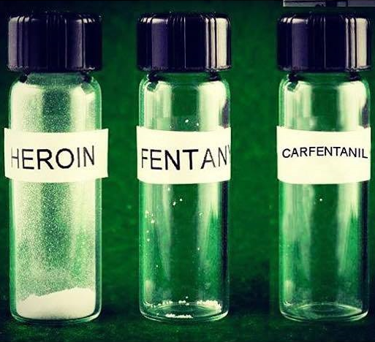
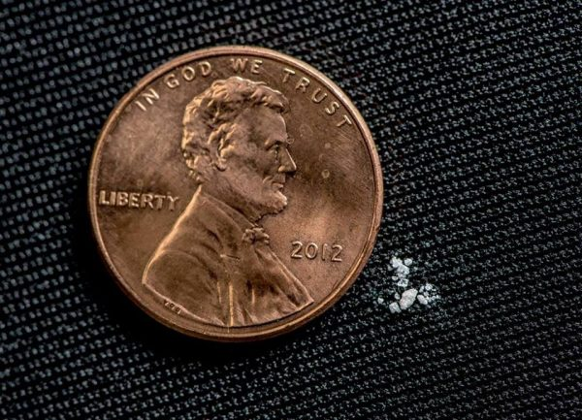
Pure Lethal Perspective

Slide 27
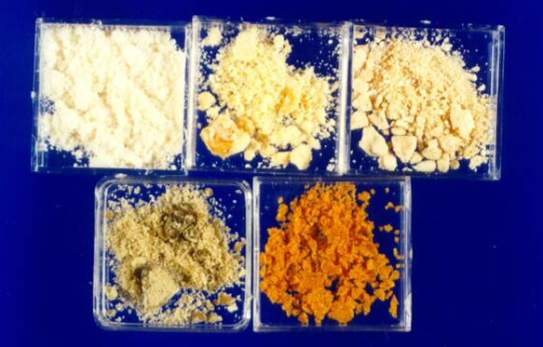
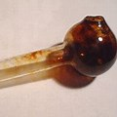
methamphetamine
-Made from
Chemicals
-Powder, Paste
Crystals
-Range of colors
-Most often
Smoked
-same s/s as cocaine + meth mouth, tremors

Slide 28
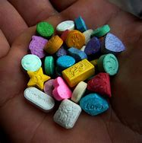
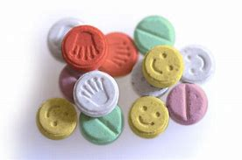
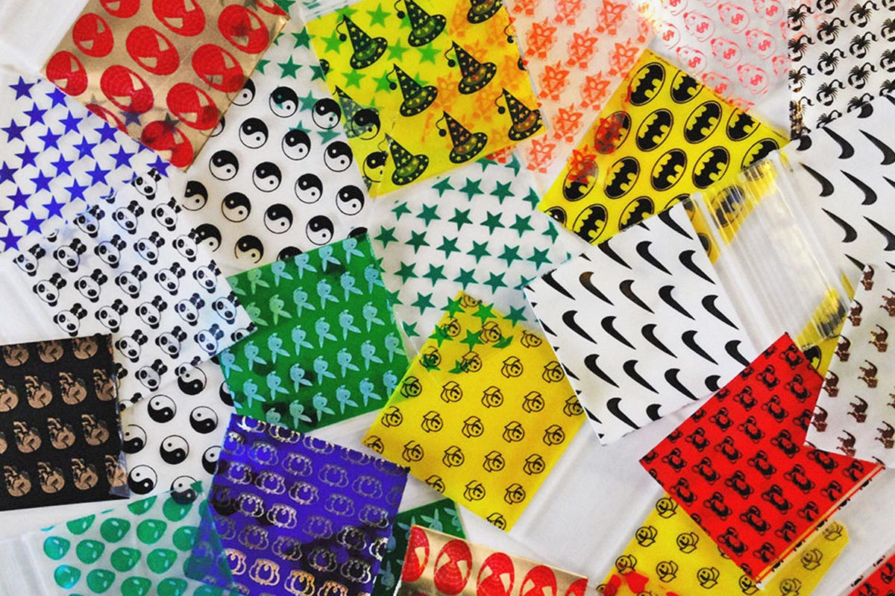
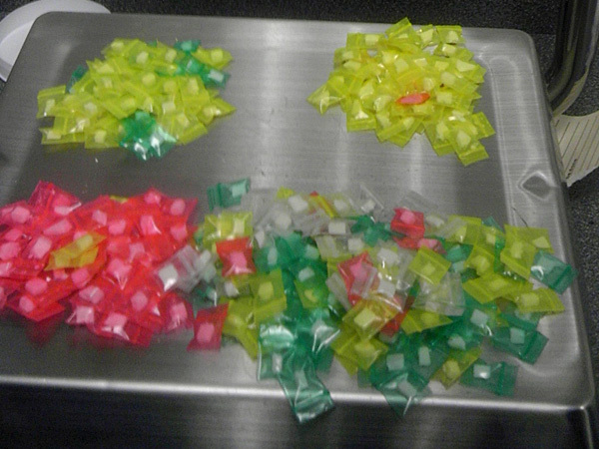
Type of amphetamine Ecstasy
Usually made
Into “colorful”
Pills
------
Packed in
“Happy”
baggies

Slide 29
Ecstasy s/s
-Stimulant
-Heightens senses past point of enjoyment to agitation
-Artificially causes oxytocin surge in brain
-Withdrawal:
-intense depression, anxiety, isolation
-inability to experience happiness/ enjoyment
-intense cravings

Slide 30
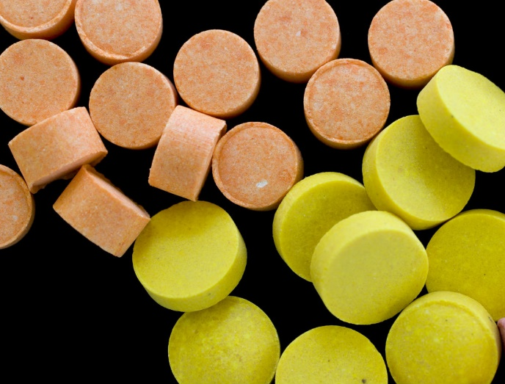
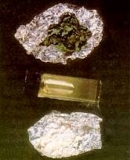
PCP
Most often in pill form
But
has forms mimicking
other drugs

Slide 31
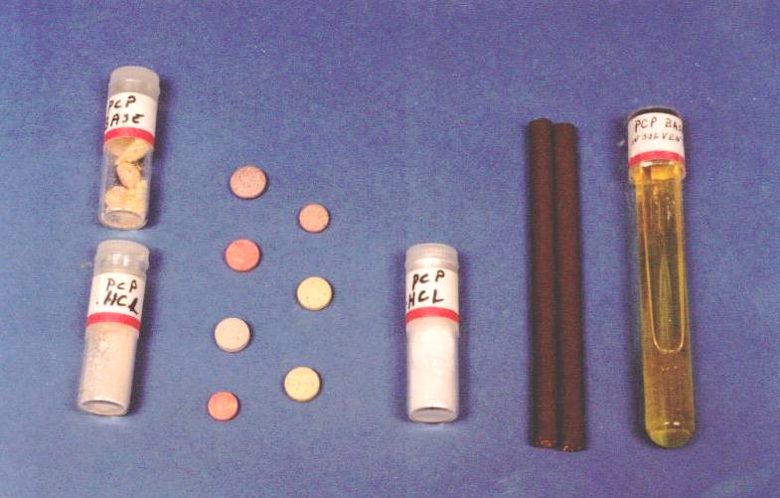
PCP forms
Good Trip or Bad trip
Profuse sweating, nystagmus, often “noise” vs speech

Slide 32
If you are interested in your supervisors attending this class
Please contact me for the next scheduled class.
Sherry Harvan
Mercy Occupational Health
440-233-1081 or SAHarvan@mercy.com

Slide 33
Reasonable suspicion procedure
Talking Points
Observe: anyone can observe, supervisor initiates test
Document: protects you and your company
Confirm: with another manager (not person’s co-worker)
Confront: in private, with witness, document responses
agreement or refusal to test
Transport: employee with the 2 witnesses
Test: Do not leave employee until collector calls their name
Do’s/Don’ts

Slide 34
references
Altarum. (2017). Community assessment of the opioid crisis in Lorain county, Ohio: Executive summary.
Retrieved from: https://altarum.org/sites/default/files/uploaded-publication-files/Lorain-County-Community-Assessment_Executive-Summary.pdf
Centers for Disease Control and Prevention, Division of Population Health. (2017). Drug overdose
mortality by state: 2017. Retrieved from: https://www.cdc.gov/nchs/pressroom/sosmap/drug_poisoning_mortality/drug_poisioning.htm
EHS Today. (2019). Drug abuse costs employers $81 billion per year. EHS Today, Health. Retrieved from:
https://www.ehstoday.com/health/drug-abuse-costs-employers-81-billion-year
Houser, S. (2018). CBD oil, sold in stores throughout Ohio, is illegal and can carry a felony charge, WOIO Channel 19
Retrieved from https:www.cleveland19.com/2018/10/10cbd-oil-sold-stores
OHS Health & Safety Services Inc. (2019). What every employer should know. Retrieved from:
https://www.ohsinc.com/info/what-every-employer-should-know/
State of Ohio Board of Pharmacy. (2019). Ohio medical marijuana control program CBD oil faq. Retrieved from https://medicalmarijuana.ohio.gov/Documents/formsmethods/FINAL%20FORMS%20AND%20METHODS%20RULES/CBD%20Oil%20FAQ.pdf
Steer, J. (2019, February 5). Mother arrested after student brings marijuana candy to Cleveland school.
Fox 8 News. Retrieved from: https://fox8.com/2019/02/05/mother-arrested-after-students-bring-marijuana-candy-to-cleveland-school/
U.S. Department of Transportation, Federal Motor Carrier Safety Administration (FMCSA). (2018). Drug
and alcohol testing program. Retrieved from: https://www.fmcsa.dot.gov/regulations/drug-alcohol-testing-program

