Slide 1
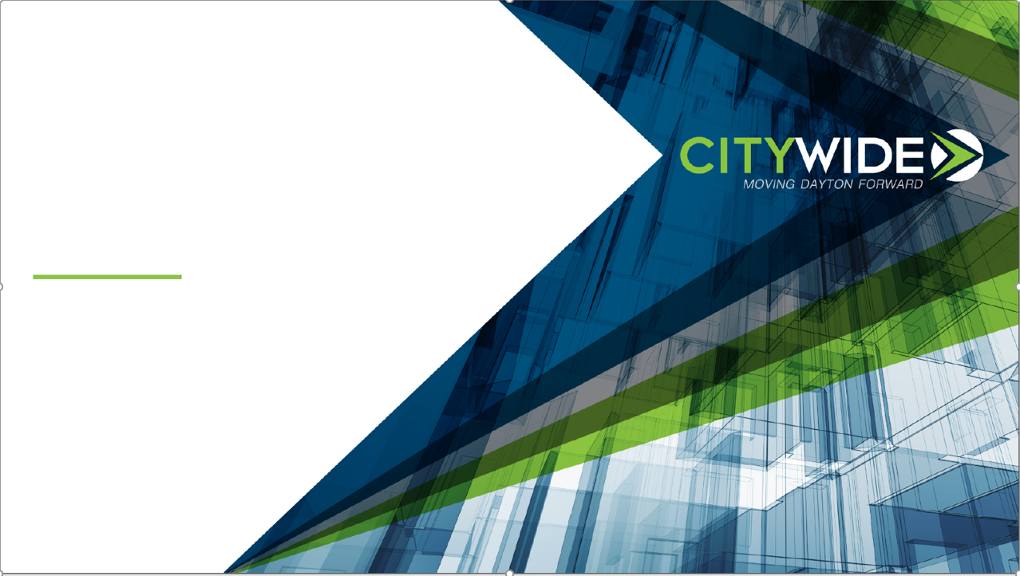
Dayton, Ohio:
SETTING THE STAGE FOR OUR FUTURE
Brian Heitkamp, President
CityWide
Lorain Chamber of Commerce
May 10, 2019

Slide 2
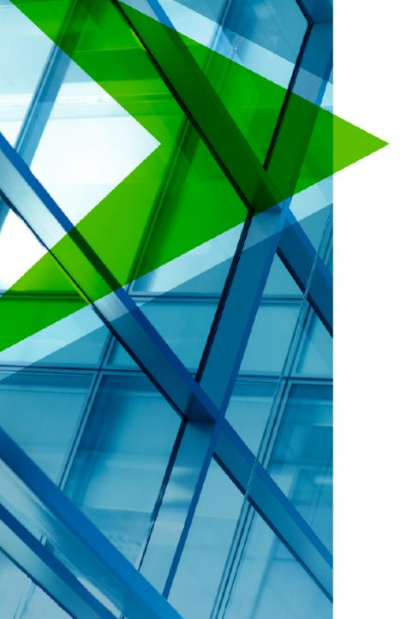

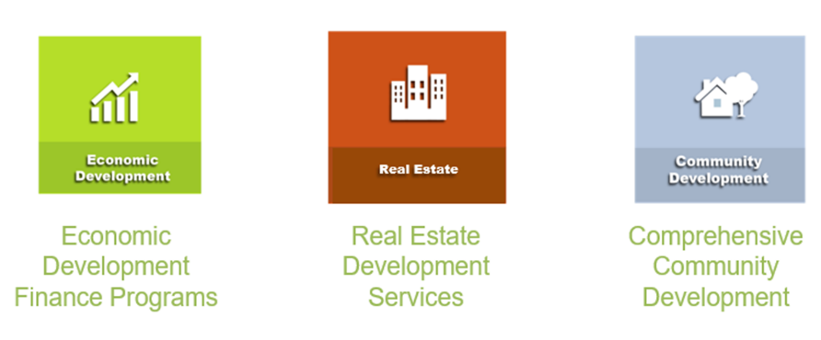

Slide 3
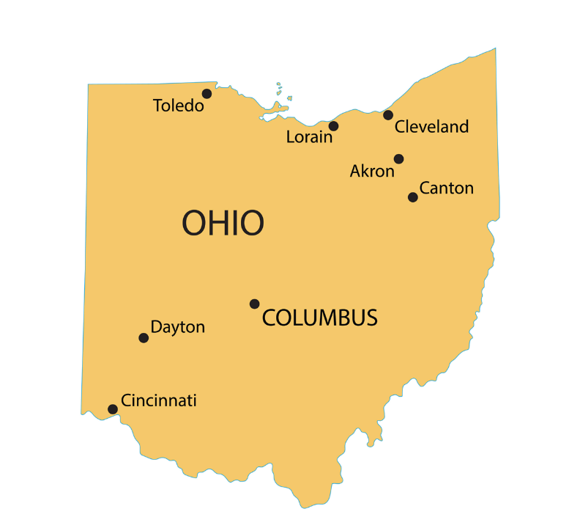

Dayton, Ohio
Cincinnati 55mi.
Columbus 71mi.

Slide 4
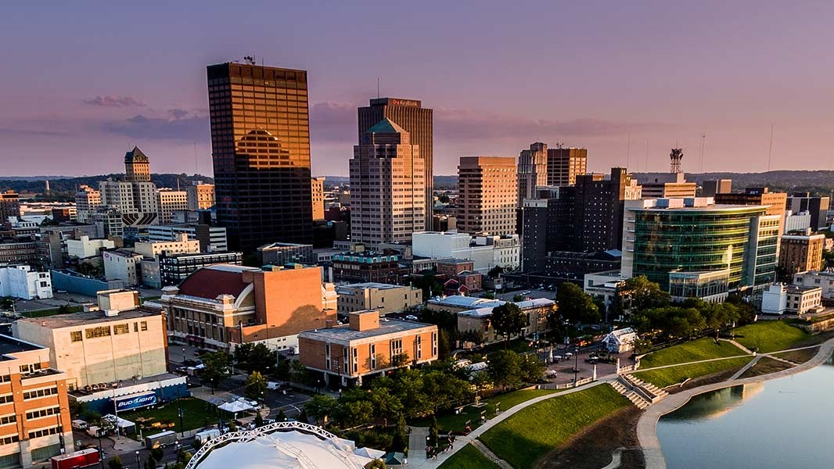
DAYTONOHIO

Slide 5
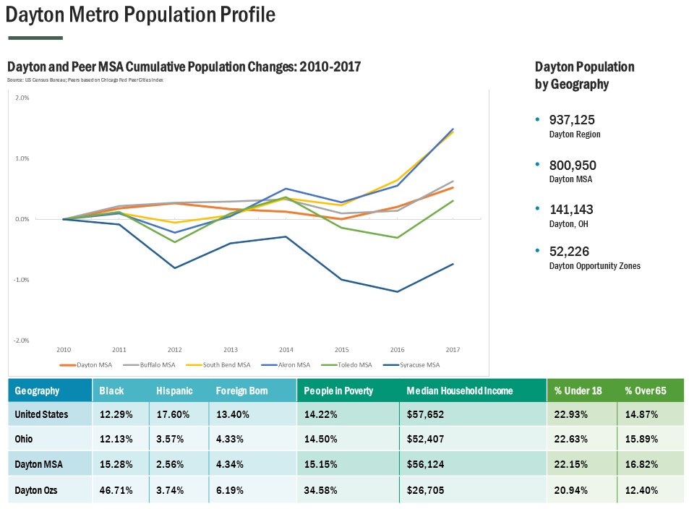

Slide 6
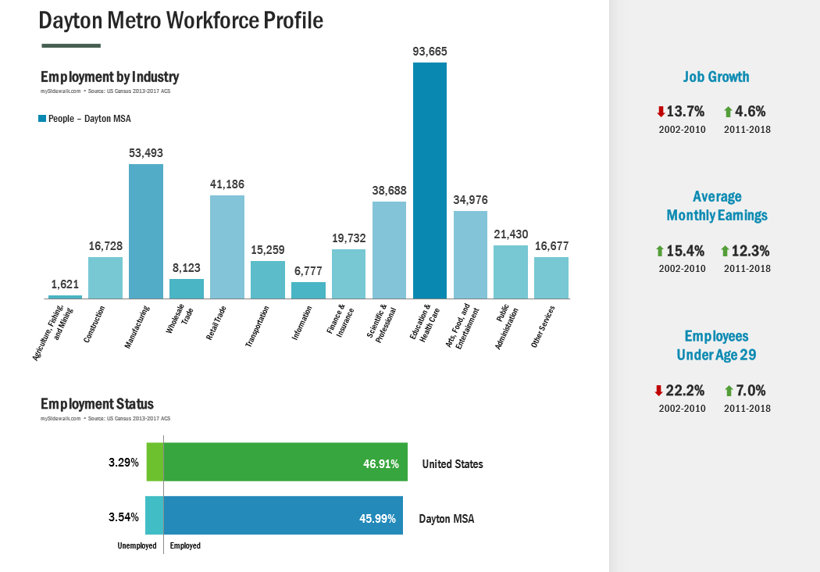

Slide 7
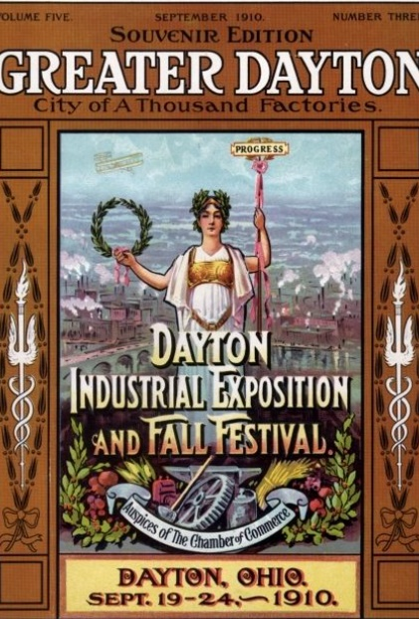
A look back on Dayton…
1900-1960
“The Golden Age of Manufacturing”
  Dayton was a powerhouse and part of a national network of invention and innovation (GM, DELCO, NCR)
Results of WWII
  Doubled the U.S. Gross National Product and was 50% of the world’s manufacturing capacity

Slide 8
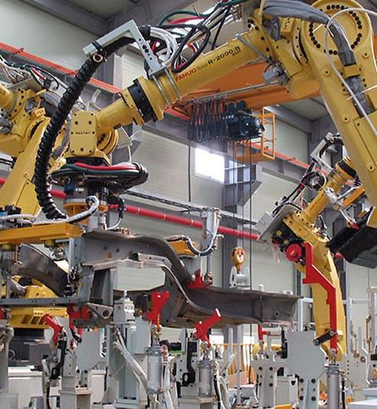
A look back on Dayton…
1970 to the 2000’s
“A New World Economy”
  An international revolution in manufacturing began:
    Fueled by global competition;
    Emergence of highly efficient, advanced manufacturing.
  Federal support to urban areas peaked and then began contracting.

Slide 9
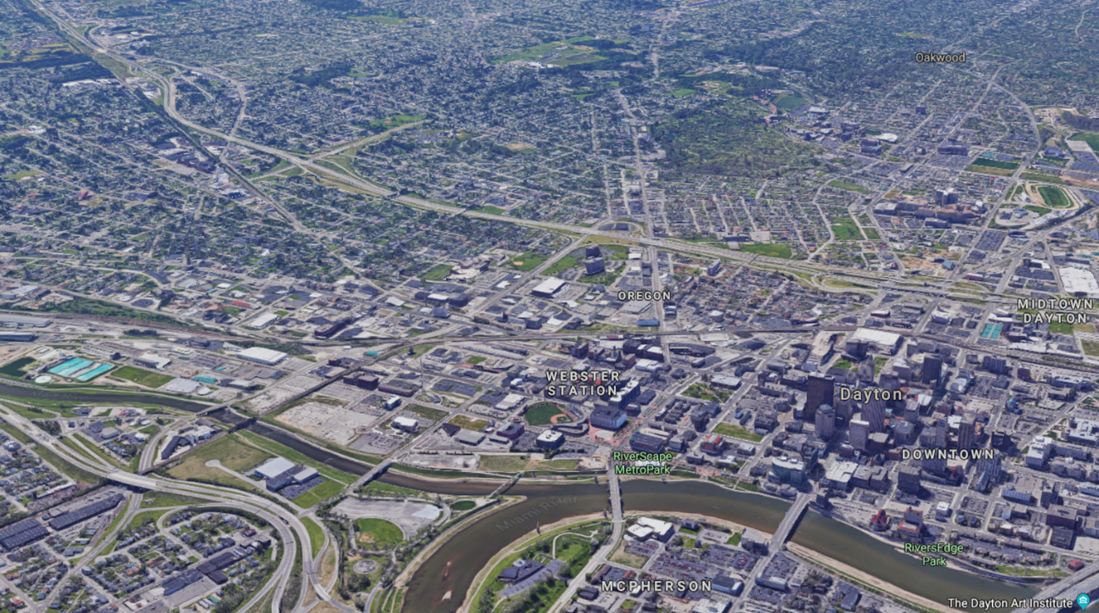
Backdrop of the Dayton Story
1980 to the 2000’s
“A New Era of Sprawl”
Facilitated by additional & supplementary freeways, beltways and interchanges
Made strong growth markets stronger, slow growth markets weaker;
Much of the real estate boom of the early 2000’s was largely driven by availability of credit and not necessarily real market demand

Slide 10
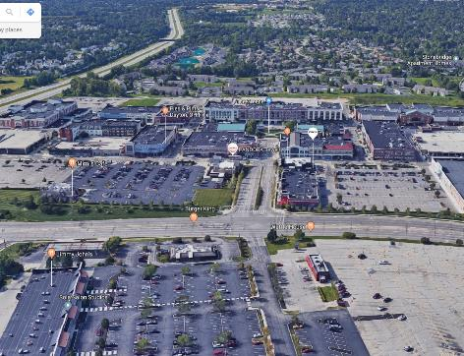
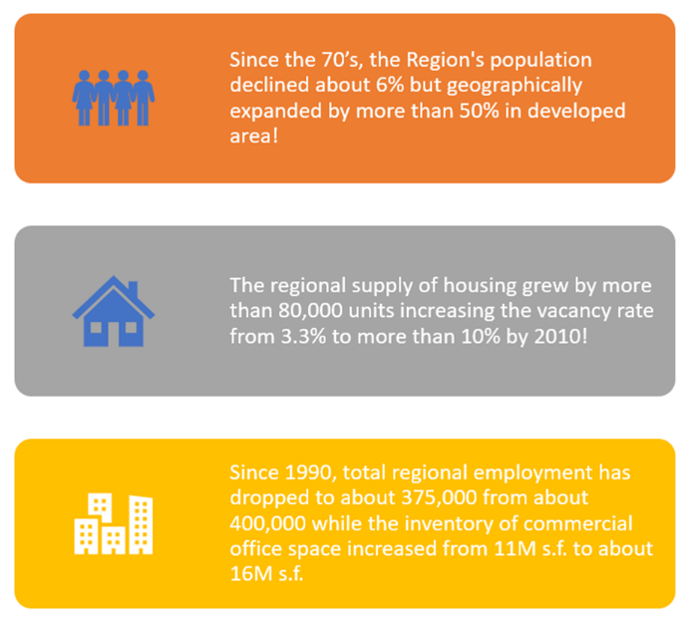
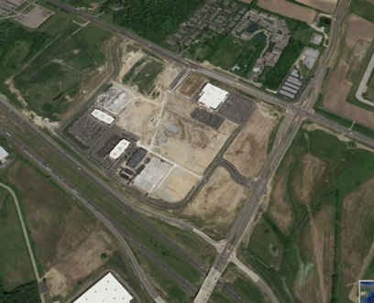
Situation Sprawl: Dayton

Slide 11
“How can Dayton compete to retain and attract residents, jobs and investment with fewer citizens, high vacancy rates in housing and commercial spaces and a contracting tax base?”

Slide 12

Because our PAST is not as important as our FUTURE. Look ahead and move on…

Slide 13
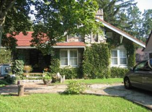
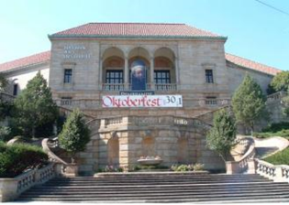
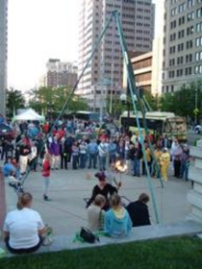
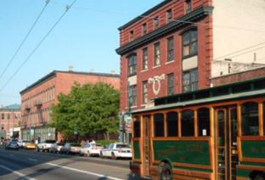
The Adoption of Asset-based Development
Align Market, Vision, and Community Stakeholder’s Strategies
Leverage investments
Build on public assets
Facilitates Wealth Building & Strengthens Tax Base
Strengthening the “community capital & confidence quotient”

Slide 14
Dayton has been reinventing itself from the urban center outward since the late 1990’s…
City leaders and partners crafted a strategy focused on attracting economic activity by leveraging existing market strengths centered around:
Education Institutions
Healthcare Providers
Advanced Manufacturing Companies
Aerospace/WPAFB
By building public-private partnerships between the City and anchor institutions, resources were directed in targeted areas and industries.
Notes:
Mention the Genesis as the first large-scale project that will be

Slide 15
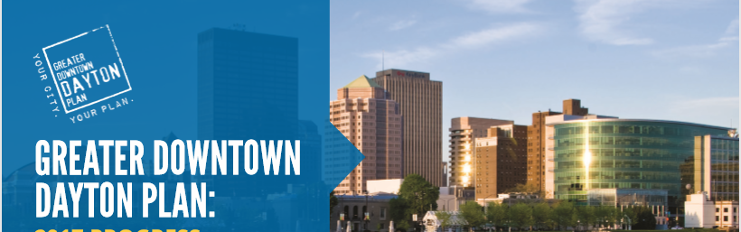
Expanding the Urban Core
With asset-based development proving successful, there was a deliberate effort to “reset” what was long-considered the Urban Core of Dayton
The Greater Downtown Plan developed in 2010 with significant business leadership created a new “downtown geography” that was purposefully connected anchor intuitions and areas of economic success.
Notes:
Business leadership was key in “bringing the public and businesses along with this strategy

Slide 16
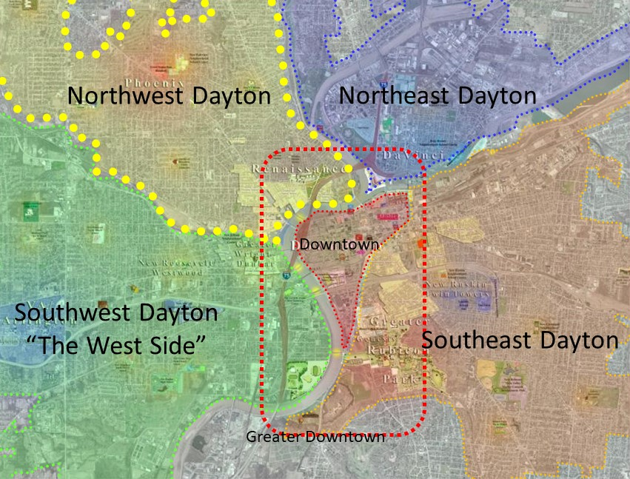
Greater Downtown Geography

Slide 17
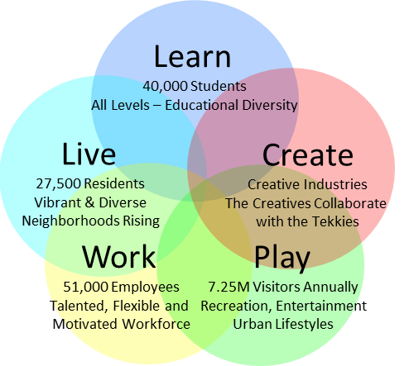
The Downtown Dayton Renaissance
TODAY
Core Urban Economic Development Strategy

Slide 18

Expand & Increase Density of Economic Activity
What Do We Mean by Economic Activity?
Employment/Jobs
Commerce – Exchanges of Goods & Services
Business Revenues
Capital Investment:
  Facilities, Buildings, Sites, Tenant Spaces
  Equipment, Furniture, Fixtures
  Public Corridors, Spaces & Places, Infrastructure
Operational Investment:
  Investing in People, Workforce Development, Leveraging Social Capital
Growing Tax Base to Support Services throughout the City

Slide 19
Core Urban Economic Development Main Components
Reactivate the Core
Leverage Strategic Adjacency & Connectivity
Keep the Momentum Going - Expand Economic Activity
Leverage Community Confidence & Value
Develop Planning and Opportunity Visioning
Integrate and Connect the Surrounding City with the Place & Asset-Based Economic Strategy

Slide 20
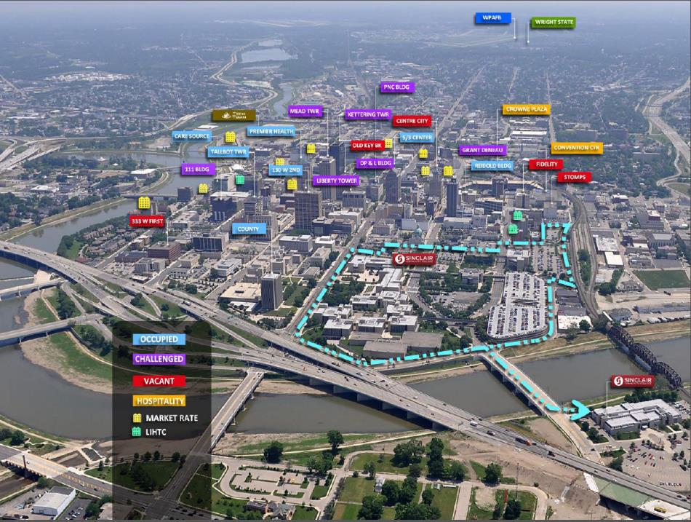
Advancing Dayton’s
Core Urban ED Strategy
3 million s.f.
Reactivation Challenge
Central Economic Opportunity at its Center

Slide 21
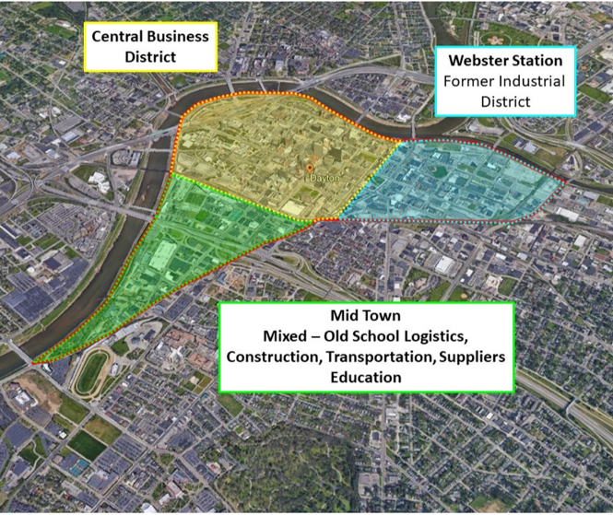
The Downtown Story –
After the Great Recession (2008)
Webster Station District of Downtown demonstrates market momentum and vibrancy – Something to build on!
West downtown anchored by Government and Education
Center City (Main Street) has about half of its 6M square feet of commercial space in varying stages of vacancy and abandonment
The question became… do we demolish or save?
  $25M to demolish with another $45 to $60M in tax credit equity potentially lost to landfills

Slide 22
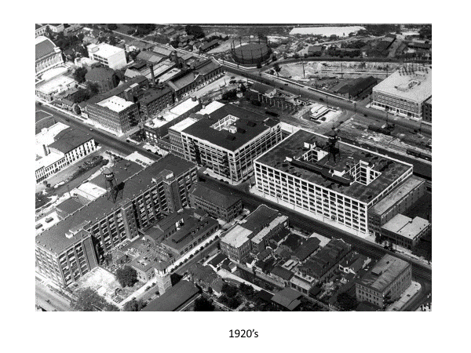
The Transformation of Webster Station
The area that today is know as Webster Station, was once home to the emerging industrial backbone of Dayton. From the time that the Canal and Railroads roared through Dayton, this nexus of industrial might was home to such names as DELCO, Frigidaire, Barney Car Works and the Stoddard Dayton Automobile Company.

Slide 23
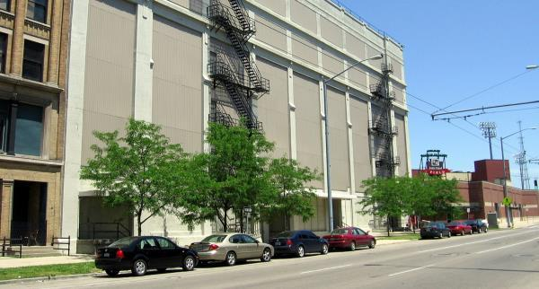
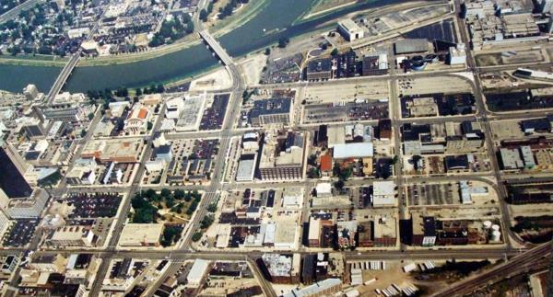
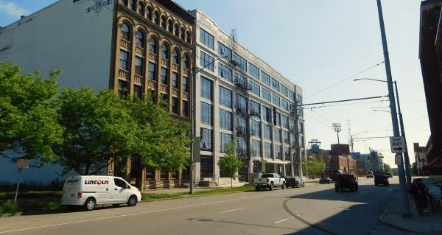
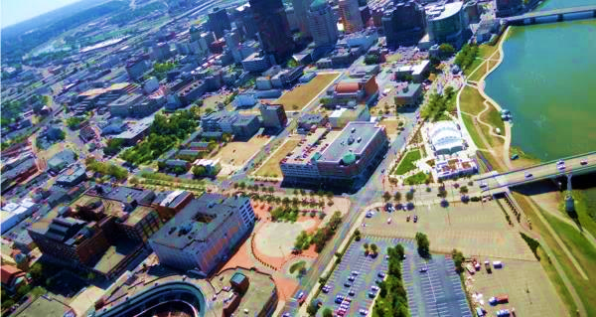

Slide 24
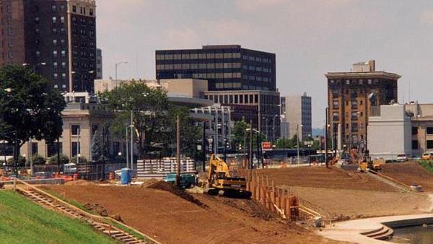
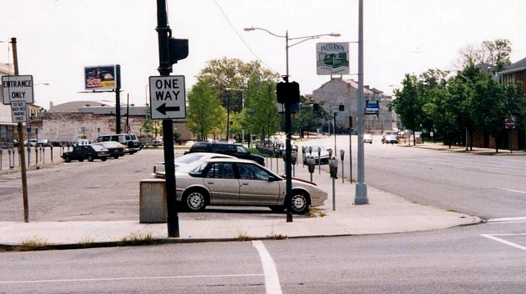
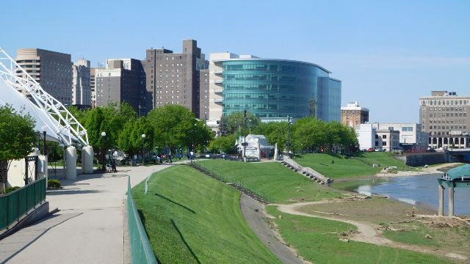
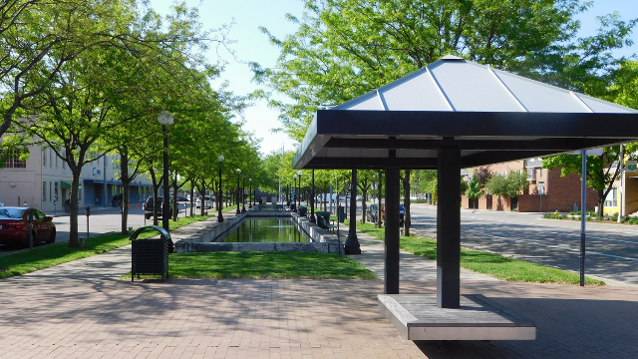

Slide 25
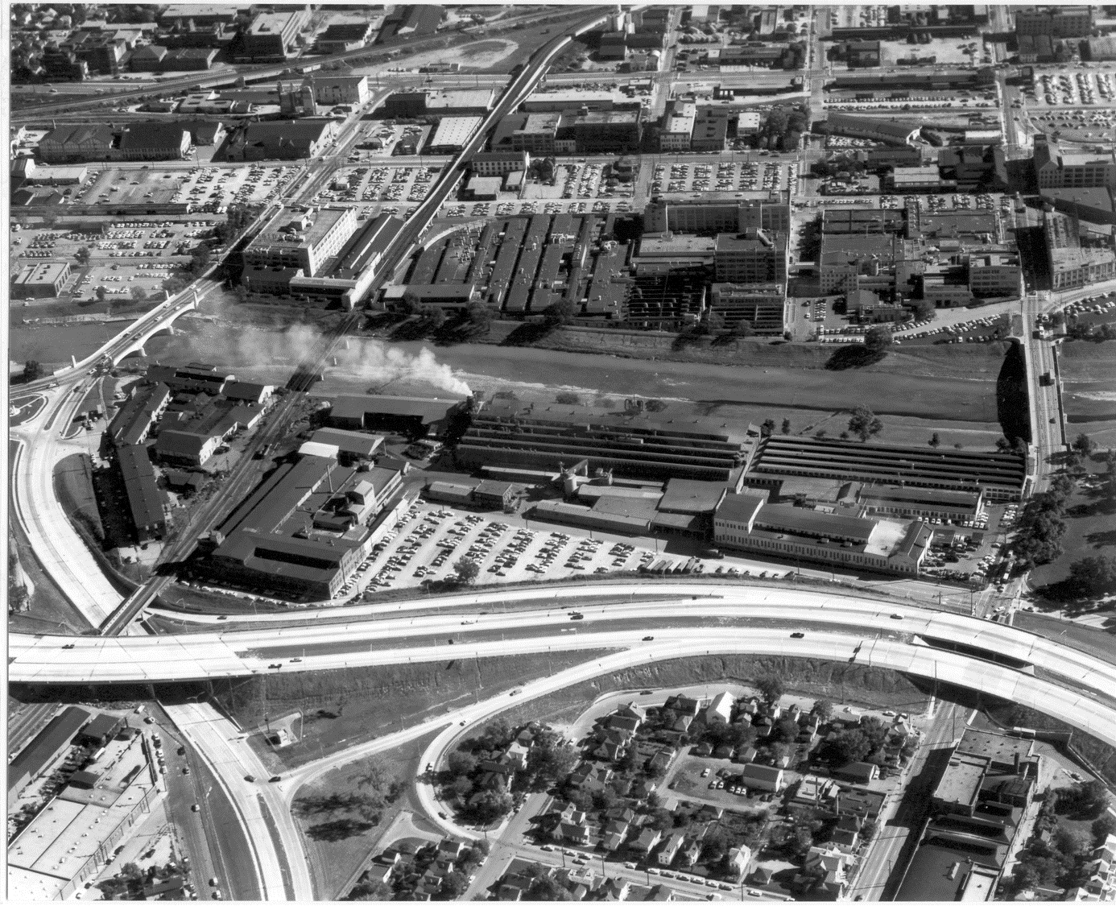
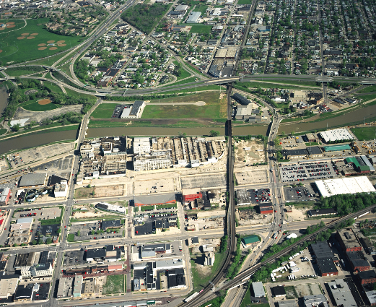
Tech Town Site Before…

Slide 26
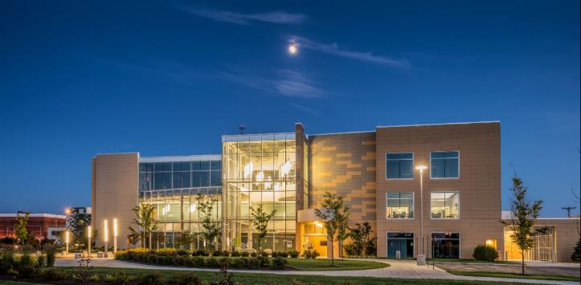
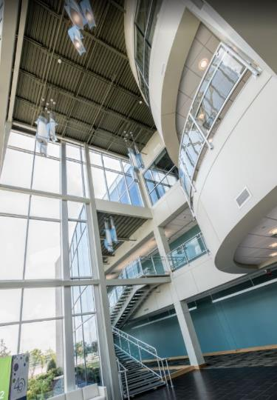
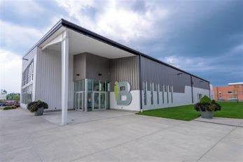
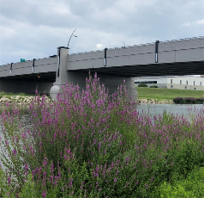
Tech Town Today…

Slide 27
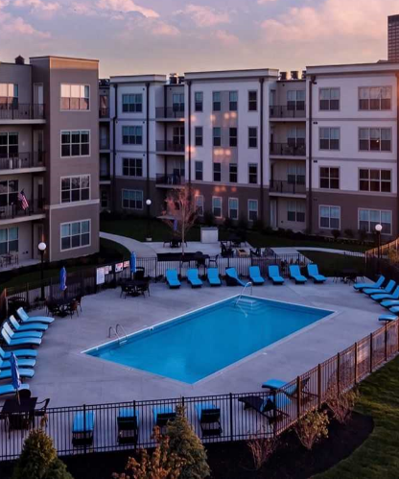
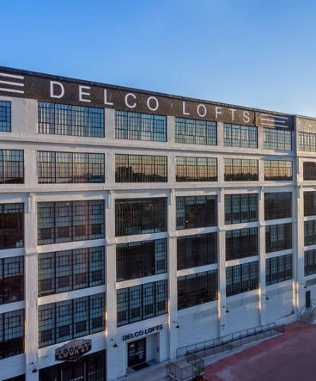
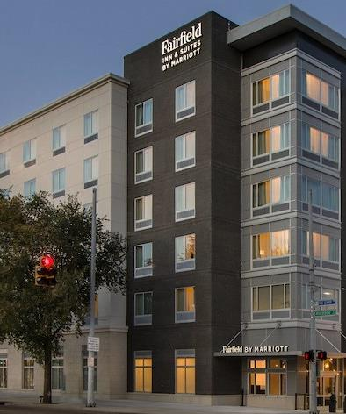
Webster Station Momentum Continues Today

Slide 28
The Downtown Intervention –
City Manager directs CityWide Development to take the lead in the CBD to:
Find expert adaptive reuse developers to tackle more than 2M square feet of historic commercial buildings
Accelerate and fuel the emergence of robust downtown/urban housing market
Work with other downtown partners to support the emergence of downtown urban lifestyle uses: Breweries, restaurants, urban entertainment and leisure operations

Slide 29
Downtown Intervention Continues
‘The Nine’ Strategy’
–Reposition Dave Hall Plaza to a Levitt Pavilion to activate the center of the nine blocks
–Dayton Metro Library expands and transforms downtown library
–The long dormant historic Arcade:
•Vacant for 29 years, deteriorated, 400,000+ square feet, iconic Dayton landmark
•Gets new leave as a mixed-use innovation hub
•Another 400,000 square feet of historic buildings purchased for mixed-use reactivation – Fire Blocks

Slide 30
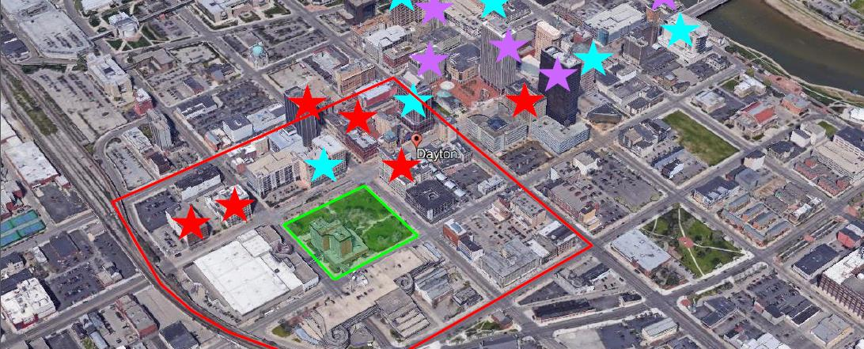
The Nine Geography

Slide 31
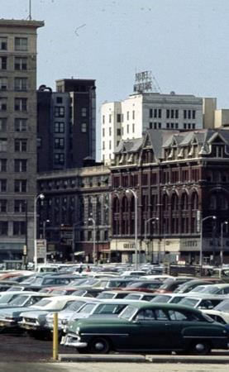
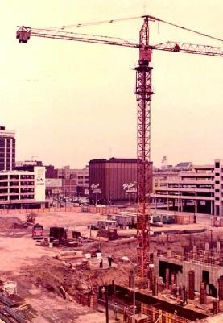
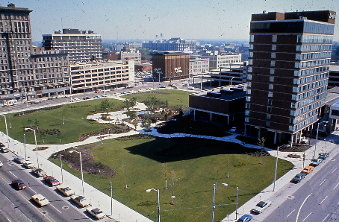
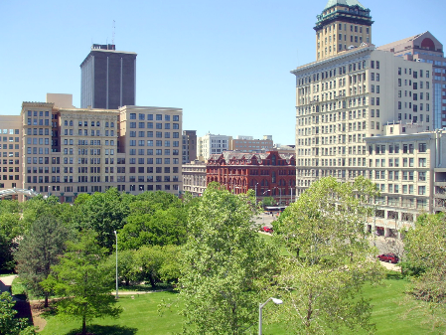
The Transformation of Levitt Pavilion – Music to our Ears

Slide 32
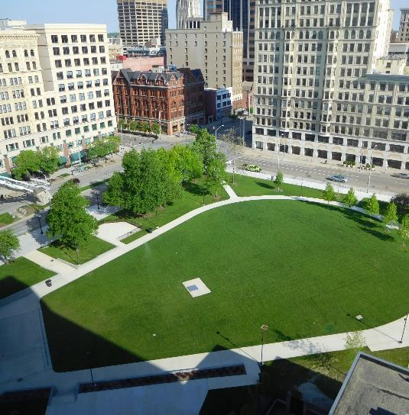
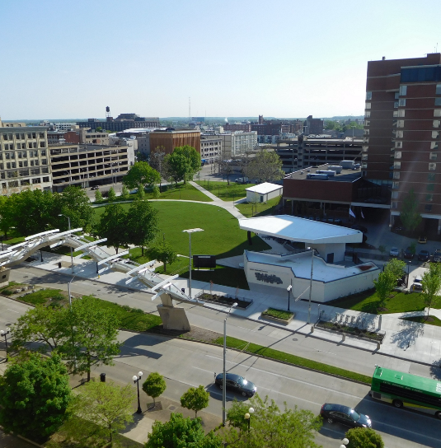

Slide 33
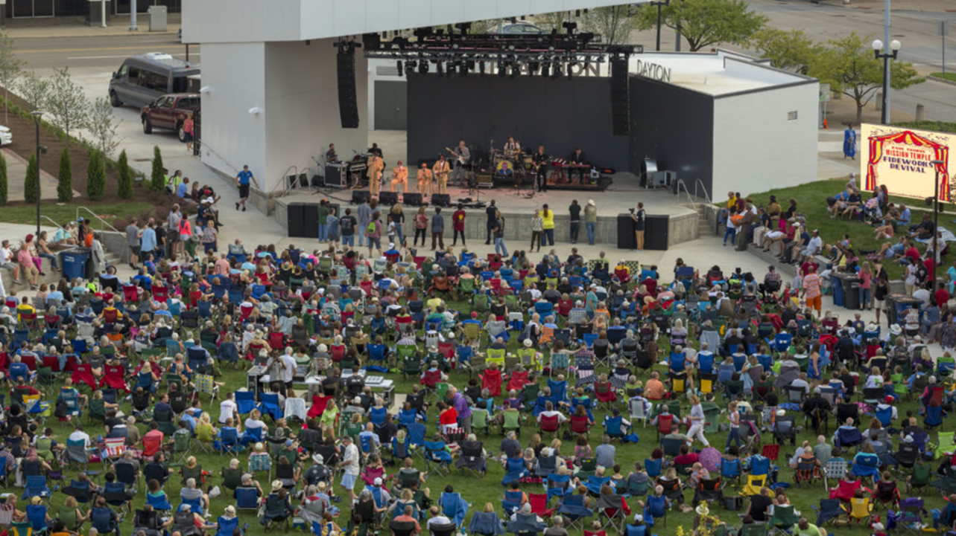

Slide 34
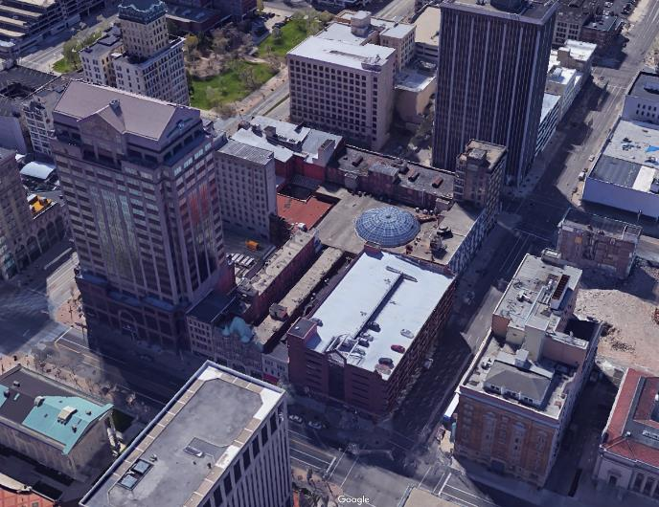
Saving the Arcade
$95M Phase I (7 buildings) Underway
Iconic Rotunda will house community event space and offer daily programing
90,000 sf Innovation Hub with lead anchor tenants University of Dayton and Entrepreneurs Center

Slide 35
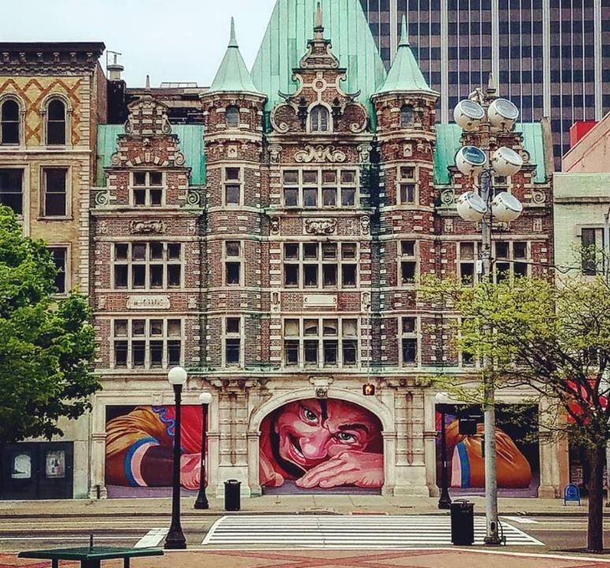



Slide 36


Slide 37



Connectivity is KEY!
A Focus on how connecting and circulating through our greater downtown.
Connecting Corridor Redevelopment
Create a sense of Place
Signage and Wayfinding
Riverfront Master Plan
RTA Flyer Circulator
330 mi. Connected Trail System

Slide 38

Development Financing

Slide 39


Slide 40


Slide 41


Slide 42

Dayton Opportunity
Zones

Slide 43


How does it work in neighborhoods?

Slide 44
Principals of Asset Based
Community Development
Assets
Identifies strengths of neighborhoods.
What is working well?
Who cares?
Relationships
Engages residents & key stakeholders to gain a “real time” understanding of community challenges and opportunities.
Creates the space for transparent conversation.
Clarifies roles, limitations and opportunities.
Partnerships
A good partnership is not casual.
Partnership are built around areas of mutual self interest.
Leads to a consensus vision: what is agreed upon; often where a project will start.
Leveraged investment
What funding is being in spent in the target area?
How can we leverage those investments to make something bigger happen?

Slide 45
Civic
CityWide’s Community
Development Approach
Social
Economic
Comprehensive
Community Development
Physical
Notes:
CityWide’s approach to community development considers all facets of a healthy community. The intersection of these areas is where real change happens.

Slide 46

A Case Study in Asset-based
Community Development
2001

Slide 47


Slide 48




Concerned Entities
Fairgrounds Neighborhood
Rubicon Park Business Association
Miami Valley Hospital
University of Dayton
City of Dayton

Slide 49

Shared Interests
  Attractive, affordable, sustainable residential neighborhood
  Revitalization of commercial business district driven by market demand and private investment
  Stronger, safer, healthier image of the district and surrounding areas

Slide 50
Genesis:
What we set out to do…
Implement the #1 component of the Rubicon Park Master Plan (1998) -Revitalize the Fairgrounds neighborhood
Create a safe, affordable residential and commercial area that reflects positively on both University of Dayton and Miami Valley Hospital

Slide 51
Partner Roles and Responsibilities
Genesis Board
Neighborhood Life Team
Land Use
Committee
CityWide

Slide 52
Financial Commitments
SOURCES
Miami Valley Hospital $3,850,000
University of Dayton 2,230,000
City of Dayton 3,300,000
CityWide Development 350,000
Local Banks 4,380,000
Total $14,110,000
USES
Acquisition $7,090,000
Construction 5,170,000
Infrastructure 700,000
Program Adm. 1,150,000
Total $14,110,000

Slide 53
Accomplishments
  Removed blight
  Build 45 new and renovated affordable housing units
  Employer Assisted housing or MVH employees
  Community Policing resulted in huge decrease in crime
  Neighborhood Association formed
  New Streets/Gateways/Infrastructure
  Business Development (Local Independents and Major Chains)
  Private Sector development
  Catalytic Investment: over $350M

Slide 54


BEFORE…

Slide 55





AFTER

Slide 56



Momentum Continues –
Catalytic Investment
Brown/Warren Commercial Development
Charlie Simms Condos
Goodwill Easter Seals
Former NCR Land – GE EpisCenter and Emerson
Flats at South Park
Fairgrounds Redevelopment - OnMain

Slide 57

Notes:
GE Epis Center, Emerson, Former NCR campus, CoCo’s, Warren Flats, Goodwill Easter Seals, Brown Street Rebuild, Private business investment, Main Street.

Slide 58

The DaVinci Collaborative
2012

Slide 59


Slide 60
DAVINCI
Asset-Based Community Development
Partner Collaboration
  CityWide, City of Dayton, Dayton Children’s Hospital, Salvation Army, UD Fitz Center, GONDBA, St. Mary’s Development Corp., Vectren, and Five Rivers MetroParks
Adjacent Geography to Downtown incorporates two neighborhoods
Strong business base with over 10,000 jobs (2nd to Downtown in job concentration)
No large funder on the onset of the project – more organic development

Slide 61
Project Highlights
Transportation Strategy
Wayfinding & Placemaking
DIY Home Repair and Paint Program
Children’s Garden
Ongoing Resident Engagement

Slide 62
Placemaking – Corridor Improvement
Significant number of busy corridors that traversed the neighborhood and most were in need of repair.
Complaint of residents, businesses, and institutions that there was “no pretty way to get into our neighborhood/business”
Perception is often built on what people see while driving the corridors
Placemaking and Streetscapes affect Economic Development.
3 Main Focus areas:
Gateways
Greening
Streetscape

Slide 63

DAVINCI – Transportation Strategy
Developed this Commission-adopted Strategy to leverage ongoing & upcoming infrastructure projects in the development area
Became more competitive on future transportation funding
Through this process able to affect or attract funding for 6 projects in less than 4 years

Slide 64




Valley Street Improvements –
Greening and Placemaking
Whitewater Warehouse Boat House
Greening at the Point
Rt. 4 Improvements
STANLEY VALLEY GATEWAY
Notes:
Add Bernie’s new storage building

Slide 65

Wayfinding
Businesses and stakeholders identified navigation as a major neighborhood issue from day one.
Goal: improve navigation and neighborhood identity through community wayfinding signage
Engaged community and stakeholders in design process
Fabrication & installation in 2018

Slide 66


Wayfinding

Slide 67

Home Repair & DIY Paint Program
CDBG Funded project ($300K)
Way to make an immediate physical improvement to homes in the neighborhood
Provided FREE paint to homeowners
Had a Repair Component for homeowners that needed exterior repairs

Slide 68
Children’s Garden
Goal: provide an interactive outdoor play space for patients’ families and neighborhood residents
CityWide led fundraising efforts and managed construction
100% Privately Funded $1M Project (Foundations & Individuals)
Completed in June 2016
Benefits:
  Improved image of Valley Street corridor
  Adds neighborhood amenity
  Provides respite for hospital patients and families (1,200 kids in project neighborhood)

Slide 69


Slide 70









Slide 71
Investment Tracking: 2009-2020
 | Investment | Year
Salvation Army Kroc Center | 37,000,000 | 2009
Demolition | 3,000,000 | 2009-2016
I-75 Rebuild | 101,900,000 | 2007-2011
Infrastructure | 10,347,200 | 2009-2016
Business/Institution | 112,729,694 | 2009-2016
Residential Improvements | 15,000,000 | 2005-2016
Dayton Children’s – Patient Tower | 150,000,000 | 2017
Planned Infrastructure | 40,552,800 | 2017-2020
TOTAL | $460,529,694

Slide 72
What about areas without a major anchor?
Start Small
Figure out the “first step”
Do something to build trust and confidence

Slide 73

Pineview Neighborhood
Lessons from The Lake

Slide 74




What Lake?
What the neighborhood organizing revealed:
  Neighborhood History and Culture of the area
  (former site of Lakeside
  Amusement Park)
  Pride
  It mattered.
Notes:
Pictures
Why it mattered
What we learned through community organizing
History, pride
Potential

Slide 75

Telling the Story – Share the Vision
Pineview residents
Dayton VA
Garden Club of Dayton
City staff and leadership
Area businesses
Anyone who would listen!

Slide 76



“When you don’t know where to begin, start with what is in front of you.”
- Mother Teresa
Notes:
May 2017 – Groundskeepers, CityWide opportunity fund

Slide 77




Unconventional Organizing
Social media driven clean-ups/meet ups
Attended by Diverse groups
Done in a day –4 hrs. max
Keep talking about it

Slide 78



Diverse Partners
Garden Club of Dayton
Pineview neighbors
Dayton Inspires
UpDayton
Dayton Regional Labor Council
Ohio AFL-CIO
Union Sportsman Alliance
Job Corp Students
University of Dayton River Stewards

Slide 79




Slide 80
What can your Community do Now?
Involve Institutions, Higher Ed and Businesses in your plan for the future
Engage New/Out of the Box Partnerships
Leverage Infrastructure Projects & Funding to do more
Treat Placemaking as Economic Development
Delineate Geographies for Development
Focus on connectivity of corridors (water, roads, trails)
Incorporate and Plan for your waterways
Vision (Responsibly) – Create Renderings of “what could be”
Embrace Legacy. Decisions we make regarding development will be around for a long time – DO IT RIGHT.

Slide 81


