Slide 1
How Mental Health Affects Workplace Safety:
Why Understanding Mental Health Helps Everyone
Sarah Papesh, LPCC-S, CTP

Slide 2
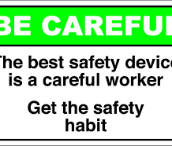
Importance of Workplace Safety
Safety first, safety last, safety always!
Reducing threat of risk or harm to employees, employers, consumers, and public
Reducing cost to employers, employees, consumers, and public

Slide 3
Myths About Mental Health and Workplace Safety
Mental health only affects the individual
Mental health is not a workplace issue
Only significant mental illness impacts the workplace
Workplace violence is a direct result of individuals with an underlying mental illness

Slide 4
Reducing the Stigma
Mental health is everyone’s responsibility
Mental health is often misunderstood and overlooked
Mental health is as important as physical health

Slide 5
Why Focus on Mental Health?
Nearly 1 in 5 US adults aged 18 or older reported experiencing diagnosable mental illness at least once in the last year
More than half of these will go untreated
Stressful occupations impact those experiencing diagnosable mental illness

Slide 6
Other Factors Related to Poor Mental Health
Social/familial issues
Substance use/abuse
Health Conditions
Heart disease
Diabetes
Respiratory illness
Gastrointestinal disorders
Disorders that affect bone, muscles, joints
Decreased immunity
Chronic illness

Slide 7
in the Workplace
Can be just as detrimental as unmanaged mental illness
Can be influenced by unmanaged mental illness
71% of adults reported at least one symptom of stress, such as a headache or feeling overwhelmed or anxious

Slide 8
Why do we need to consider mental health and stress in the workplace?
Can directly impact:
Employee morale
Attendance
Job performance and productivity.
Engagement with one’s work
Communication with coworkers
Physical capability and daily functioning
Can lead to higher rates of disability and unemployment
Can lead to burnout
Unmanaged mental health and stress directly impact workplace safety
Safety is about people – understanding human factors can help with workplace safety

Slide 9
Impact to Individual
Poor sleep/fatigue
Poor eating habits
Weight fluctuations
Illness
Poor coping/”coping threshold”
Low morale
Lack of motivation
No interest
Anxiety
Irritability/short temper
Concentration/focus issues
Working more slowly
Substance use/abuse
Workplace aggression/violence

Slide 10
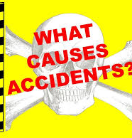
How does this impact workplace safety?
Safety problems due to human error can be a direct result of unmanaged stress or poor mental health
An employee dealing with such disorders may struggle to participate in social aspects at work, concentrate on one task at a time, put their full attention and effort into daily tasks, and often feel like they can’t bring their mental health needs to their employer’s attention.

Slide 11
Examples
Lack of motivation/no interest
Carelessness
Sloppiness
Poor concentration/focus
Poor sleep/fatigue
Can lead to absences
Poor concentration/focus
Slower work speed
Absences
Low/understaffing
Overworked staff
Related accidents
Perpetuate a cycle
Impaired immune system
Increased illness
Spread of illness

Slide 12
Examples
Poor coping
Substance abuse
Medication abuse/misuse
Can impact worker health or reaction time
May not be done during work hours
Can lead to distraction, which can directly result in accidents
Cumulative effects can cause one to reach his/her “coping threshold”
Puts one’s ability to function at risk

Slide 13
MOST EXTREME
Workplace violence/aggression
Workplace violence is a threat everywhere
On the decline
Vast majority of people who are violent do not suffer mental illness
Can further perpetuate the cycle

Slide 14
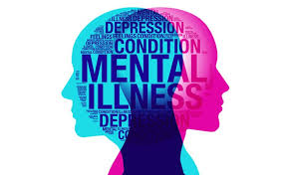
How to tell when someone is struggling with poor mental health/unmanaged stress
Mood changes
Cognitive changes
Physical changes
Behavioral changes

Slide 15
Signs may include . . .
They may be making more mistakes than normal or having trouble with decision-making and concentration.
They may become more irritable and sensitive to criticism.
They may become increasingly absent or alternatively start work excessively, staying late and bypassing lunch breaks.
They may exhibit physical symptoms, such as being constantly tired or suffering from a cold that won’t go away.
They may take less care with their appearance or show signs of drinking alcohol to help them switch off in the evenings.

Slide 16
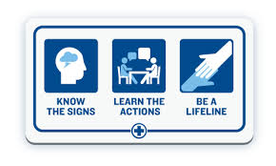
How to Help Others
Reduce the stigma!
Create a supportive environment where mental illness and stress aren’t taboo
Create an environment of inclusivity
Check in on co-workers/employees
Learn your team so you can recognize uncharacteristic behavior
Encourage health and wellness and practicing good self-care
Speak up if something is different/amiss
Turn the work environment into a welcoming environment
Providing leadership through empathy and social support has also shown to reduce occupational injuries

Slide 17
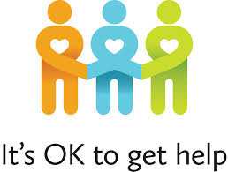
How to Help Yourself
Take time for yourself – use sick time, vacation days, personal days when needed
Practice good, healthy self-care
Know yourself
Speak to HR
Utilize employer sponsored benefits
Seek out social supports
Ask for help
Seek out professional services

Slide 18
References
American Psychiatric Association Foundation: Center for Workplace Mental Health. (2012). Violence in the workplace. Retrieved from http://workplacementalhealth.org/Mental-Health-Topics/Violence-in-the-Workplace
Centers for Disease Control and Prevention. (2018). Mental health in the workplace: Mental health disorders and stress affect working-age Americans. Retrieved from https://www.cdc.gov/workplacehealthpromotion/tools-resources/workplace-health/mental-health/index.html
EW Group. (n.d.). Why is mental health awareness at work so important? Retrieved from https://theewgroup.com/mental-health-awareness-work/
Jacob, I. G. (2006). Depression’s impact on safety. Occupational Health and Safety. Retrieved from https://ohsonline.com/Articles/2006/10/Depressions-Impact-on-Safety.aspx?Page=1
Total Safety. (2016). Stress on the job can impact workplace safety. Retrieved from https://www.totalsafety.com/insights/stress-on-the-job-can-impact-workplace-safety/
Wilhite, L. (2018). Mental health safety in the workplace. Onsite Safety: Creating Safe Solutions. Retrieved from https://www.onsitesafety.com/safety-articles/mental-health-safety-workplace/
Work Safe. (n.d.). Mental health: Safety basics. Retrieved from https://www.worksafe.vic.gov.au/mental-health-safety-basics
Young, K. (2018). Mental health and safety performance. Trinity Safety Group. Retrieved from https://www.trinitysafetygroup.com/employee-mental-health-and-safety

Slide 19
Thank you for your time!
Psych and Psych Services
440-323-5121
www.psychandpsych.com

